Slide 1
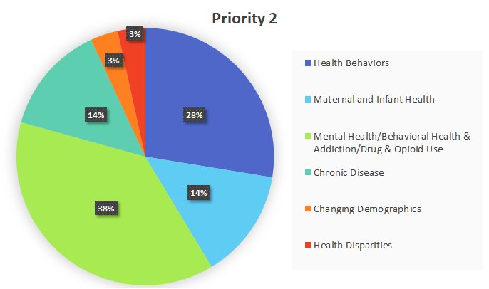
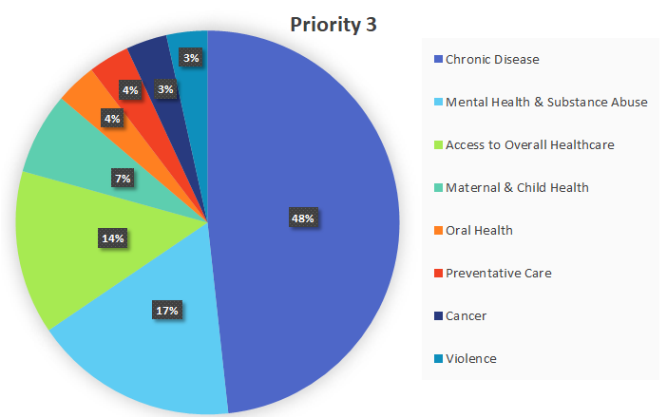
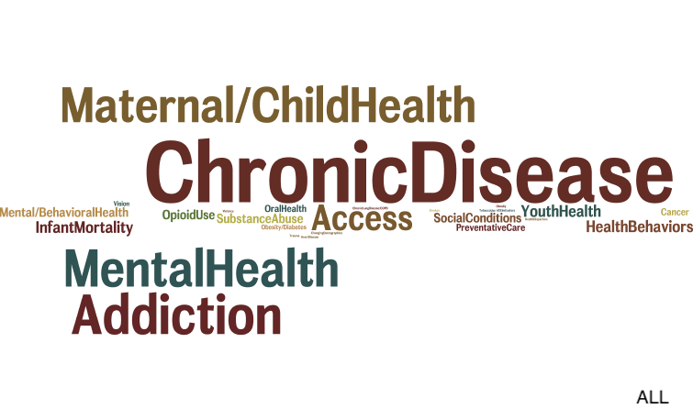
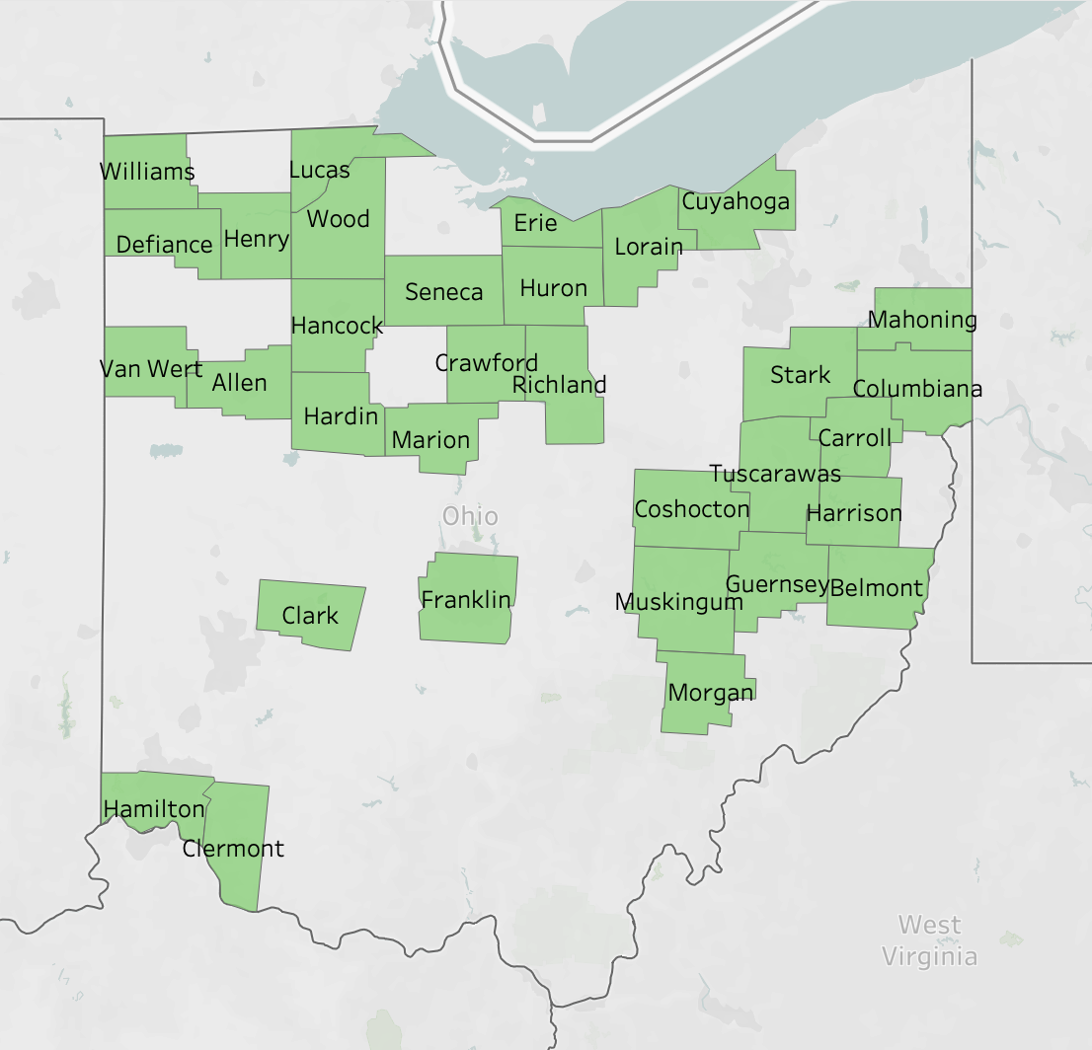
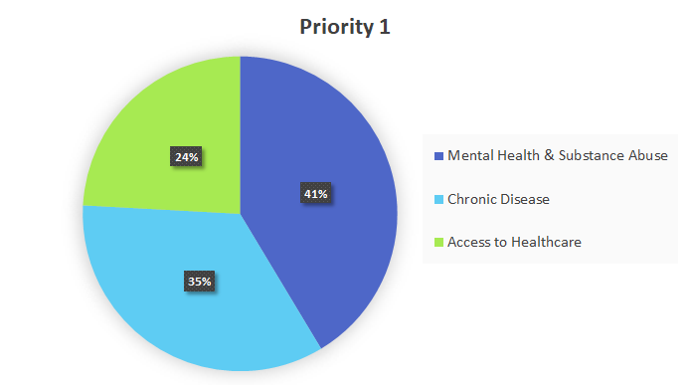
Mapping Health Priorities of Ohio’s Federally Qualified Health Centers
Authors: Katherine Deagan, OMS Vl, Cleveland, OH; Chelsea Rambo, OMS Vl, Athens, OH; Shaina Rood, MPH, OMS Vl, Cleveland, OH;
Elizabeth Santucci, OMS Vl, Cleveland, OH; Sharon Casapulla EdD, MPH, Athens,OH
Background/Methods:
Federally Qualified Health Centers (FQHCs) provide vital services to people who are underserved in Ohio
Federal regulations require FQHCs to complete or update a needs assessment at least once every 3 years, which outlines priorities for each FQHC
Currently, little is known about which areas Ohio FQHCs have chosen to prioritize
Objective: To better understand how FQHCs focus efforts to improve the health of communities in Ohio
Mental Health & Substance Abuse, Chronic Disease, and Access to Health Care, respectively, were the most common top priorities
Conclusions:
Understanding how FQHC’s prioritize is important in understanding how they interact with their communities and what health challenges they continue to face.
Once challenges are understood, coordinated efforts between counties can occur
Ultimately, this research can help FQHC’s with similar priorities share best practices and lessons learned
Contact: katiedeagan@gmail.com
Results
Discussion
Top priorities chosen are long-standing and complex
Priorities reflect connection of medical care with social determinants of health
Mental Health seen as top priority by FQHCs
Top priorities mirror those in Ohio State Health Improvement Plan, except Maternal and Infant Health
FQHC and community partners value shared effort to determine top priorities
Limitations:
Assumptions were made about health priorities when documents were not specific
Challenging to find an appropriate contact at each FQHC
Difficulties in organizing the raw HRSA data as some FQHCs had overlapping or multiple service areas
Future Directions for Research:
Explore ways to facilitate reporting of FQHC Data to the Ohio Department of Health
Creation of a centralized health priority tracking too
Standardize information collection and reporting
Perform additional analysis of health priorities to identify larger trends in health needs
Rural vs Urban, Regional differences
Methods:
Data was compiled from the Health Resources & Services Administration (HRSA) to develop a list of FQHCs in Ohio.
The top 3-5 health priorities were determined for each FQHC by using data collected from Community Health Needs Assessments, Community Health Assessments, Needs assessments, and Community Health Improvement Plans.
Data was coded based on priority similarity; both raw data and coded data were analyzed
Results:
We received responses from 29 different organizations that represent 148 FQHC locations in 31 counties.
Notes:
Poster Template using Individual Text Boxes

