Slide 1
Using Collaboration to Address Food Insecurity
Alisha Barton, FCS Educator
Amanda Bennett, ANR Educator
Miami County
Notes:
Encourage you join, start or participate more fully

Slide 2
Food Councils
A food council is a group of people who come together to assess and recommend practices that affect one or more aspects of the food system in a specific area. Voices for Food
Notes:
Poll Question 1: Are you involved in your local food council?
Amanda
Really the idea is about Inviting a wide diversity of voices and getting everyone to the table
Extension addresses a wide range of human, plant, and animal needs in both urban and rural areas. It provides research-based education, technical information, and community
development expertise in many aspects of the food system.
A food council may operate as part of a local, regional, or state government, as a private group, or as a public– private partnership. Members might be appointed by a government official or executive board, nominated by other members, or informally self-selected. They are often chosen to represent particular stakeholder groups in the food system. Members often include hunger relief and food justice advocates, educators, representatives from nonprofit organizations, health care industry, concerned residents, government officials, farmers, grocers, chefs, food service workers, food processors, and food distributors. Ideally, councils should include representatives from all six sectors of the food system which we’ll cover in a little bit.

Slide 3
The U.S. Department of Agriculture (USDA) defines food insecurity as a lack of consistent access to enough food for an active, healthy life.
Notes:
Amanda
The particular food council that we’ll share with you today is one that is particularly focused on food insecurity so we thought we’d take a moment to define that here. If you’d like to understand what food insecurity really is and the different levels of food insecurity ranging from very low food insecurity, low food insecurity to hunger you can visit the USDA website which details that very well.

Slide 4

Notes:
Amanda
The nation’s first food council was organized in 1982 in Knoxville, Tennessee, in response to an alarming study done in 1977 by Robert Wilson, a University of Tennessee (UT) professor. Wilson and his team of graduate students from the UT School of Planning studied the availability of affordable and nutritious food in the city of Knoxville. The Knoxville Food Policy Council lobbied successfully for city schools to provide free or low-cost breakfast to low-income students. The council also worked to improve the access of families with limited resources to grocery stores through public transportation.
Since 1982, food councils have been created across the nation as more people become aware of issues related to food and agriculture, such as increasing poverty levels, the rising cost of food-related health issues (including obesity, diabetes, and heart disease), some neighborhoods’ limited access to healthy food, the rise of the local food movement, loss of farmland and farmers, and soil erosion.

Slide 5
Why Food Councils
Serve as public forums for discussing food-related issues.
Create a place for assessing the community food system as a whole.
Identify and address gaps in the food system.
Act as liaison between public and private sectors of the food system.
Build relationships among stakeholders in the food system.
Work to make food systems more environmentally sustainable and socially just.
Give a voice to often-marginalized stakeholders, such as those who rely on the emergency food system.
Play an active role in educating policy makers and the public about food system challenges and barriers.
Notes:
Amanda:
Name: Policy or Not: What’s in a Name?
Many food councils do at least some policy work. Some of the groups (such as the Every County Food Policy Council) include the word policy in their names. Others (such as the Eating Good Food Council) don’t.
Groups that leave policy out of their names have expressed concerns that using it might drive away people and organizations who don’t see policy work as part of the mission or their external stakeholders are threatened by it.
We use food council in this guide to refer to all groups – with and without policy in their names – that work to identify and address food system issues in their communities.
For today’s purpose we will be referring to them as food councils but this is an inclusive term referring to all
Why – I found that I was continually intersecting with people in cooking and budgeting classes who were using local pantries, snap benefits or just trying to stretch their food budgets.
Extension is perfectly posed to address most these issues.
This work benefits so many
Invite all voices
Get everyone at the table – end meetings talking about “Who is not here that should be?”

Slide 6
Starting a Food Council
Identifying the purpose and role of the group.
Assessing community interest in issues related to the food system.
Creating a structure for a food council – informal or formal.
Informing residents of their progress.
Notes:
Alisha:
Poll question 2:
2. How is your office involved in your food policy council?
a. Not at all
b. I know they exist
c. I meet with them regularly
d. I meet with them infrequently
e. I am active in their projects, goals, or part of their board
Many new food councils are started by a small group of local people who see a critical need in their community and want to address it. Some of the earliest steps might include the following:

Slide 7
Starting a Food Council
Identifying the purpose and role of the group.
Assessing community interest in issues related to the food system.
Creating a structure for a food council – informal or formal.
Informing residents of their progress.
Notes:
Alisha:
Another food council, how are we different, how are we the same?
What do they do?
What do we do?
explains the reason for taking action. It answers the question, “Why is the food council doing what it is doing?”

Slide 8
Starting a Food Council
Identifying the purpose and role of the group.
Assessing community interest in issues related to the food system.
Creating a structure for a food council – informal or formal.
Informing residents of their progress.
Notes:
Alisha
Are other agencies seeing this problem?
How wide spread is it?
Does this need our attention?

Slide 9
Starting a Food Council
Identifying the purpose and role of the group.
Assessing community interest in issues related to the food system.
Creating a structure for a food council – informal or formal.
Informing residents of their progress.
Notes:
Alisha
Bylaws
Meeting rules
Non profit status
Mission and vision statement
it’s important for the group to clearly articulate its purpose, mission, and vision before launching into the myriad issues it could consider.
Food councils need to recognize their own capabilities and limitations, then define their roles accordingly. Otherwise, they risk being spread too thin and relying on relatively inexperienced volunteer members to carry out major program development tasks.
It’s important for food councils to keep in mind that many of their members don’t have much time to give the council beyond attending regular meetings. It probably makes sense for most food councils to develop a shared agenda that partner organizations with dedicated staff can implement. important guiding steps in that effort are the creation of the mission, and vision statements:

Slide 10
Mission Statement:
To increase education, awareness and availability of healthy food choices to the residents of Miami County.
Vision Statement:
“The Miami County Food Insecurity Council envisions a community where citizens have the education and skills to have health and wellness through food and resources, have access to high quality and fresh foods, are aware of food insecurity, hunger, and food equity, and feel a strong sense of community around food and through wellness activities.”
Notes:
Alisha : every meeting
mission statement spells out how the food council is operating to achieve its purpose. It answers the question, “How will members of the council work together?”
• A vision statement explains what success would look like for the group. It answers the question, “What kind of food system would our community or region like to see?”
The purpose, mission, and vision statements should be referred to again and again to ensure that the group is staying on track toward its stated purpose. These statements can help local food councils explain how their work is different from, and perhaps actually complements, that of other food-related organizations in the community. Doing so can help reduce competition among groups for funding, recognition, and volunteer time.
It is critical that members agree on these guiding statements in order to align the council’s interest and efforts, govern the council’s focus, and help members explain the council’s direction to the community.

Slide 11
Starting a Food Council
Identifying the purpose and role of the group.
Assessing community interest in issues related to the food system.
Creating a structure for a food council – informal or formal.
Informing residents of their progress.
Notes:
Alisha:
A food council should work to engage and communicate with community residents as much as possible from the outset. Food system challenges cannot be addressed effectively without understanding the insights and perspectives of residents. The more open and transparent a council is, the more likely residents will support its actions, and even volunteer where needed. In addition, communicating with residents can help councils identify stakeholder groups they may have overlooked.
Food councils may find it helpful to have a communication plan in place that outlines the following:
Target audiences.
Channels of communication the council will use (for example, websites, social media, newsletters, press releases).
Types of news and information that will be shared.
Frequency of distributing news and information. (not too many emails)
TELL YOUR STORY- NO ONE WILL BUT YOU!!
Regardless of the mechanism and the frequency, councils should strive to regularly report to the broad community of food system stakeholders in their area. This communication can help keep stakeholders engaged and aware of the council’s progress toward meeting its goals.
In addition to reporting to the local community, food councils in places with a state-level council or similar group will likely want to report to that council or group. Data gathered by several local councils may be aggregated to track progress toward statewide food system goals. Additionally, connecting with other food councils often provides insights about lessons learned, encouragement, and a sounding board about challenges and opportunities that councils are facing.

Slide 12
Who to invite?
County Commissioners/City officials
Local food farmers AND commodity farmers
Health department(s)/regulatory agencies
Local-foods/citizen advocates
Local foundations
Educational organizations
Institutional buyers (e.g., school, hospital, etc.)
Food processing/distribution businesses
Chefs/food retailers
Grocery stores (chains, independents)
Farm market managers
Chambers of commerce/related businesses
Faith community leaders (e.g., churches, mosques, synagogues, temples)
Economic development agencies
Local USDA agency representatives
Local agricultural commodity leaders (e.g., cattlemen, dairy, farm bureau)
Foodbank and food pantry; community food project leaders or non-profits
Your local cooperative Extension educators
Notes:
Alisha:
An effective council will include representation from a broad cross-section of your community.
When thinking about who to invite ask yourself: Who can affect or be affected by an organizations actions, objectives, and policies?
Public health
Free Health Clinic
Women's shelter
Youth
City council
WIC
Library
Foundation
Partners in Hope
Chef
Farmers
Farmers Market
Youth Rec

Slide 13
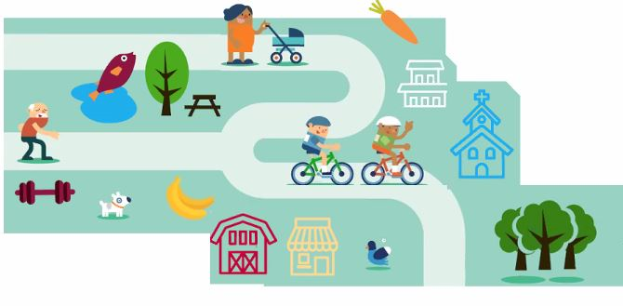
Start with a Community Food Assessment
Notes:
Alisha
CHIP CHA
Have you participated in one? Give me your thoughts- tell me why this is a positive activity for Extension.

Slide 14
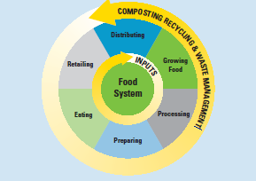
Community Food Assessment
Notes:
Alisha .
“Food policy councils, often established by state or local governments, bring together a broad array of food-related public and private stakeholders to investigate every stage of the food process from farm to table. Consumers, producers, and public officials are becoming more aware of the economic and health impacts of supporting fresh and local foods, resulting in greater attention to many food-related issues. Food policy councils are tapping into this increasing interest to explore policy options that improve the food system” ([State of] Michigan, 2001–14).
Growing – Farmers, ranchers, livestock producers, farm workers, community garden managers, home gardeners, and community gardeners.
Processing – Packers; shippers; aggregators; businesses that wash, freeze, can, or otherwise process fresh foods; meat processing businesses; and food manufacturers.
Distributing – Wholesale food businesses and markets, food hubs, and food banks.
Preparing – Businesses that prepare and serve meals, including restaurants, schools, hospitals, universities, correctional facilities, childcare sites, long-term care facilities, and food service management companies.
Retailing – Grocery and convenience stores, farmers markets, and farm stands.
Eating – Consumers of diverse age, race, socioeconomic status, ethnicity, gender, and geographic location.
Inputs – Businesses (such as seed companies, agricultural chemical companies, farm equipment manufacturers, farm and food business loan agencies) that produce the supplies used by the food sectors.

Slide 15
Food Sector 3: Distributing
Eating Establishments
Number of Restaurants 175
Number of other Eating Establishments 33
Number of bars (no food service) 18
Retail Food Establishments
Number of Convenience Stores 47
Number of Retail Grocers 23
Number of Misc. Food Stores 36
Number of Retail Bakeries 19
Number of Candy, Nut, Confectioners 10
Number of Meat and Fish Markets 4
Number of Fruit and Vegetable Mkts. 2
Number of Dairy Product Stores 1
Notes:
Alisha

Slide 16
Food Sector 5: Retailing
Are EBT (electronic benefits transfer) services available at food retailers and farmers markets?
Piqua Farmers Market – Thursdays May – September; EBT is accepted, in front of library
Troy – Saturday’s, June – September, 9 – Noon; no SNAP benefits.
Tipp City – Saturday 9 – 12:30 PM, unknown 2020 dates; unknown SNAP benefits.
Are local and healthy food choices available and affordable in retail food stores?
The larger communities seem to have access to reasonable priced foods, but the smaller communities do not.
Are there opportunities to purchase local and healthy food products from farmers markets and CSAs?
  Farmer’s markets are seasonal sources of food, CSA availability is unclear
Notes:
Alisha

Slide 17
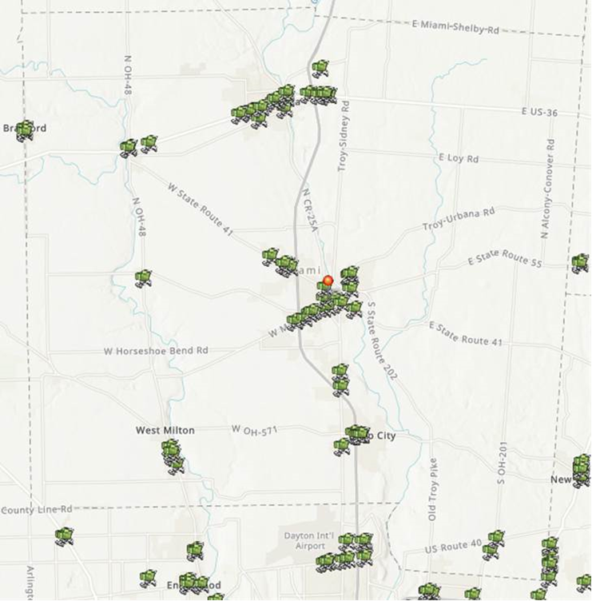
Notes:
Alisha
Map of retail services in the county

Slide 18
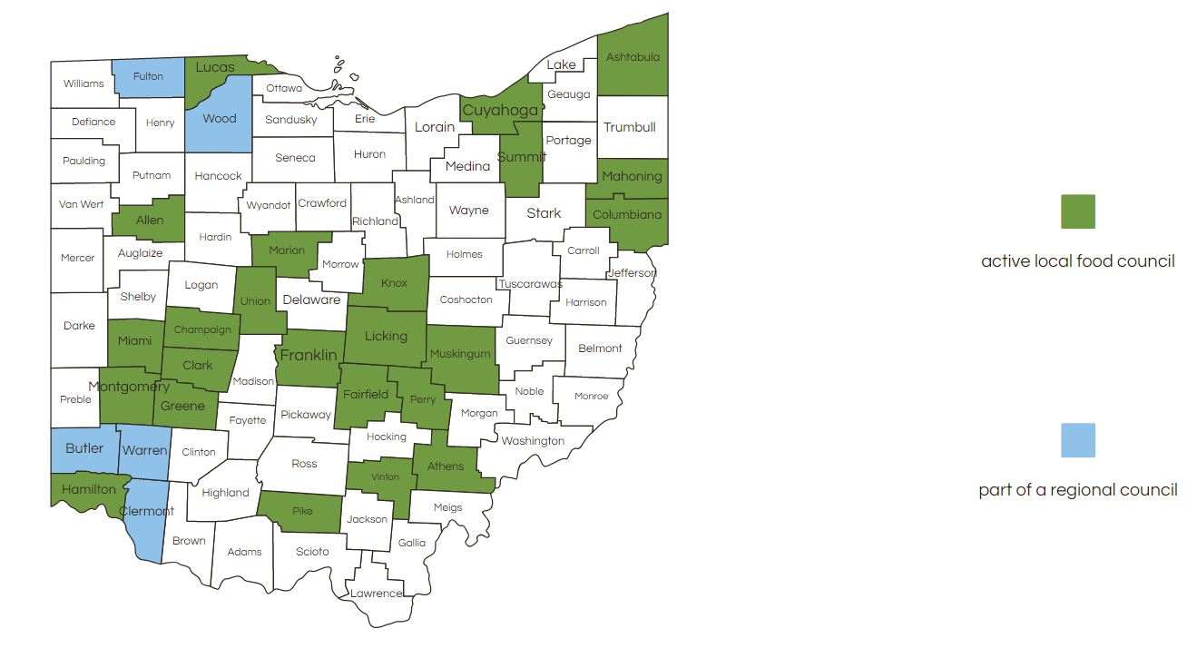
Ohio Local Councils
Notes:
Amanda:
Since the first food council was established in Ohio in 2007, more than 25 communities have seen the benefits and have now created their own councils. A food council can have a positive impact on our economy by expanding food-related jobs and businesses, and by creating new markets for Ohio farmers. In addition, many councils work to help address the issue of food insecurity—the lack of available, affordable and socially acceptable food—that many Ohioans face today in both urban, suburban and rural areas of the state.
Might be in your county now
Organized under local food council-
What starts it? You do

Slide 19
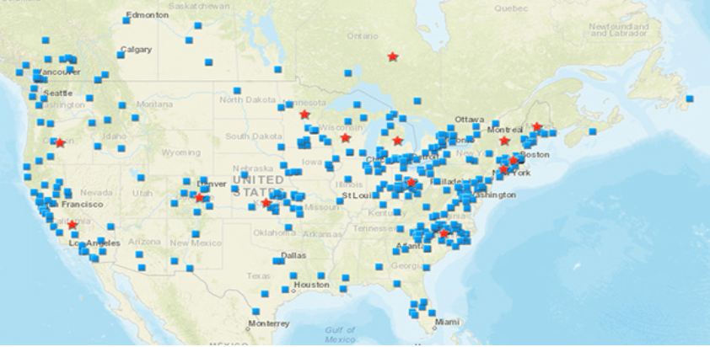
http://www.foodpolicynetworks.org/councils/fpc-map/
Notes:
Amanda:
You can register your food council with John Hopkins
Red: regional or state level
Blue: local
Step by step tool for creation at the end

Slide 20
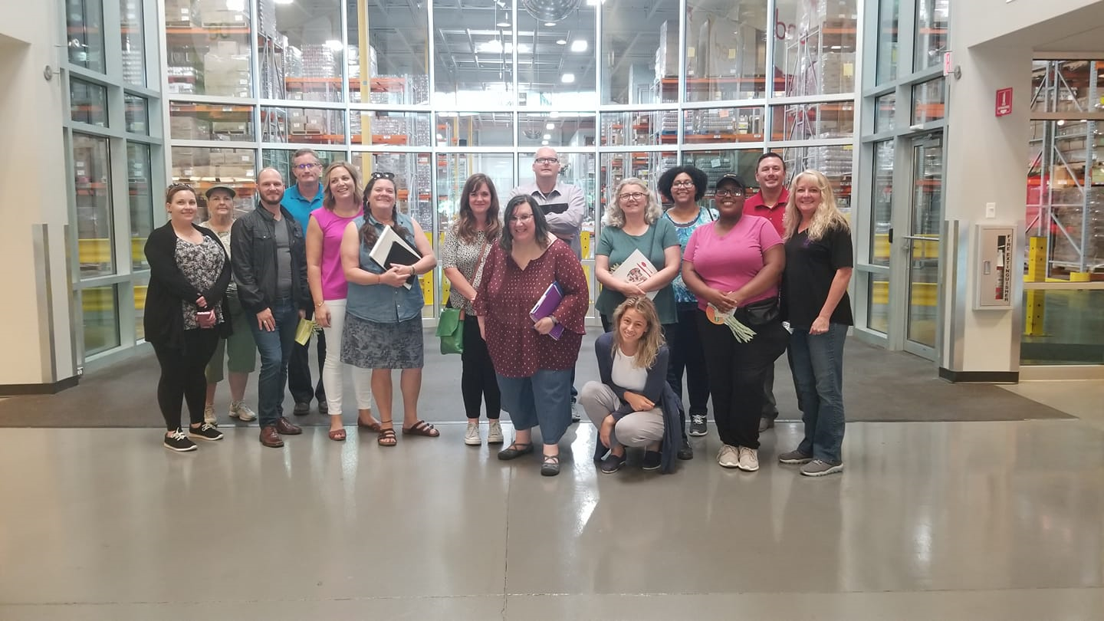
Field Trip
Notes:
Amanda:
Network and ideas
Midohio food bank

Slide 21
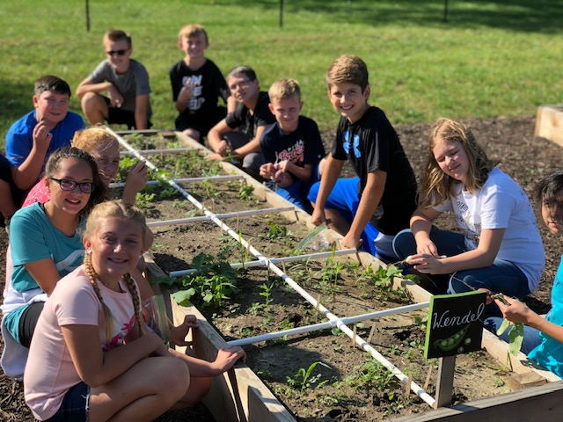
Community Garden
Notes:
Amanda
Visited Franklinton Farm in Columbus, Ohio which is an urban farm in practically downtown Columbus Ohio. They have turned vacant lots into urban gardens. They have a network that they have created where they utilize urban farming and neighborhood distribution programs to improve food security and support healthy futures for the neighbors. Got an idea to create a local community garden. We received a grant to do this work and I’ll detail it here in just a few minutes.

Slide 22
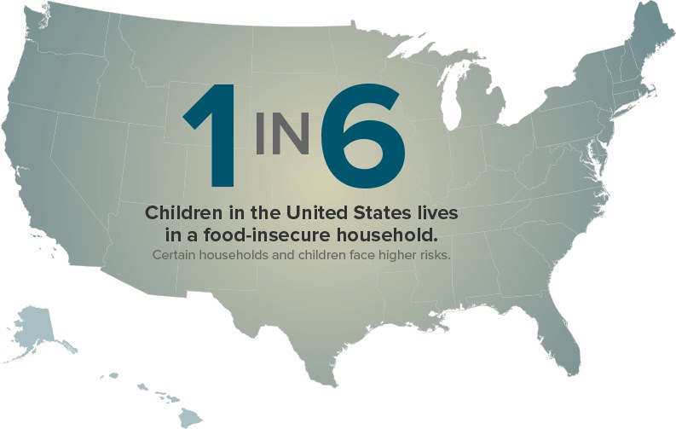
Teens Able to Access Food Pantries
Notes:
Alisha:
Started it for me
Simple policy change
Just bringing people together

Slide 23

Pantries Sharing Resources
Notes:
Alisha:
Share some successes we’ve had as a council
1- share resources as food pantries etc

Slide 24
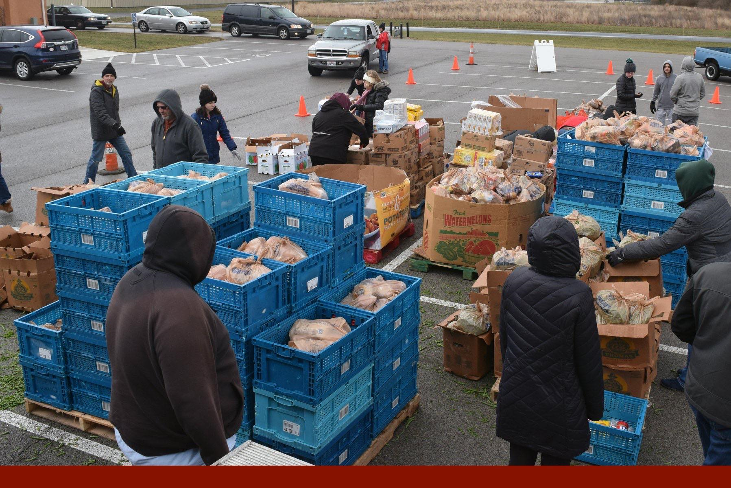
Making Foods Usable
Notes:
Alisha

Slide 25
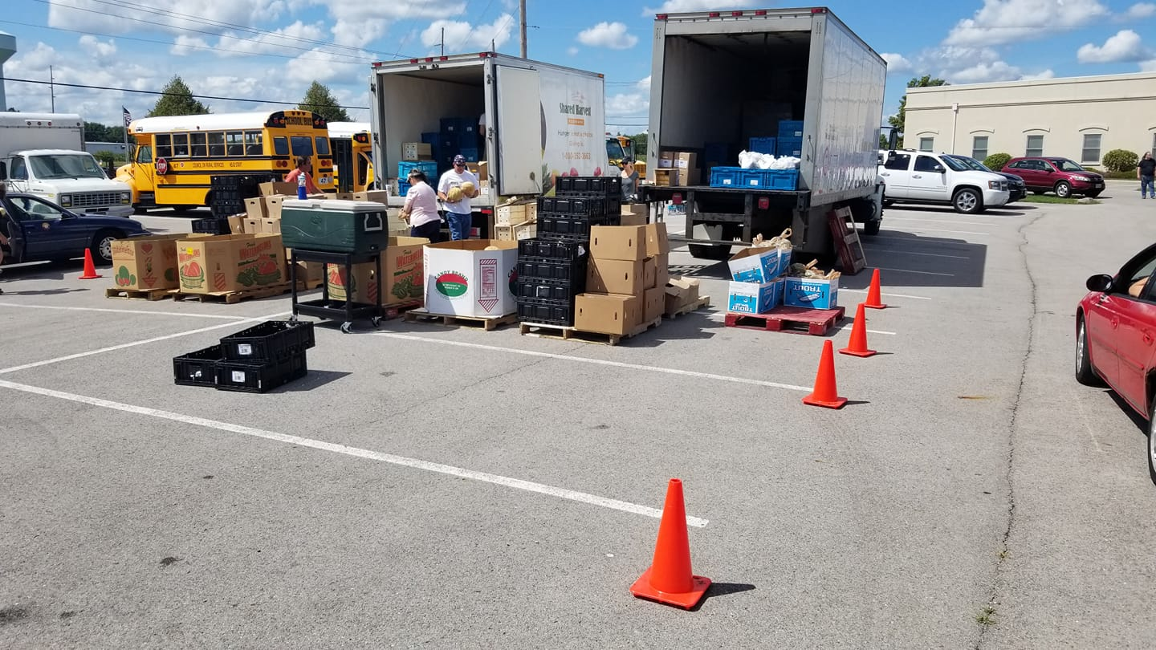
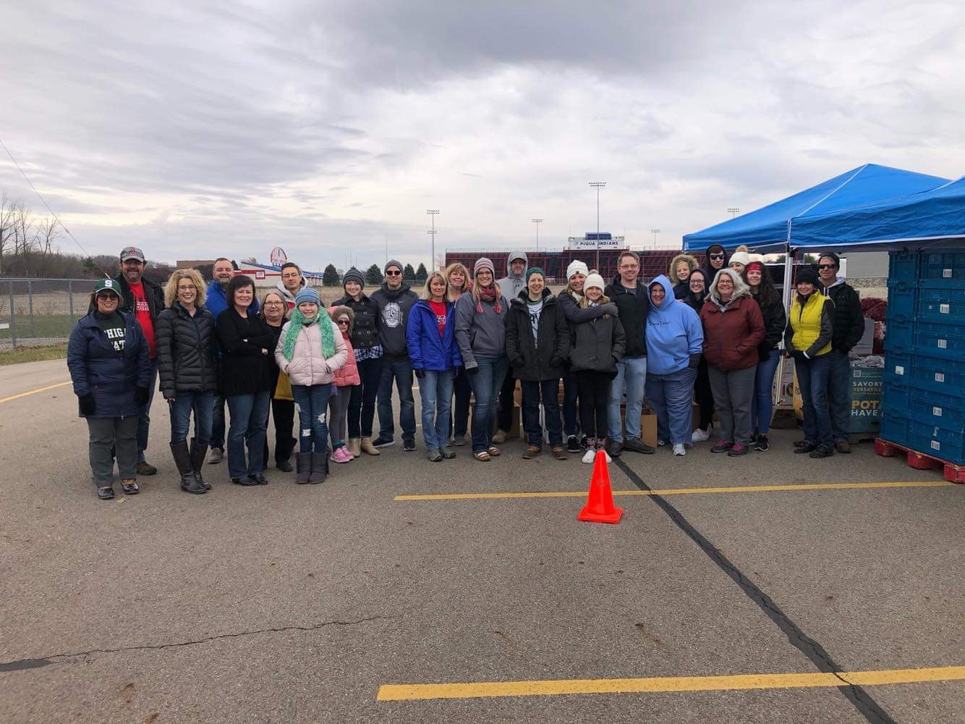
Pop Up Pantries
Notes:
Alisha
Masks
Flu shots

Slide 26
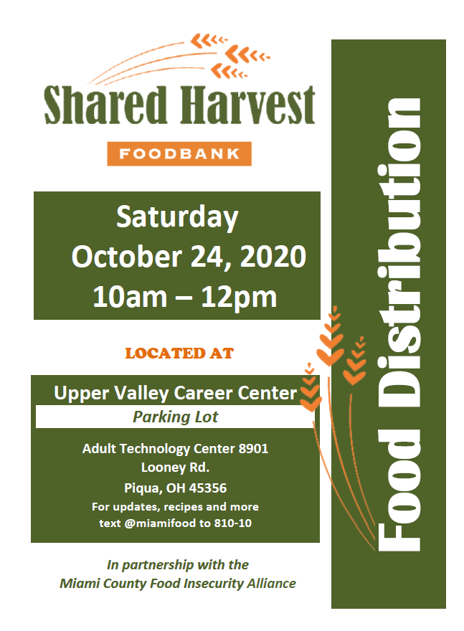
Notes:
Alisha

Slide 27
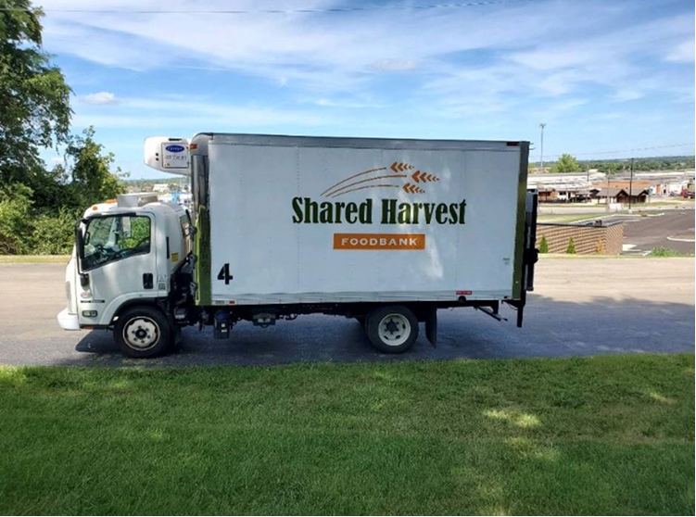
Mobile Food Pantry
Notes:
Alisha

Slide 28

Miami Smiles Dental Clinic
Notes:
Alisha

Slide 29
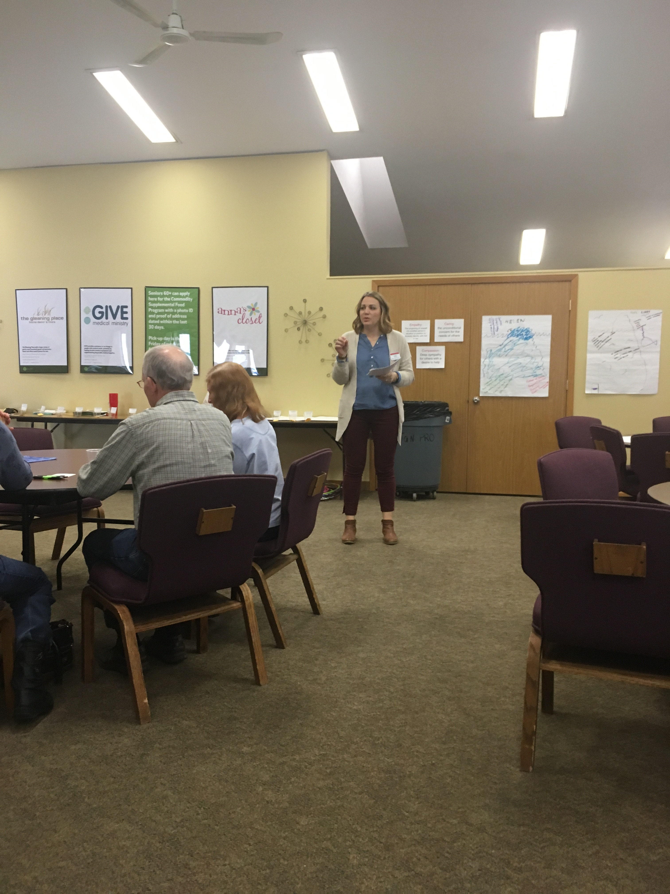
Choice Food Pantry Training
Notes:
Alisha

Slide 30
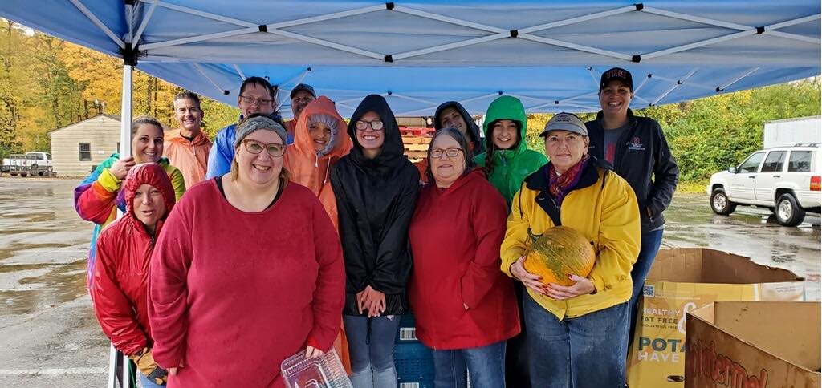
Creating Awareness
Notes:
Alisha

Slide 31

Family and Consumer Sciences
Notes:
Alisha
What can extension do?
Know struggles of family’s
Help be a voice
Also help pass on resources

Slide 32
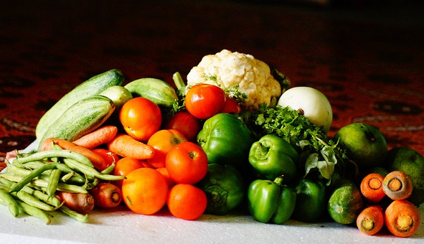
Snap-Ed and EFNEP
Notes:
Amanda
Have potential to make a lot of impact
Just to say “hey we’re here”
Share programming
Womens shelters
Exactly the population they serve. Is there someone who can teach how to get more money food budget? If they are there they can be there?

Slide 33
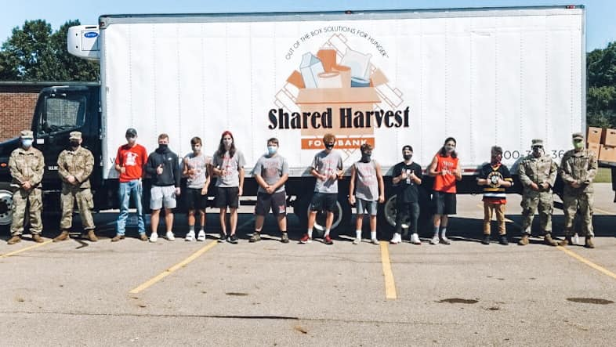
4H and Youth Development
Notes:
Amanda
Including youth in the the process is beneficial for the youth to gain experience and provide a different prospective. Additionally, by bringing youth on board early hopefully they can be instilled with a passion to not only volunteer but to care and be exposed to the need to address food insecurity right in their hometown. In turn it is a way for the food council or alliance can provide some sustainability by growing youth that care about this issue and will want to be involved long term.
Youth-serving organizations such as 4-H, Junior Master Gardener programs, FFA, and scouts; faith-based organizations; and schools are great places to recruit young people to work with the food council.
Young people can participate in the work of food councils in many ways. Following are a few examples:
Serve as a voice for the community’s youth and vote as a council member.
Volunteer for food council work such as planning, organizing, and working in community gardens; working in food pantries; organizing and conducting community PhotoVoice ™ projects; and lobbying for healthy school lunches and safe routes to school.
We have invited local high school youth to assist at our monthly food distributions. Pictured here is the local hockey team that came out and helped load cars with boxes of food. They also helped assemble those boxes prior to.
Our 4-H Health Heroes -- ???

Slide 34
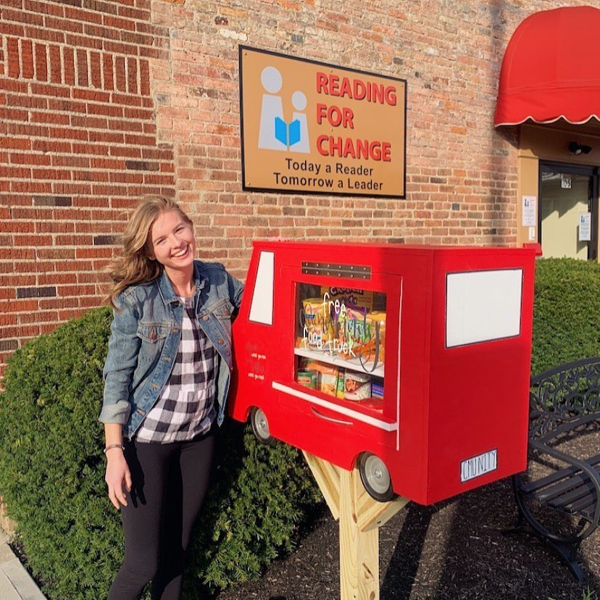
4-H and Youth Development
“Give what you can, take what you need.”
Notes:
Amanda
Another example of how our food alliance is working youth is pictured here. This is known as The Community Food Truck Blessing Box. There are around 10 of these boxes scattered throughout the county. It works very similarly to the lending libraries people have put up. People can donate unopened, nonperishable items directly to the box. In turn, people of the community that are in need can stop by and take what they need.
The Food Alliance promotes the program for this young lady, Maya, who actually started it. Helps with funding and providing volunteers to build and repair boxes

Slide 35
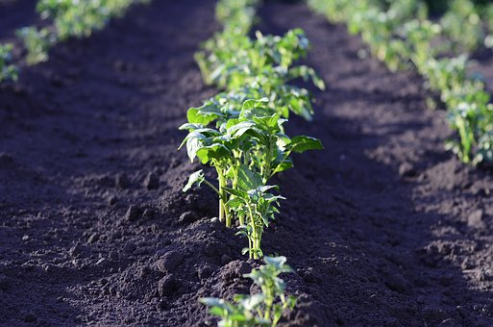
Agriculture and Natural Resources
Notes:
Amanda
As the agriculture and natural resource educator, I've been involved in the alliance from the beginning but obviously kind of serve in a different role. My biggest role with the alliance has been promoting and linking the alliance with vegetable production education. My involvement with the group has also garnered some local connections that were not in place prior to the creation of the alliance. Alisha and I, along with another member of the group, the local free clinic sought a grant to start a community garden. This garden is intended to be a little different than others. Through the grant, we are able to hire a garden manager who will coordinate all aspects of the garden including soliciting sponsor/donors for supplies and coordinating volunteer groups to maintain the garden. The site was actually donated by the free clinic. And as the ANR educator I am able to help with soil testing the site, providing recommendations, and then working with the garden manager to work on the actual purchasing garden supplies and the actual growing of the vegetables. The purpose of the garden is to provide fresh produce to anyone who needs it. For free. We are still working out details but our loose plan is to coordinate with Maya and The Community Food Truck Blessing Boxes food pantries, and other partner sites (most from members of the alliance) for distribution. My future plans also include working with My Master Gardener Volunteers through a program called Grow Ohio to donate fresh food to these sites.
Connections in the community. The school that my children attend have a program called Viking Bags where bags filled with food are sent home every Friday to children need food. I think there are many schools that have these programs. My friend happens to coordinate this effort at the school and so I coordinate with her each month to slip a flyer for the Pop Up Pantry to each bag as a way to get the information to the people that might need it.

Slide 36
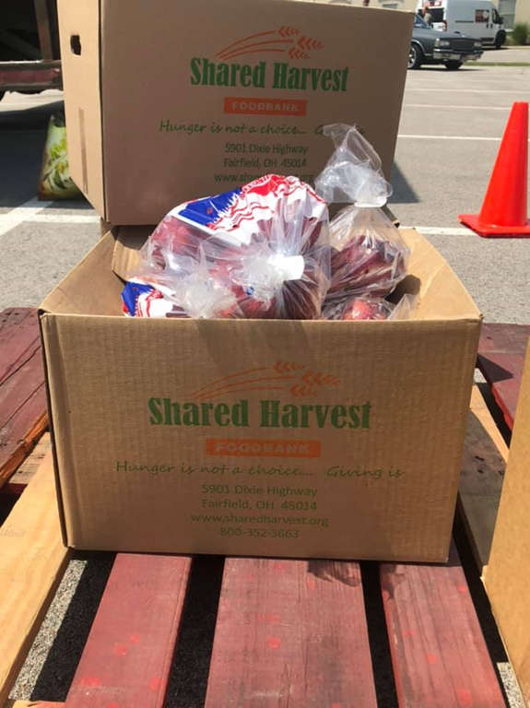
Hunger is not a choice. . . Giving is.
Notes:
Alisha
Questions

Slide 37
Resources for You:
Food Councils in the US:
http://www.foodpolicynetworks.org/
Voices for Food:
https://snapedtoolkit.org/interventions/programs/voices-for-food-vff/
Local Information:
https://www.feedingamerica.org/
Council Formation Guide:
https://ohioline.osu.edu/factsheet/cdfs-1573

Slide 38
Alisha Barton barton.345@osu.edu
Amanda Bennett bennett.709@osu.edu

Slide 39
Resources
LOCAL COUNCILS. (2017, October 18). Retrieved from http://ohiofpn.org/local-councils/.
Raison, B. (2017, July 7). Local Food Council Formation Planning Guide. Retrieved from https://ohioline.osu.edu/factsheet/cdfs-1573.
Stluka, S., Moore, L., Eicher-Miller, H. A., Franzen-Castle, L., Henne, B., Mehrle, D., … Mccormack, L. (2018). Voices for food: methodologies for implementing a multi-state community-based intervention in rural, high poverty communities. BMC Public Health, 18(1). doi: 10.1186/s12889-018-5957-9
U.S. Hunger Relief Organization. (n.d.). Retrieved from https://www.feedingamerica.org/.

