Slide 1
RHC Self Survey for Ohio
Kate Hill RN
VP Clinic Division
August 2021

Slide 2


Learning Objectives
Changes in 2020 and 2021
Common Deficiencies
Self Survey

Slide 3
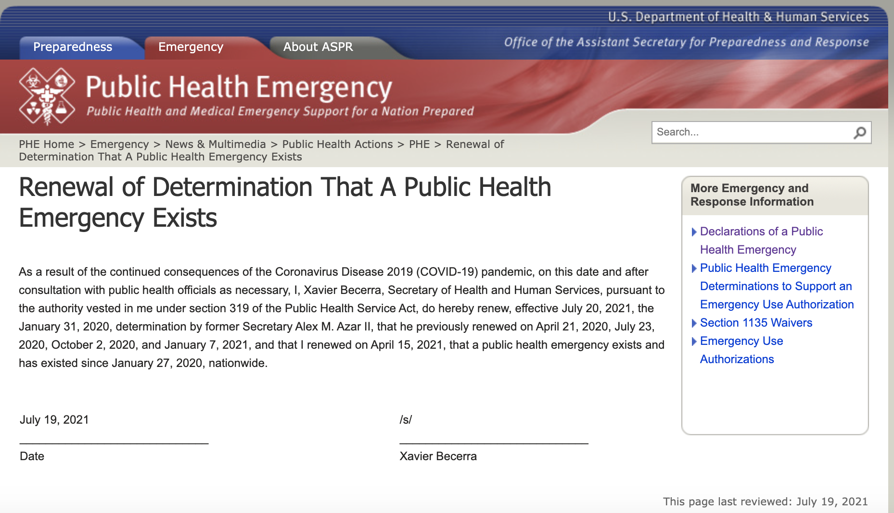
Secretary Becerra Extends PHE to October 20, 2021

Slide 4
Waivers to July 20, 2021, or the end of the PHE.
Beneficiary Location for Telehealth Services
  Medicare can pay for many types of office, hospital, and other visits furnished via telehealth across the country and including in patient’s places of residence. Additionally, the HHS OIG is providing flexibility for healthcare providers to reduce or waive cost-sharing for telehealth visits paid by federal healthcare programs.
2. Additional Telehealth Services Covered by Medicare
  Clinicians are allowed to provide more than 135 new telehealth services, including: emergency department visits, initial and subsequent observation, initial hospital care and hospital discharge day management, initial nursing facility visits, critical care services, intensive care services, therapy services.
3. Virtual Check-Ins, Remote Evaluations, & E-Visits
  Clinicians can provide virtual check-in, remote evaluation of patient-submitted video/images, and e-visit services to both new and established patients. These services were previously limited to established patients. Licensed clinical social workers, clinical psychologists, physical therapists, occupational therapists, and speech language pathologists can provide e-visits, virtual check-ins, and remote evaluations. A broad range of clinicians, including physicians, can now provide certain services by telephone to their patients.

Slide 5
Waivers to July 20, 2021, or the end of the PHE.
Remote Patient Monitoring
  Clinicians can provide remote patient monitoring services to both new and established patients. These services can be provided for both acute and chronic conditions and can now be provided for patients with only one disease.
Eligible Practitioners
  CMS is waiving the requirements of section 1834(m)(4)(E) of the Social Security Act and 42 CFR § 410.78 (b)(2) which specify the types of practitioners that may bill for their services when furnished as Medicare telehealth services from the distant site. The waiver of these requirements expands the types of health care professionals that can furnish distant site telehealth services to include all those that are eligible to bill Medicare for their professional services. This allows health care professionals who were previously ineligible to furnish and bill for Medicare telehealth services, including physical therapists, occupational therapists, speech language pathologists, and others, to receive payment for Medicare telehealth services.

Slide 6
Waivers to July 20, 2021, or the end of the PHE.
Practitioner Locations
  CMS is waiving the Medicare requirement that a physician or non-physician practitioner must be licensed in the State in which s/he is practicing for individuals for whom the following four conditions are met: 1) must be enrolled as such in the Medicare program, 2) must possess a valid license to practice in the State which relates to his or her Medicare enrollment, 3) is furnishing services – whether in person or via telehealth – in a State in which the emergency is occurring in order to contribute to relief efforts in his or her professional capacity, and 4) is not affirmatively excluded from practice In the State or any other State that is part of the 1135 emergency area.
Allowing FQHCs and RHCs to Serve as Distant Sites for Telehealth
  FQHCs and RHCs may serve as distant site practitioners to furnish telehealth services. Medicare pays for these telehealth services based on payment rates similar to the national average payment rates for comparable telehealth services under the Medicare Physician Fee Schedule. These services are excluded from both the FQHC prospective payment system and the RHC all-inclusive rate calculation.

Slide 7
Waivers to July 20, 2021 or the end of the PHE.
Audio-Only Telehealth for Certain Services
  CMS is waiving the requirements of section 1834(m)(1) of the Social Security Act and 42 CFR § 410.78(a)(3) for use of interactive telecommunications systems to furnish telehealth services, to the extent they require use of video technology, for certain services. This waiver allows the use of audio-only equipment to furnish services described by the codes for audio-only telephone evaluation and management services, and behavioral health counseling and educational services.
Temporary Expansion Locations for RHCs and FQHCs
  CMS is waiving the requirements at 42 CFR §491.5(a)(3)(iii) which require RHCs and FQHCs be independently considered for Medicare approval if services are furnished in more than one permanent location. Due to the current PHE, CMS is temporarily waiving this requirement removing the location restrictions to allow flexibility for existing RHCs/FQHCs to expand services locations to meet the needs of Medicare beneficiaries. This flexibility includes areas which may be outside of the location requirements 42 CFR §491.5(a)(1) and (2) for the duration of the PHE.
Bed Count for Provider-Based RHCs and RHC Payment Limit.

Slide 8
Waivers to July 20, 2021, or the end of the PHE.
Cost Reporting
“Stark Law” Waivers
  The physician self-referral law (also known as the “Stark Law”) prohibits a physician from making referrals for certain healthcare services payable by Medicare if the physician (or an immediate family member) has a financial relationship with the entity performing the service. There are statutory and regulatory exceptions, but in short, a physician cannot refer a patient to any entity with which he or she has a financial relationship. On March 30, 2020, CMS issued blanket waivers of certain provisions of the Stark Law regulations. These blanket waivers apply to financial relationships and referrals that are related to the COVID-19 emergency. The remuneration and referrals described in the blanket waivers must be solely related to COVID-19 Purposes, as defined in the blanket waiver document. Under the waivers, CMS will permit certain referrals and the submission of related claims that would otherwise violate the Stark Law.
Reporting
  CMS has established toll-free hotlines for all providers as well as the following flexibilities for provider enrollment: » Waive certain screening requirements. » Postpone all revalidation actions. » Expedite any pending or new applications from providers.

Slide 9
Waivers to July 20, 2021, or the end of the PHE.
Advance Beneficiary Notice of Noncoverage (ABN) Use Extension
Medicare Physician Supervision Requirements
  For services requiring direct supervision by the physician or other practitioner, that physician supervision can be provided virtually using real-time audio/video technology.
Practitioner Locations
  CMS waives the Medicare requirement that a physician or non-physician practitioner must be licensed in the State in which s/he is practicing for individuals for whom the following four conditions are met:
    must be enrolled as such in the Medicare program,
    must possess a valid license to practice in the State which relates to his or her Medicare enrollment,
    is furnishing services – whether in person or via telehealth – in a State in which the emergency is occurring in order to contribute to relief efforts in his or her professional capacity, and
    is not affirmatively excluded from practice in the State or any other State that is part of the 1135 emergency area.
Home Nursing Visits
  RHCs and FQHCs can provide visiting nursing services to a beneficiary’s home with fewer requirements, making it easier for homebound beneficiaries to receive care.

Slide 10
Waivers to July 20, 2021, or the end of the PHE.
Staffing Requirements for RHCs and FQHCs
  42 CFR 491.8(a)(6). CMS is waiving the requirement in the second sentence of § 491.8(a)(6) that a nurse practitioner, physician assistant, or certified nurse-midwife be available to furnish patient care services at least 50 percent of the time the RHC operates. CMS is not waiving the first sentence of § 491.8(a)(6) that requires a physician, nurse practitioner, physician assistant, certified nurse midwife, clinical social worker, or clinical psychologist to be available to furnish patient care services at all times the clinic or center operates.
Physician Supervision of NPs in RHCs and FQHCs
  42 C.F.R. 491.8(b)(1). CMS is modifying the requirement that physicians must provide medical direction for the clinic’s or center’s health care activities and consultation for, and medical supervision of, the health care staff, only with respect to medical supervision of nurse practitioners, and only to the extent permitted by state law. The physician, either in person or through telehealth and other remote communications, continues to be responsible for providing medical direction for the clinic or center’s health care activities and consultation for the health care staff, and medical supervision of the remaining health care staff.

Slide 11
Waivers to July 20, 2021, or the end of the PHE.
Modification of 60-Day Limit for Substitute Billing Arrangements (Locum Tenens)
Accelerated/ Advance Payments
Temporary Suspension of Medicare Sequestration
COVID-19 Diagnostic Codes11
High-Production Coronavirus Lab Tests
Antibody (Serology) Tests
COVID-19 FAQs on Medicare Fee-for-Service (FFS) Billing
COVID-19 Provider Burden Relief FAQs
Standards of Practice and Flexibilities for Outpatient Settings
  42 C.F.R. 491.8(b)(1). CMS is modifying the requirement that physicians must provide medical direction for the clinic’s or center’s health care activities and consultation for, and medical supervision of, the health care staff, only with respect to medical supervision of nurse practitioners, and only to the extent permitted by state law. The physician, either in person or through telehealth and other remote communications, continues to be responsible for providing medical direction for the clinic or center’s health care activities and consultation for the health care staff, and medical supervision of the remaining health care staff.
Reporting of COVID-19 Clinical Trial Data through the Quality Payment Program

Slide 12
Waivers to July 20, 2021, or the end of the PHE.
CMS COVID-19 Stakeholder Engagement Calls
  CMS hosts recurring stakeholder engagement sessions to share information related to the agency's response to COVID-19. These sessions are open to members of the healthcare community and are intended to provide updates, share best practices among peers, and offer attendees an opportunity to ask questions of CMS and other subject matter experts. Recordings of these sessions are publicly available for those unable to attend and can be found here: https://www.cms.gov/OutreachandEducation/Outreach/OpenDoorForums/PodcastAndTranscripts
CMS Office of Minority Health (CMS OMH): COVID-19 Resources on Vulnerable Populations
  CMS OMH has compiled Federal resources on the 2019 Novel Coronavirus (COVID19) to assist its partners who work with those most vulnerable--such as older adults, those with underlying medical conditions, racial and ethnic minorities, rural communities, and people with disabilities. Those resources can be found here:
  https://www.cms.gov/About-CMS/Agency-Information/OMH/resource-center/COVID19-Resources
Interim Final Rules and Waivers
  CMS regularly updates a webpage that includes Interim Final Rules, waivers, and provider-specific fact sheets related to COVID-19, which can be found here:
  https://www.cms.gov/about-cms/emergency-preparedness-responseoperations/current-emergencies/coronavirus-waivers

Slide 13
Appendix Z update
New Guidance March 26, 2021. Effective 4.26.21
Your exercise must be one of your listed items on your HVA, unless it’s an event.
HVA must include EID (Emerging infectious Disease)
Since Emerging infectious disease outbreaks may affect any facility in any location across the country, a comprehensive EP program should include emerging infectious diseases.
The plan should encompass how the facility will plan, coordinate and respond to a localized and widespread pandemic.
Facilities should ensure their EP programs are aligned with their State and local emergency plans/pandemic plans.
The plan must be in writing.

Slide 14
Appendix Z update
New Guidance March 26, 2021. Effective 4.26.21
Testing
Survey Procedures: Refer to the facility’s risk assessment to determine if the training and testing program is reflecting risks and hazards identified within the facility’s program.
  This means you can’t use something as an exercise unless it’s on your hazard list.
Testing should also not test the same thing year after year or the same response processes. The intent is to identify gaps in the facility’s EP program as it relates to responding to various emergencies and ensure staff are knowledgeable on the facility’s program.

Slide 15
Appendix Z update
New Guidance March 26, 2021. Effective 4.26.21
Volunteers:
While not required to use volunteers as part of their plans to supplement or increase staffing during an emergency, the facility must have policies and procedures to address plans or emergency staffing needs.
Survey Procedures:
Ask facility leadership to explain their staffing strategies. Do they use volunteers? If no volunteers are used, does the facility have other emergency staffing strategies?
Verity the facility has included policies and procedures for the use of volunteers another emergency staffing strategies in its emergency plan.
Verify that the facility’s program includes a policy and procedures which address surge needs during an emergency.

Slide 16
Appendix Z update
New Guidance March 26, 2021. Effective 4.26.21
Waivers during a PHE
The facility’s emergency preparedness program must include policies and procedures
which outline the facilities role in the provision of care and treatment under 1135 waivers during a declared public health emergency in alternate care sites (ACS).
Survey; Verify the facility has included policies and procedures in its emergency plan describing the facility’s role in providing care and treatment at alternate care sites under an 1135 waiver.

Slide 17

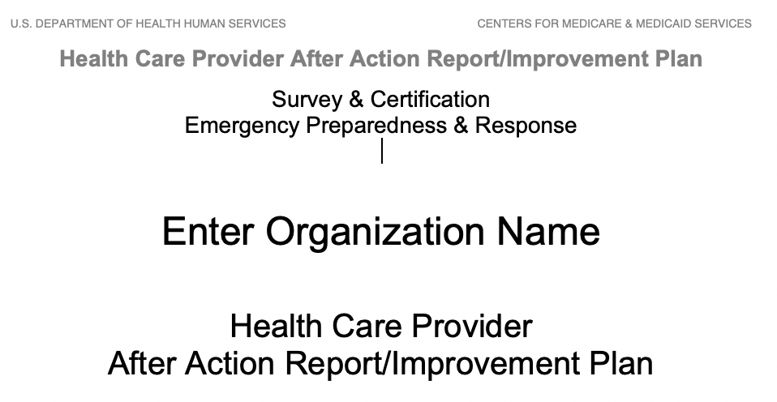
Emergency Preparedness Resources

Slide 18
AAR
This event in 2020 occurred as a result of a Corona Virus from Wuhan, China which resulted in a worldwide Pandemic.
The event began for ABC clinic on March __, 2020.
The emergency team was composed of _________ (names of staff in leadership)
Governor DeWine declared a State emergency on March 9, 2020.
This report is the follow up analysis of the COVID-19 event which occurred in early 2020.
The purpose is to evaluate ABC clinic’s Emergency Preparedness program
Enter the top three strengths of your Emergency Plan
Examples: Staff training conducted on infection prevention
Plan to triage patients who come to the clinic
Plan to put sign on door to call from the car if symptomatic

Slide 19
AAR
Areas of Improvement
Need to order extra supplies such as masks and hand sanitizer earlier.
Need to minimize things in the waiting room to decrease things needing disinfecting.
Need for more screening of clinic staff, temps in the morning.
Need more separation of patients.
Event Successes
Staff immediately began calling patients instead of visit to decrease exposure for patients
Some staff sent to hospital to assist with surge
Older providers working from home doing Telehealth
Document staff meeting with date, time and training log with signatures.
Staff Training
Report reviewed with staff
Assignments given
Attendance log at AAR meeting

Slide 20
Part 2
COMMON DEFICIENCIES
MOCK/SELF SURVEY

Slide 21
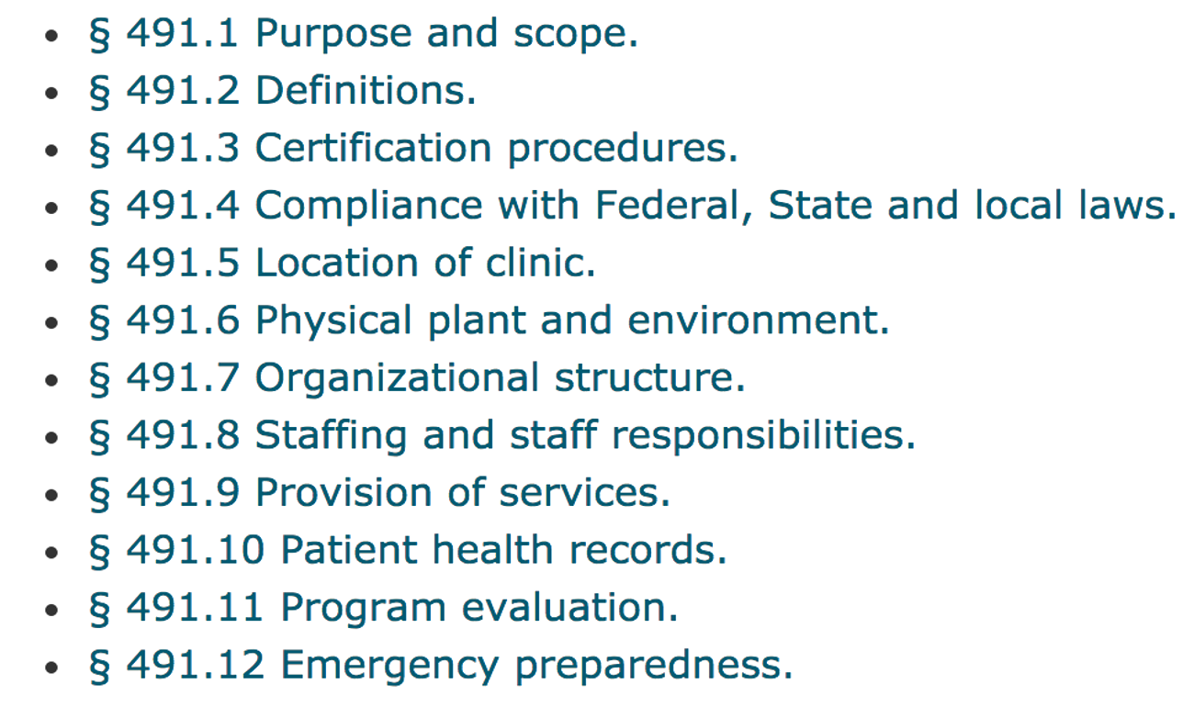
42. CFR 491.1 to 491.12

Slide 22
Overview of Mock Survey
Work your checklist! Conduct your own mock survey with clinic staff based off the agenda that we provided as a handout.
Hold a kickoff conference with staff and discuss how the mock survey will prepare them for the onsite visit.
Complete a walk through of the clinic with checklist in hand. Can you answer yes to all the regulations? Are there areas of concern that need more attention?
Complete a policy review based on the policy section of the checklist. Do you have all the policies? Are they complete? If you are provider-based, are the policies specific to your clinic? (or have you clearly identified that you follow hospital policy?)
Interview staff to ensure they are knowledgeable about clinic policy, procedures and their individual job responsibilities. They should be comfortable answering any questions that the surveyor may ask.
Finish with a wrap up conference to discuss any areas of concern that need to be addressed prior to survey. Once you are confident you are ready for survey day, take time to celebrate your accomplishments!

Slide 23
Conducting a Self Survey – Time to Shine!
Everyone has worked hard to stay compliant and now is their time to shine!
Set the tone for the mock survey with a discussion to remind staff this is an “open book test” and there should be no surprises. If you can answer yes to each item on the checklist, your clinic is in compliance.
Enthusiasm not apprehension! Your surveyor will conduct a fair and unbiased survey. Staff should not be nervous but ready to show the surveyor what they do best.

Slide 24
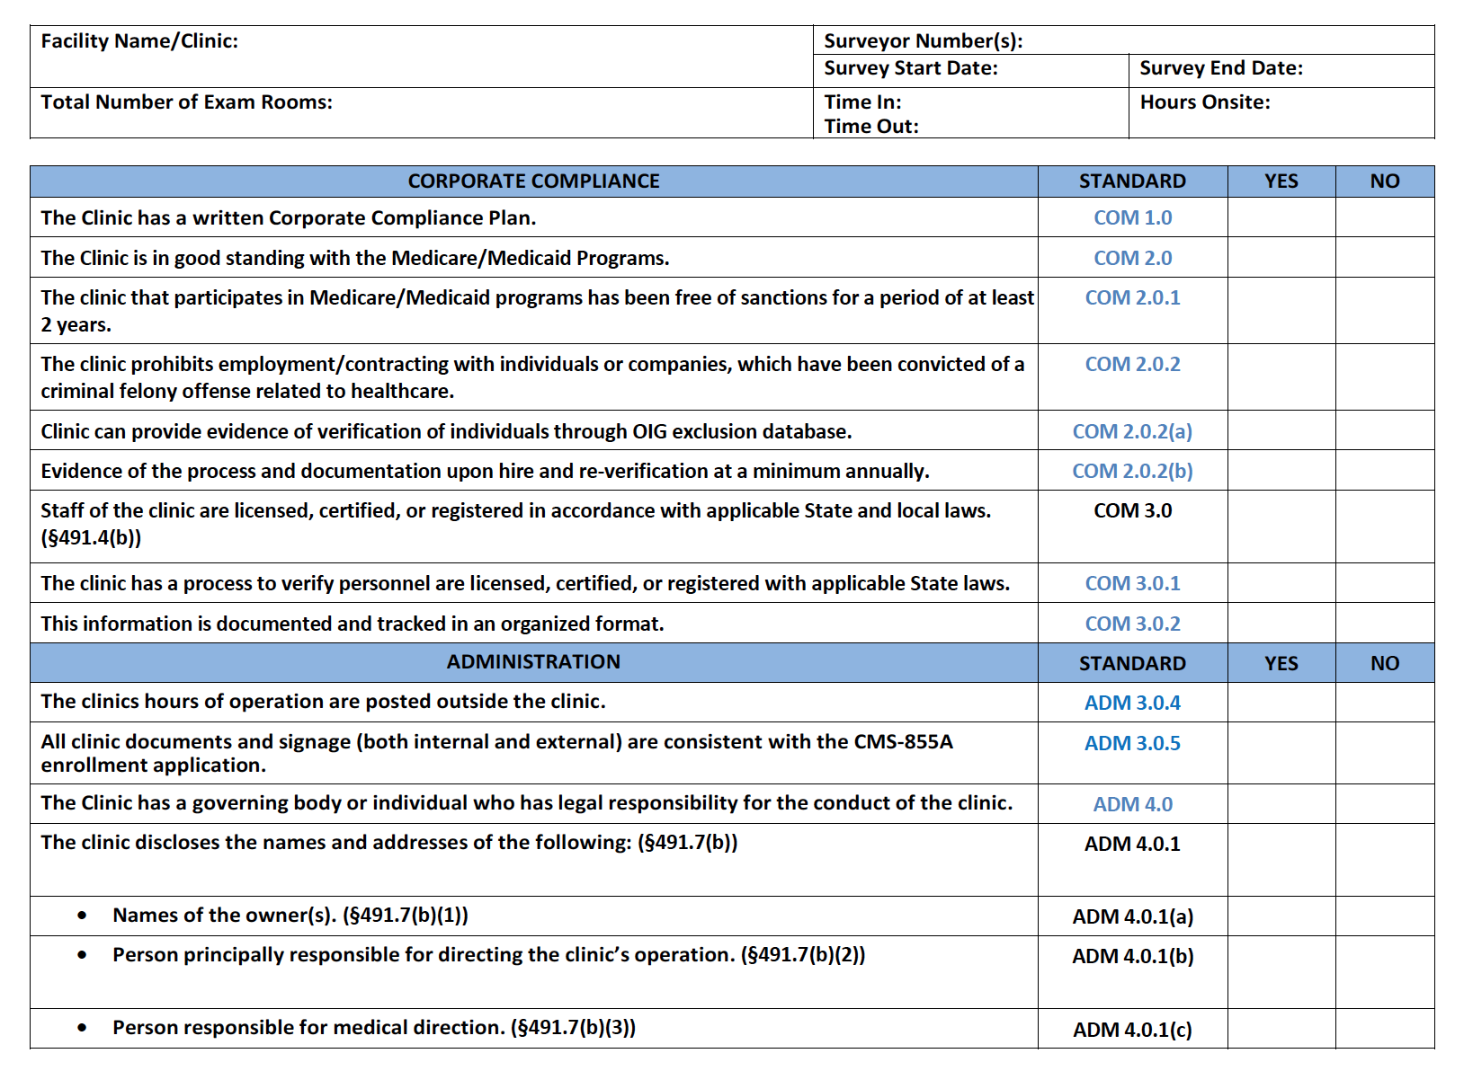
The RHC Checklist
The Compliance Team Quality Standards and Checklist incorporate the federal regulatory requirements with universal and specialty standards to demonstrate rural excellence through Exemplary Provider Accreditation

Slide 25

Mock Survey – Signage
Name on the sign is consistent with CMS 855A application

Slide 26
Changes to Clinic Name, location and Medical Director
Before moving: Check with State office of Rural Health and your MAC to be certain your new address is still in a HPSA, even if it’s next door.
  Your location is grandfathered in at your present location.
Report name changes to CMS.
Report change in Medical Director to the State on a CMS29
Update your 855a and CMS 29 as things change.

Slide 27
The Entrance

Slide 28
The Entrance
Posted Hours of
Operation

Slide 29
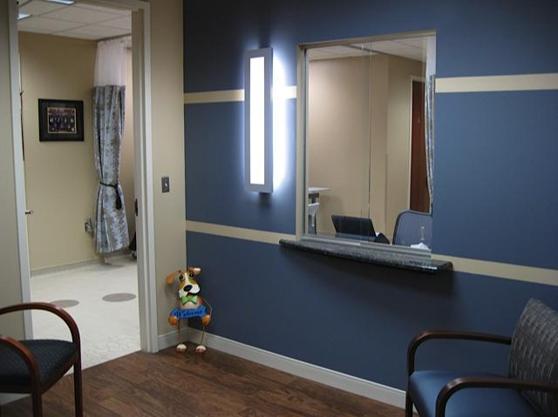

The Waiting Room

Slide 30

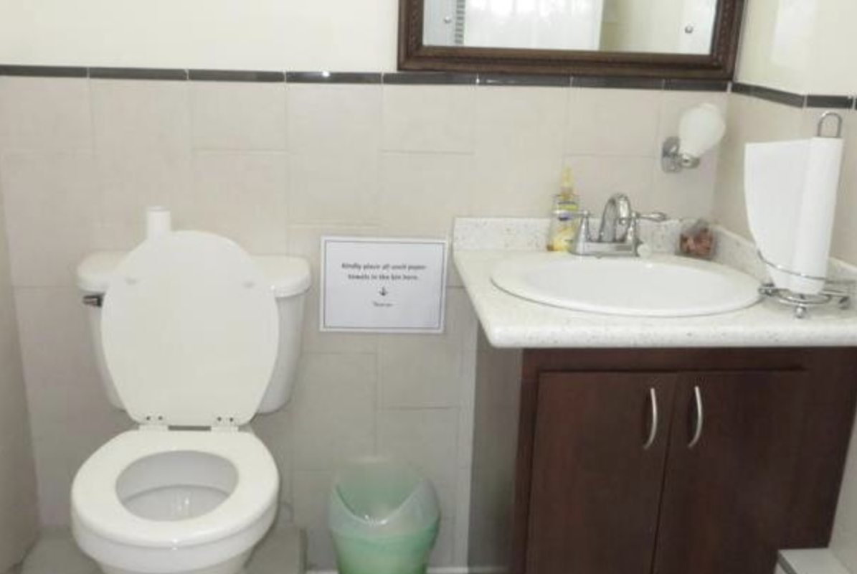
The Exam Rooms and Patient Bathroom

Slide 31
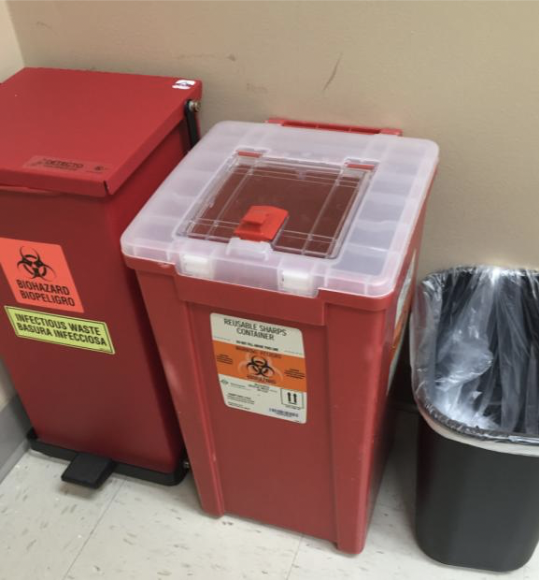
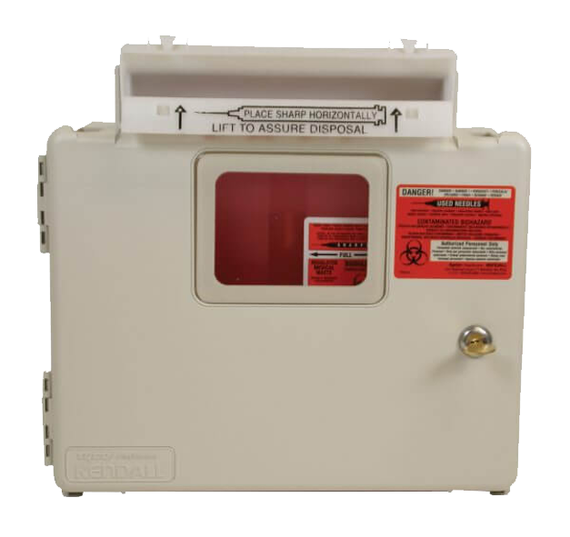
Biohazard Containers
Sharps containers cannot be easily accessible.
Several states require specific times on emptying of sharps containers.
Must be marked with a Bio-Hazard sticker

Slide 32
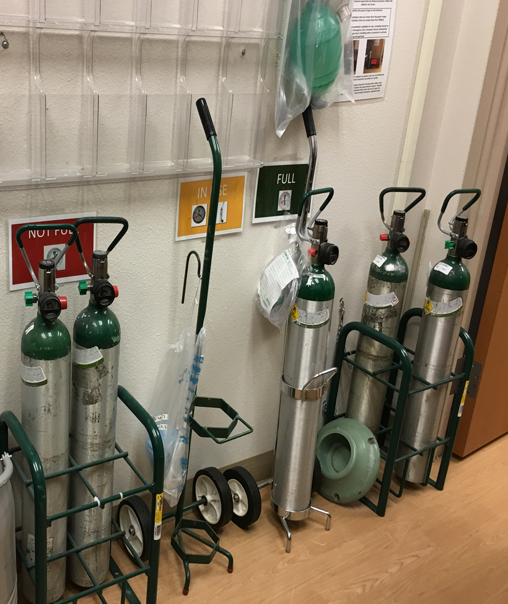
Mock Survey – Supply Storage and Oxygen
Safe storage of Oxygen:
Chained or in an approved cart.
Keep full separated from empty.

Slide 33

Mock Survey – Posters
State and Federal Posters are required to be in places visible to the staff.
Make sure you have the current year.
Provider based clinics must have these postings in the clinic even when the clinic in the hospital building

Slide 34
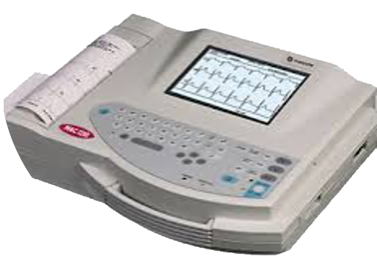
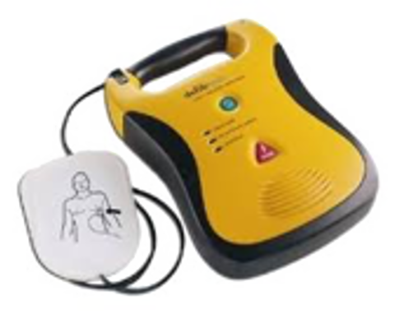
Mock Survey – Physical Plant: Equipment
All equipment resides on an Inventory List
Manufacturer’s IFUs determines need for Inspection vs Preventive Maintenance (PM)
Process in place for tracking due dates for PM
Evidence of initial inspection BEFORE use
in patient care
Annual Bio-Med inspection is evident with stickers or report
Equipment not in use is labeled as such
and stored away

Slide 35
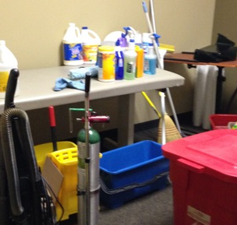
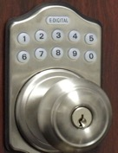
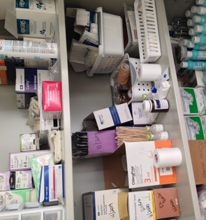

Mock Survey – What to Lock

Slide 36

HR File Elements
Application
I-9
W-4
OIG Exclusion
Signed Job Description
Standards of Conduct
Performance evaluations, according
to your clinic schedule
Annual Training
Competency
Background checks as appropriate
TB screening on hire
Hep B for those who work with patients

Slide 37
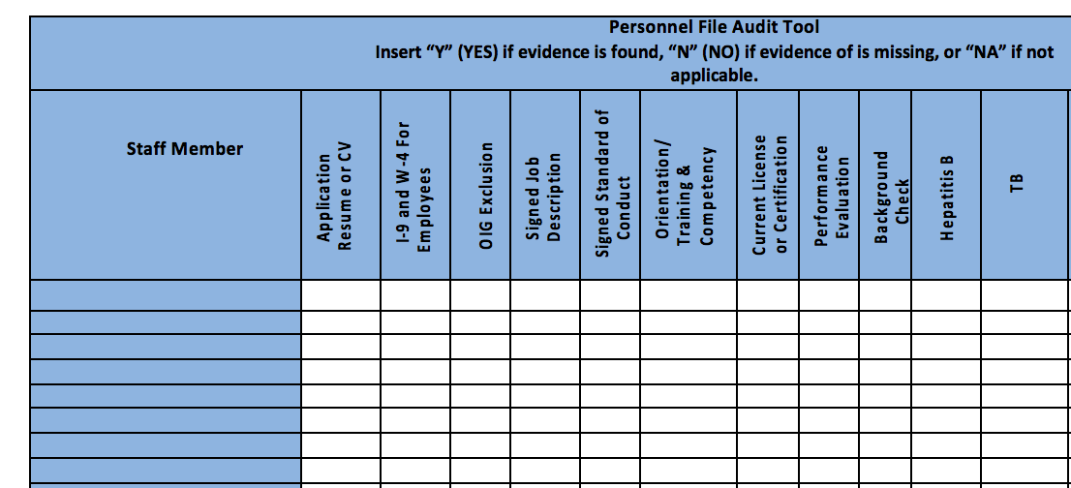
Mock Survey – HR Files
Are your HR Files complete and in order? Accessible for review?
Staff of the clinic or center are licensed, certified or registered in accordance with applicable State and local laws.

Slide 38
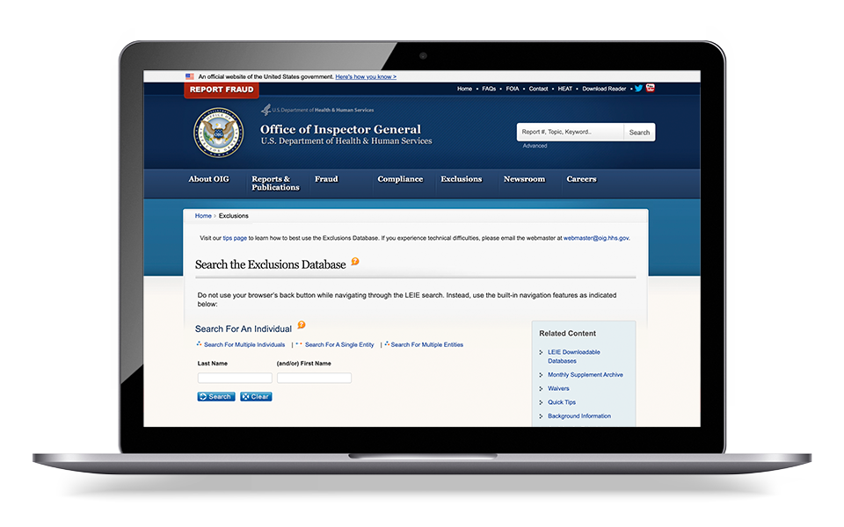
HR File
OIG Exclusion list:
https://exclusions.oig.hhs.gov/

Slide 39
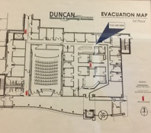


Mock Survey – Fire Safety
Fire Safety Process per State Regulations

Slide 40
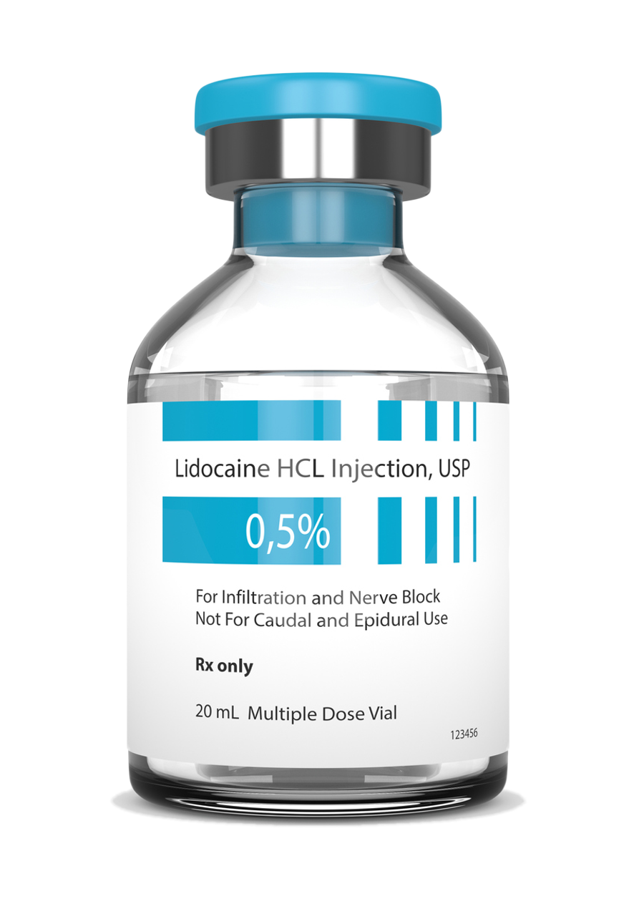
Mock Survey – Vials and Outdated Supplies
Possibly a staff member does not know the difference between a single dose or multi-dose vial.
Possibly a certain drug always comes to you as an MDV but your supplier sent a shipment where the drug was an SDV.
Possibly we store MDVs and SDVs together making it easy to confuse.
What to do:
Train all staff to always look at the vial to verify if it’s an SDV or MDV and to check the date.
Train staff that SDVs do not have a preservative in the vial and why that’s important.
In the drug closet, separate the MDVs from the SDVs
Label all SDVs with a sticker
Single Dose Vials
Ensure Single-Dose Vials (SDVs) Are Never Used for More Than One Patient
Do Not Assume All Staff Know the Difference Between SDVs and MDVs.

Slide 41
Vials and Outdated Supplies
Multi Dose Vials
Single Dose Vials
28 Days

Slide 42
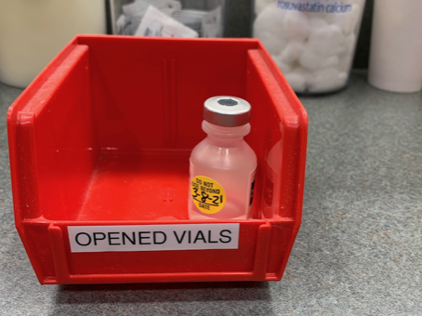
Vials and Outdated Supplies
Ensure Single-Dose Vials (SDVs) Are Never Used for More Than One Patient.
Once and done, discard!

Slide 43
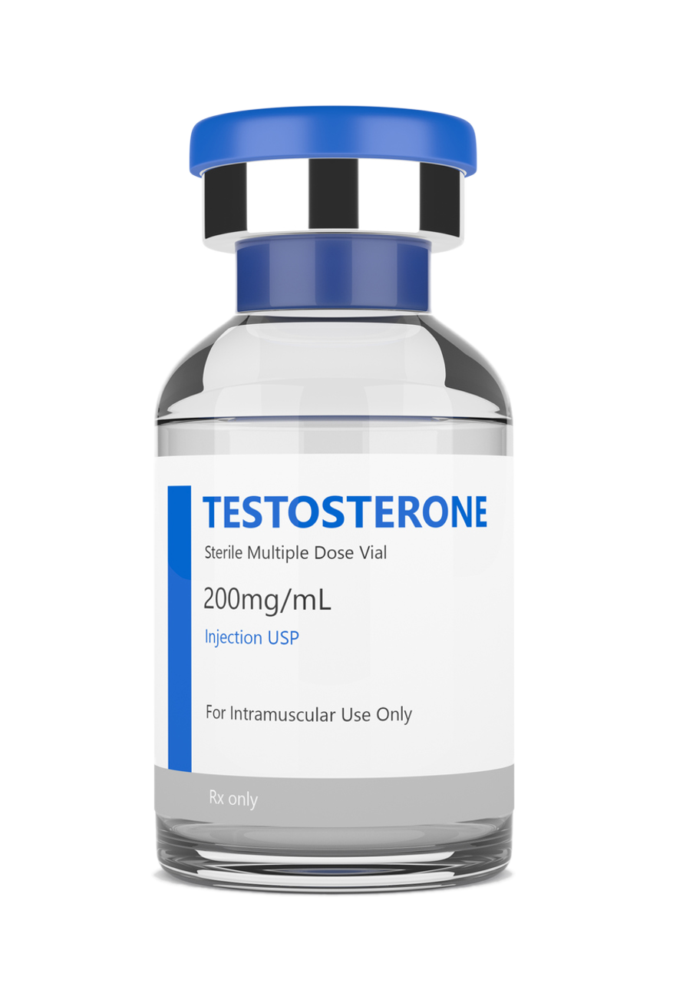
Controlled Substances
Controlled Substances (CS) locked in a Substantial Cabinet.
Recordkeeping Logs for Ordering/ Dispensing.
MDVs, Storage in Sample Closet, Med Fridge, or
Emergency Boxes must be secured.

Slide 44
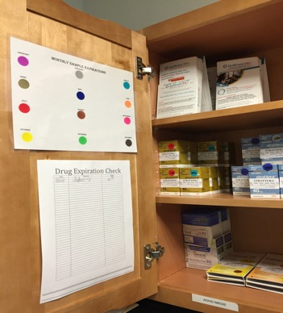
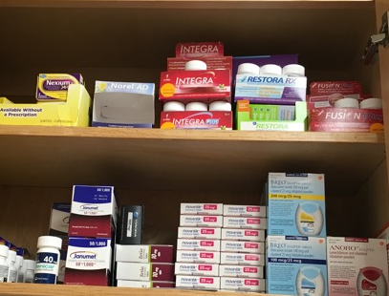
Mock Survey – Samples
Sample Medications secured and
logged to track in the event of a recall
Secured/Organized
In Original Containers

Slide 45
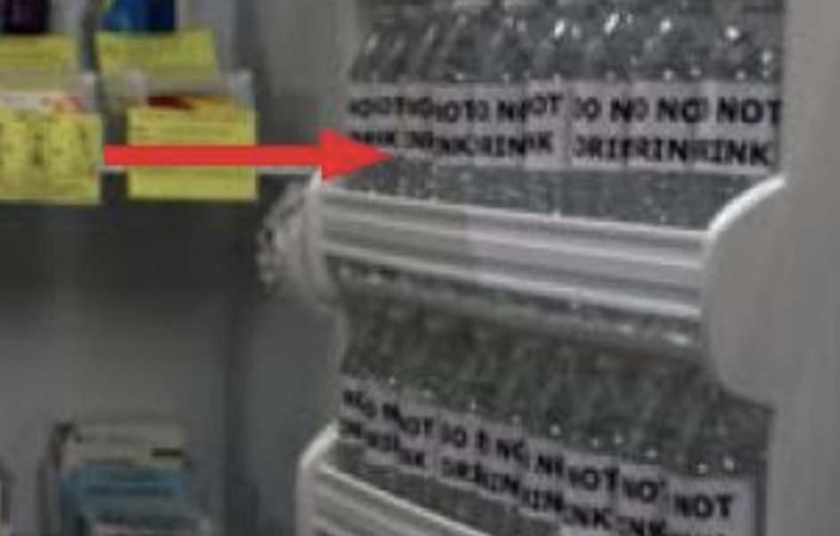
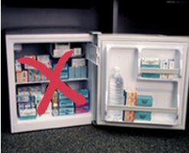
Mock Survey – Refrigerated Medications
No medications in the door of the refrigerator
Use water bottles to take up dead space
https://www.cdc.gov/vaccines/hcp/admin/storage/toolkit/storage-handling-toolkit.pdf

Slide 46
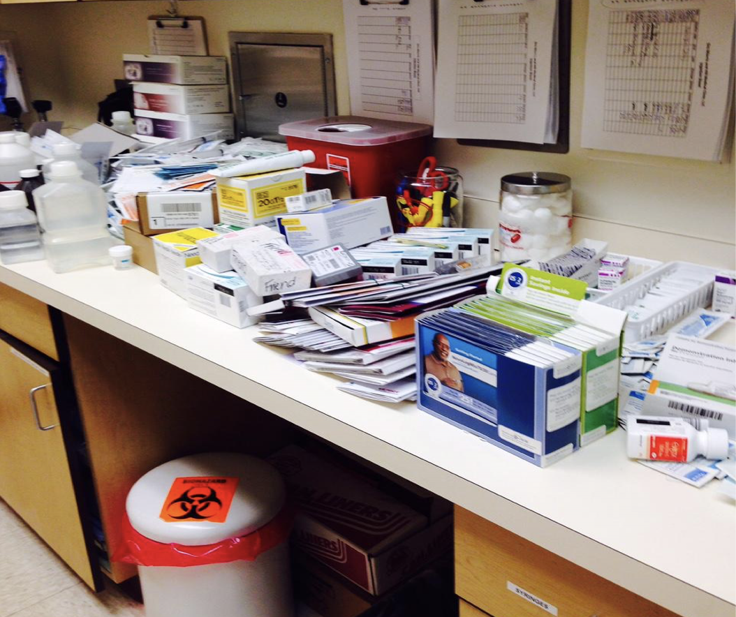
Mock Survey – Supplies
Telfa, gloves, peroxide, electrodes, needles
Iodoform gauze, etc.
Check anything with a date!
The red sharp container is not acceptable.

Slide 47
Infection Prevention
Clean to Dirty Process to Avoid Cross Contamination

Slide 48
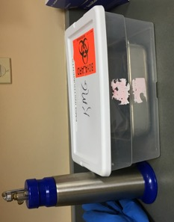
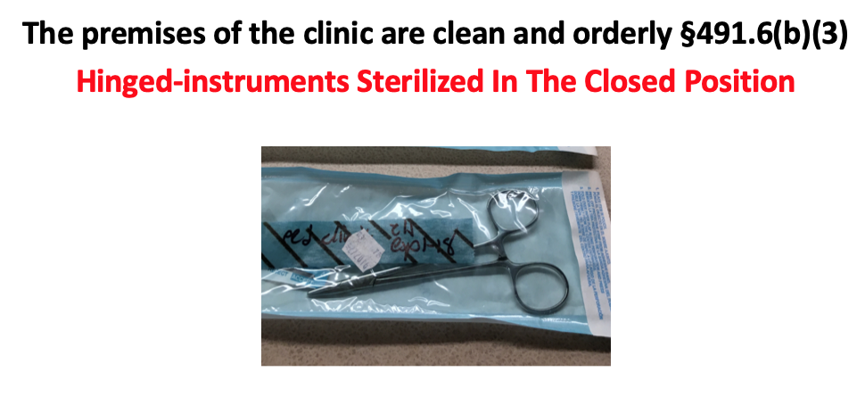
Instruments
Sterilizing instruments in the clinic.
- OR -
Accepting sterilized instruments from the hospital.

Slide 49
Table Top Sterilizers
Tabletop Sterilizers
OH My!

Slide 50
Mock Survey – Infection Prevention
Disposable Instrumentation is the easiest way to be compliant with recommended practices from nationally recognized organizations.
Once and done!

Slide 51


HIPPA
Visible PHI
Computer Time Outs
Cloud Storage
Passwords
Social Media

Slide 52
Chart Review – 2 Types
Physician oversight If the State silent, you choose a number and put it in your policy
  Even when the NP has autonomy
  Have a review log to prove the number of reviews matches your policy.
Quality Improvement to feed into your Biennial Evaluation.
  Maintain log and keep those charts for inclusion in your evaluation
  Remember to add a closed record on occasion.

Slide 53
Mock Survey – Staff Responsibilities
At least one PA or NP must be an employee of the clinic.
A Physician, NP, PA, certified nurse-midwife, clinical social worker, or clinical psychologist is available to furnish patient care services at all times the clinic operates.
This means no patient gets out of the waiting room unless there is a provider in the building.
In addition, for RHCs, an NP, PA, or certified nurse-midwife Is available to furnish patient care services at least 50 percent of the time the RHC operates.

Slide 54
Staff Responsibilities
Physician responsibilities.
The physician performs the following:
In conjunction with the PA or NP participates in developing, executing, and periodically reviewing the clinic’s written policies and the services provided to Federal program patients.
Periodically reviews the clinic’s patient records, provides medical orders, and provides medical care services to the patients of the clinic
What does your review policy say? How many charts per month or quarter per NP or PA?

Slide 55
Staff Responsibilities
Physician assistant and nurse practitioner responsibilities.
Practices in accord with clinic policies
Participate with a physician in a periodic review of the patients' records.
Sign the policy binder review page

Slide 56
Provision of Services
The clinic is primarily engaged in providing outpatient health services...
Means 51% RHC services
“The services of these practitioners are those commonly furnished in a physician’s office or at the entry point into the health care delivery system. These services include taking complete medical histories, performing complete physical examinations, assessments of health status, routine lab tests, diagnosis and treatment for common acute and chronic health problems and medical conditions, immunization programs and family planning.”
Appendix G

Slide 57

Mock Survey – Lab
6 Required tests in the Clinic:
  Chemical examination of urine by stick or tablet method
  Hemoglobin or Hematocrit
  Blood Glucose
  Examination of stool specimens for occult blood
  Pregnancy Test
  Primary Culturing for transmittal to a certified lab
Clinic follows all Manufacturer’s IFU for equipment and supplies.
Check for outdated supplies!!

Slide 58

Lab
Clinic must have the ability to do all 6 required tests.
Most common one missing is Hemoglobin or Hematocrit for Provider Based clinics.
All reagents, strips, controls, etc., must be in date.
CLIA Certificate is current and posted.
CLIA has correct clinic name, address and lab director

Slide 59
Patient Care Policies
The policies are developed with the advice of a group of professional personnel that includes one or more physicians and one or more PAs or NPs.
****At least one member is not a member of the clinic or center staff.

Slide 60
Patient care policies
The policies include:
A description of the services the clinic furnishes directly and those furnished through agreement or arrangement.
Guidelines for the medical management of health problems which include the conditions requiring medical consultation and/or patient referral,
The maintenance of health care records, and procedures for the periodic review and evaluation of the services furnished by the clinic.
Rules for the storage, handling, and administration of drugs and biologicals.
These policies are reviewed at least biennially by the group of professional personnel required. (Medical Director, NP/PA and outside person)

Slide 61
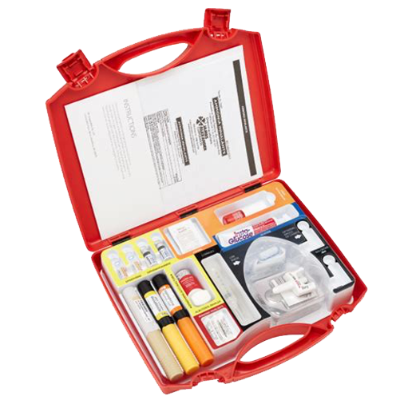
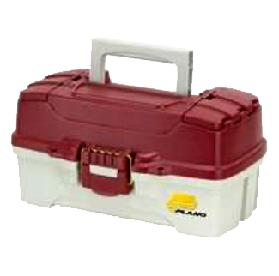
Mock Survey – Emergency Services
An RHC must have those drugs and biologicals that are necessary to provide its medical emergency procedures to common life-threatening injuries and acute illnesses.
The RHC should have written policies and procedures for determining what drugs/biologicals are stored to provide emergency services.
Policies and procedures should also reflect the process for determining which drugs/biologicals to store, including who is responsible for making the determination.
They should also be able to provide a complete list of which drugs/biologicals are stored and in what quantities.

Slide 62
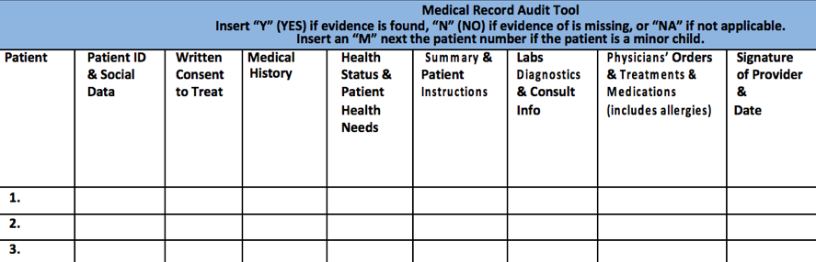
Mock Survey – Medical Record Review

Slide 63
Biennial Evaluation
A review of your program every two years:
Must include review of:
  Utilization of clinic services, including at least the number of patients served and the volume of services;
  A representative sample of both active and closed clinical records; and
  The clinic's health care policies.

Slide 64
Biennial Evaluation
Why do this?
To determine whether:
Utilization of services was appropriate;
The established policies were followed; and
Any changes are needed.
The clinic considers the findings of the evaluation and takes corrective action if necessary.

Slide 65

Emergency Preparedness

Slide 66
Mock Survey – EP
Hazards assessment must be documented and a plan for each hazard identified.
Communication plan is complete including name and contact information for all staff and local, regional, state and federal emergency staff.
Must address volunteers
Address how refrigerated medications are handled in a power outage.
Training: Have a log to document the staff trained, signed and dated. (every 2 years)

Slide 67
Testing
Must participate in a full-scale exercise that is community-based or when not accessible, an individual, facility-based exercise.
If one year is full-scale exercise, then the other can be tabletop.
Every other year for full-scale or at least a clinic-based exercise.
Analyze the clinic’s response to exercise or activation of plan.
Your exercise or tabletop must be one of your hazard assessments

Slide 68
Community Emergency Response Team
The Community Emergency Response Team (CERT) program educates volunteers about disaster preparedness for the hazards that may impact their area and trains them in basic disaster response skills, such as fire safety, light search and rescue, team organization, and disaster medical operations.
CERT offers a consistent, nationwide approach to volunteer training and organization that professional responders can rely on during disaster situations, which allows them to focus on more complex tasks. Through CERT, the capabilities to prepare for, respond to and recover from disasters is built and enhanced.
https://www.ready.gov/cert

Slide 69
Mock Survey – Staff Interviews
Can staff articulate procedures they are responsible for?
If asked, “What do you have to do to get fired here?” Do they know the answer?
If asked, “What do you do if you have to evacuate the clinic?” Do they know the protocol or have easy access to the emergency preparedness information for evacuation procedures?
Staff should be prepared to answer questions related to their job responsibilities, clinic policies and emergency protocols.

Slide 70
What to Expect on Survey Day
RHC surveys are unannounced so be prepared!
Most surveys take between 6 to 9 hours per clinic depending on the size and number of providers/staff. If multiple clinics are being surveyed at the same time, the surveyor or survey team will inform you upon arrival of the number of days they expect to be onsite.
Remember that having easy access to policies, personnel records and medical records as they are requested will allow the surveyor to proceed without delay.
Once complete, the surveyor will conduct an exit interview to discuss the survey findings.

Slide 71

QUESTIONS?
        Kate Hill, RN, VP Clinic Division
        215-654-9110
        khill@thecomplianceteam.org

