Slide 1





2021
The case for the COVID Medical Home.
2021 Ohio Rural Health Conference

Slide 2

Learning Objectives
Fall of 2021?
Implementing the Model with COVID
A new way to move forward

Slide 3
Clinic Managers Getting Ready for Fall 2021
Do you know what the vaccination rate is in your town or county?
What efforts have been made to increase vaccinations in your community?
Do you know what the major barriers are to being vaccinated?
What other organizations are available to collaborate with the clinic?
What works and what doesn’t?
What staff is available to help?
What financial resources are available?
Are you aware that a COVID related hire is a possible use of these funds?

Slide 4
Getting Ready for Fall 2021
Independents: can you collaborate with your local hospital if there is a surge?
PB clinics, what is your plan to collaborate with the hospital for a surge?
What operational changes can be made:
Telemedicine
Texting systems
Physical space changes
Extended hours
What staff adjustments can you make?

Slide 5
Your Grant Money
NARHC-News Vaccine Confidence Grants Page 1 of 1 7/22/2021 @ 3:27:00 PM Post 1 of 8 Add Your Response Contributor: Sarah Hohman, National Association of Rural Health Clinics Notices of Award began to go out today for the RHC Vaccine Confidence Grants. More than 1,980 clinics will receive approximately $49,500. It may take up to a day for the system to process awards given the large number, but notifications are being sent to the email contact listed in the grant application. Congratulations to those of you that received the grant and we look forward to working with you as you use this funding to combat vaccine hesitancy within your communities! Just a reminder that this funding will not automatically appear in RHC bank accounts, but instead will be accessed through a sub-account in the Payment Management System (PMS). More details on this can be found in individual NOAs and resources on overall grants management are coming soon! We hope that RHCs will utilize this discussion thread to share their plans for use of the Vaccine Confidence grant funding, to ask questions, and to collaborate on ideas.

Slide 6
Why COVID Home and Why Now?
Team based care is always a good idea
HRSA is wanting you to use the funds for the current issues
COVID Home is one way to use it.

Slide 7
Important Point to remember.
You won’t do this alone!

Slide 8
The TCT Call Advisors will:
Schedule an orientation call for key staff
Walk you through the standards and requirements of the program
Answer all your questions
Provide templates, webinars and other useful resources
Help with processes and monitor progress
Create an open book self survey to prep for survey day
Support you and your staff every step of the way start to finish

Slide 9
Principals:
Comprehensive Care
  Develop plans for increasing vaccination uptake in the community
Patient Centered
  Concern over patients who don’t have transportation to get vaccinated
Coordinated Care
  Involve the whole clinic team to encourage each patient for vaccination
Accessible Services
  Extended hours and locations for vaccination sites
Quality and Safety
  Follow all appropriate recommendations for vaccine storage and handling.

Slide 10
Basic Standards
A team-based approach for patient-centered coordinated care.
A Patient Centered Health Improvement Plan™ (PCHIP™) for those patients whose care needs to be managed and coordinated.
Provide patient education and self-management tools to patients and their family/caregivers.
Provide advanced access and Community Resources.
Provide patient follow-up.
Meets the healthcare needs of patients when closed.
Take steps to reduce unnecessary utilization of services.
Ensure patient health records are complete.

Slide 11
Why Add COVID or Emerging Infectious Diseases
The Department of Health and Human Services (HHS) announced nearly $1B from the American Rescue Plan Act of 2021 will be available to strengthen the COVID-19 response efforts and increase vaccinations in rural communities.
The Health Resources and Services Administration (HRSA), a part of HHS, will increase the number of vaccines sent to rural communities, expand testing and other COVID-19 prevention services, and work to increase vaccine confidence by empowering health care providers with additional funding for outreach efforts in underserved areas.
Because RHCs and Small Rural Hospitals are trusted messengers in rural communities and provide consistent, fact-based public health messaging, the COVID-19 Programs will help rural communities make informed decisions about their health and COVID-19. This will improve health care in rural areas and reinforce basic messages about prevention of COVID-19 and other infectious diseases.

Slide 12
Why Add COVID or Emerging Infectious Diseases
Your projects must be COVID related.
Hence adding a COVID module to PCMH is the perfect solution.
It’s a perfect response to meet rural community public health needs,
Use these funds to strengthen your primary care delivery system through COVID prevention, mitigation and confidence.
We’ve integrated proprietary COVID-related standards, rural telemedicine best practices to the PCMH model, a redesigned monitoring function which will reduce staff time dedicated to data collection and reporting.

Slide 13
Twelve New COVID/EID Standards
EID 1.0 Scope of service documentation
EID 2.0 Policies and procedures, staff training
EID 3.0 Staffing needs based on disease prevalence
EID 4.0 Point of care testing process
EID 5.0 Quality control plan for testing
EID 6.0 Patient education on testing and mitigation
EID 7.0 Vaccination program
EID 8.0 Policies and procedures for vaccine administration
EID 9.0 Storage and handling of vaccines
EID 10.0 Infection control policy
EID 11.0 Community Mitigation strategies
EID 12.0 Safe work environment per current OSHA regs

Slide 14
EID 1.0
Written description of the scope of services offered and the ability to test and vaccinate for infectious diseases.
Evidence of Compliance
The organization has written information available to the public regarding testing and vaccinations to include:
  Hours of availability and
  Contact information.
  Infectious disease management services such as testing, vaccinations, treatment, mitigation and contract tracing

Slide 15
EID 2.0
A process for entry, receipt and disposition of orders for point of care. COVIID-19 testing.
The organization has a process in place for entering, receiving, tracking and retaining orders.
If the organization cannot fulfill the order, the organization will offer referral assistance.

Slide 16
EID 3.0
The organization has a Quality Control plan for testing.
The organization has written quality control policies and procedures. The content includes:
  A record of tests performed.
  Periodic review of sample collection, labeling and documentation.
  An annual review of the quality control policy by appropriate personnel
The policy and procedures are reviewed and updated on an annual basis and revised as necessary.

Slide 17
EID 4.0
The organization instructs the patient on testing and collection procedures for Emerging Infectious Diseases
The organization has a process for patient instruction prior to testing.
The staff is trained on what needs to be covered and training is documented in their personnel file.
Prior to each test, the organization performs an assessment that includes at a minimum:
  Signs and Symptoms
  Vital signs as applicable
The results of assessment match the criteria established for performing the specific test.

Slide 18
EID 5.0
All testing equipment and supplies are stored and tested according to manufacturer guidelines for use including a process for handling hazards, defects or recalls.
All items (e.g., controls, chemicals, swab kits) containing expiration dates stored, and destroyed according to manufacturer guidelines.
The staff is trained on equipment requirements and training is documented in their personnel file.

Slide 19
EID 6.0
The organization establishes a vaccination program for staff and patients considering or receiving an emerging infectious disease vaccinations.
The organization educates staff and patients at a minimum on the following:
  Vaccines.
  Preventive Measures.
  Treatment.
  Transmission.
  Impact of infectious diseases like COVID 19.
The organization provide staff and patients educational materials upon request (i.e., summary, written instructions).
The staff is trained on vaccine administration and training is documented in their personnel file.

Slide 20
EID 7.0
The organization has a Quality Control Plan for the Vaccination Program.
The organization has a written quality control policies and procedures.
The content, includes:
  A record of the vaccinations performed.
The organization collects and reviews data on the reasons given by staff and patients for declining an infectious disease vaccination (i.e., COVID-19).
The organization analyzes this data annually to determine strategies that may be utilized to improve the vaccination rate.
A Quality Improvement plan that increases community vaccinations to reduce vaccine hesitancy.
The organization performs an annual review of the quality control plan by appropriate personnel.

Slide 21
EID 8.0
Vaccines are stored and handled in accordance with manufacturer guidelines.
The organization develops and maintains written vaccine storage and handling policies and procedures that include:
  Ordering and accepting vaccine deliveries.
  Managing inventory.
  Storing each vaccine and diluent.
  Handling vaccines prior to administration.
  Disposal of vaccines and supplies.
All staff members are trained on vaccine storage and handling training is documented in their personnel file.

Slide 22
EID 9.0
The Organization has a process to implement community mitigation strategies for Emerging Infectious Diseases.
The organization has a process to work with community members (i.e., community-based organizations such as healthcare coalitions, faith-based organizations, community centers, local government, etc.) to develop and implement mitigation strategies. These strategies include but are not limited to:
  A process to build relationships and encourage community engagement. Some common forms of community engagement could include open houses, town halls, surveys, health fairs and focus groups.
  A communication plan to keep the community informed (i.e., signage for point of entry to clinic, handouts, answering service message, social media).
  A process that enables the organization to hear the communities’ questions and concerns (i.e. Q&A portal, hotline, etc).

Slide 23
EID 9.0
The Organization has a process to implement community mitigation strategies for Emerging Infectious Diseases.
  A process to minimize the negative effects of these strategies
  (i.e. social distancing, masks, quarantine).
  A process to emphasize individual responsibility for implementing recommended actions (i.e., call the organization prior to visit if you’re sick, masks, hand washing, social distancing).
  A process to collaborate with businesses, schools, and other settings to implement appropriate actions
  A process to minimize disruptions to daily life while ensuring access to health care.
Mitigation Strategies are included the organizations emergency preparedness plan and reviewed at a minimum biennially.

Slide 24
Quality Data Ideas
Readmissions (yes in collaboration with hospital)
Disease Management
  HTN
  Diabetes
  CHF
  Asthma
  BMI
Health literacy
Medication management/reconciliation
Immunizations
MWV
Health screenings
Patient compliance/adherence to treatment

Slide 25





Data Fatigue
Search
Sort
Report
Analyze
Rinse and Repeat
The typical reporting process leaves little time for actual performance improvement
Slide 25

Slide 26
Data Management Summary
Current
Future
Staff disconnected with performance data
Staff works on projects as teams
Reporting is a tedious administrative task
Reporting happens organically
Limited change nor improvement
Improvement is built into the work
Not much fun or joy, to be honest
Fun = Making a difference
Slide 26

Slide 27




Design Criteria for Data Management
We looked for a new way of managing RHC data that met the following criteria:
Saves Time
Action Oriented
Collaborative
Teaches
Slide 27

Slide 28




How Do We Do This?
Stop
Determine the most important metrics to track and stop tracking all the others – this will leave time for performance improvement
Prioritize
Work as a team to identify and put into rank order the most impactful processes that need to be addressed and improved
Act
Just doing one initiative at a time, start a PDSA cycle that is well-documented, simple and reasonable for the team
Learn
TCT-curated PDSA templates located in the LAKE public library provide ideas and inspiration for your project selection

Slide 29

How Do We Do This?
A secure web application that enables RHCs to create, manage and document performance improvement initiatives using the PDSA methodology
Slide 29

Slide 30
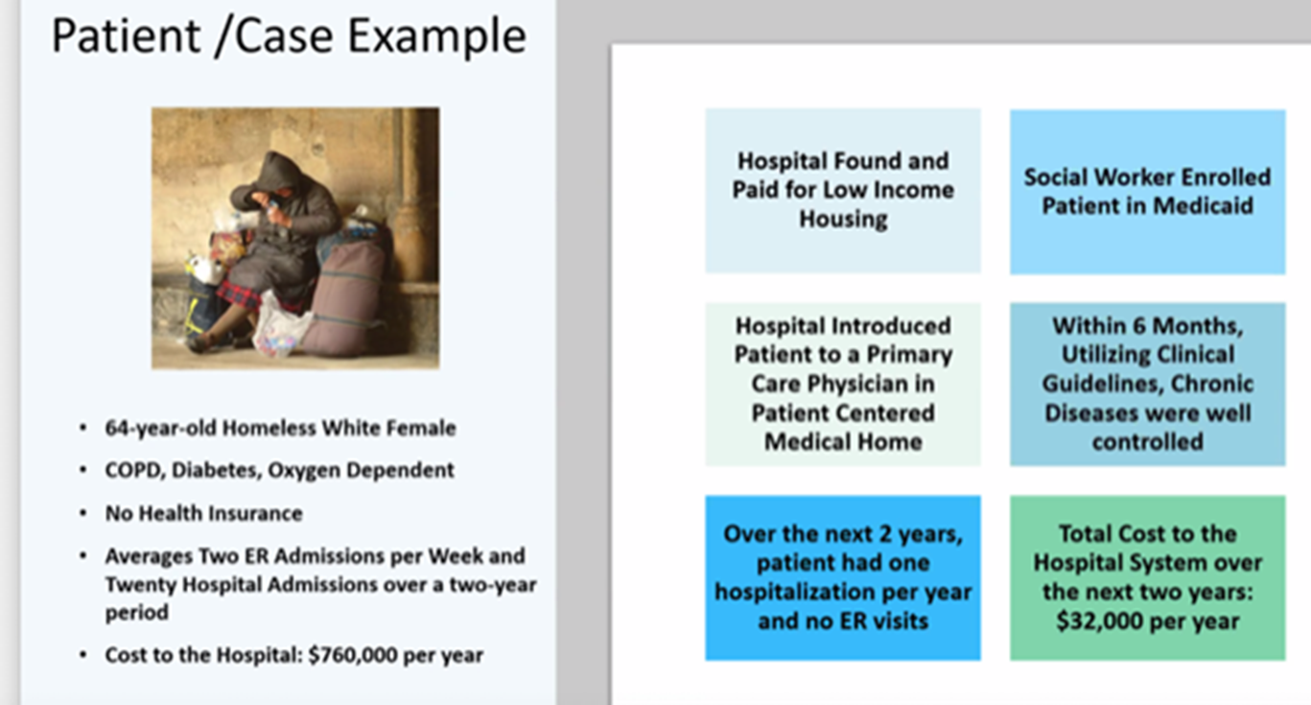
Great Results:
You can have an even greater impact on improving the quality of your patient’s lives!
Communities across the country including many in need more Patient Centered Medical Homes.
Leading edge patient centered care begins when you see yourself playing a part in
Great Results!

Slide 31
Ideas will be plentiful in LAKE

Slide 32
Ideas will be plentiful in LAKE
Create a culture of vaccination
Patient Communication Strategies*
Provide information about vaccine preventable diseases at the beginning of every visit.
Enroll patients in electronic health portal.
Train staff to discuss vaccines during routine processes such as vital signs.
Discuss the serious nature of vaccine preventable diseases.
Promote 100% vaccination rates among staff to set a good example.
Use on-hold messages, poster, fliers, electronic message board, website posting, and social media to promote vaccination.
Reach out by email, phone, text, mail, health portal etc. to recommend vaccines that are due and about arrival of influenza vaccine supplies.
* University of Pittsburgh

Slide 33
Ideas will be plentiful in LAKE
Motivation Strategies*
Create a chart to track progress. Set an improvement goal and regularly track progress (e.g., daily or weekly). Post the graph of your progress in a prominent location and update it regularly.
Provide ongoing feedback to staff on vaccination progress at staff meetings or through other forms of communications.
Create a competitive challenge for the most vaccinations given among your staff.
Provide rewards for successful results to create a fun-spirited environment.
* University of Pittsburgh

Slide 34
Ideas will be plentiful in LAKE
Change the way we talk about ‘vaccine hesitancy’
This phrase is easily misinterpreted. It can over emphasize the threat posed by low vaccine confidence and distract from larger issues such as access to immunization.
Instead, it’s important to be specific about the different barriers that stop people getting vaccinated and what can be done to remove them, avoiding tactics like myth-busting and focusing on amplifying positive and accurate information.

Slide 35
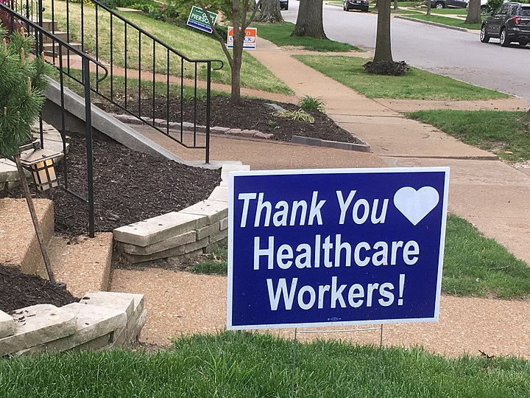
Thank You For All You Do!

Slide 36

QUESTIONS?
        Kate Hill, RN, VP Clinic Division
        (o) 215-654-9110 ext.1021
        khill@thecomplianceteam.org
        Greg Wolf, President, Lilypad, LLC
        Gwolf@lilypad207.com

