Slide 1
The Rural Health Landscape
Alan Morgan
CEO
August 2021

Slide 2

Our mission is to provide leadership on rural health issues.
Notes:
NRHA is a national nonprofit membership organization with more than 21,000 members, made up of a diverse collection of individuals and organizations with the common goal of ensuring all rural communities have access to quality, affordable health care.
Our mission is to provide leadership on rural health issues.

Slide 3
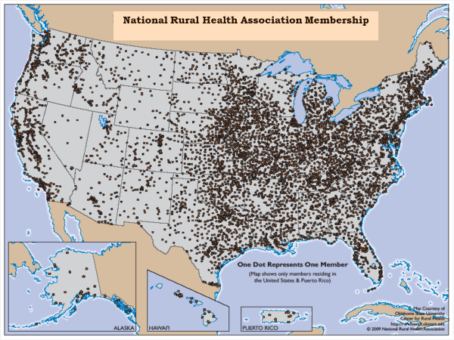

Slide 4

Destination NRHA
Plan now to attend these 2021-22 events.
Rural Health Clinic Conference Sept. 21-22 Kansas City, MO
Critical Access Hospital Conference Sept. 22-24 Kansas City, MO
Policy Institute Feb. 8-10, 2022 Washington, DC
Annual Conference May 10-13, 2022 Albuquerque, NM
Rural Hospital Innovation Summit May 10-13, 2022 Albuquerque, NM
Visit RuralHealthWeb.org
for details and discounts.

Slide 5

2021:
An unprecedented year (continued)
Unprecedented challenges to an already fragile rural health safety net
Impact of the pandemic today and tomorrow
Unprecedented NRHA advocacy and funding victories
Rural health inequality and racial injustice focus
New 117th Congress and Biden Administration
Innovation continues

Slide 6
The Rural Landscape

Slide 7
Fragile Rural Health Safety Net Pre-COVID-19
Vulnerable populations
Systemic workforce shortages
Scattered populations with inherent access to care issues
Limited resources for providers
Inadequate Medicare, Medicaid and private insurance coverage
Lack of Medicaid expansion and high uninsured populations
Rural provider closures

Slide 8
Rural Hospital Closures
AK
VT
NH
ME
WA
MT
ND
SD
MN
WI
MI
NY
CT
MA
OR
ID
WY
NE
IA
IL
IN
OH
PA
NJ
RI
CA
NV
UT
CO
KS
MO
KY
WV
MD
DE
DC
AZ
NM
OK
AR
TN
VA
NC
138 Closures
as of August 9, 2021
HI
TX
LA
MS
AL
GA
SC
FL
Number of rural hospitals closed since 2010.
0
1-2
3
4
5-8
10+
Source: Sheps Center, UNC
Medicaid Expansion State (implemented as of 12/31/19)
Source: The Chartis Center for Rural Health, 2021.

Slide 9
Rural Hospitals Vulnerable to Closure
AK
VT
NH
ME
WA
MT
ND
SD
MN
WI
MI
NY
CT
MA
OR
ID
WY
NE
IA
IL
IN
OH
PA
NJ
RI
CA
NV
UT
CO
KS
MO
KY
WV
MD
DE
DC
AZ
NM
OK
AR
TN
VA
NC
453 At-Risk
as of May 3, 2021
HI
TX
LA
MS
AL
GA
SC
FL
0
1%—9%
10%—15%
16%—20%
21%—25%
26%—30%
31%—40%
41%+
Medicaid Expansion State (implemented as of 12/31/19)
Percentage of State Rural Hospitals Determined to be Vulnerable
Source: The Chartis Center for Rural Health, 2021.

Slide 10
Rural Population Disparity
Uninsured Adults
AK
VT
NH
ME
WA
MT
ND
SD
MN
WI
MI
NY
CT
MA
OR
ID
WY
NE
IA
IL
IN
OH
PA
NJ
RI
CA
NV
UT
CO
KS
MO
KY
WV
MD
DE
DC
AZ
NM
OK
AR
TN
VA
NC
HI
TX
LA
MS
AL
GA
SC
FL
Percentage of population served by rural hospitals that is adults under age 65 without health insurance.
0-5%
6%-10%
11%-15%
16%-20%
21%-25%
>25%
Medicaid Expansion State (implemented as of 12/31/19)
Source: The Chartis Center for Rural Health, 2021.

Slide 11


Population Health Disparity
Percentile Ranking
Rural
69
61
60
63
62
40
40
33
33
32
Urban
Over 65
Premature Death
Uninsured Children
Access to
Primary Care
Access to
Mental Health
Source: The Chartis Center for Rural Health, 2021.

Slide 12
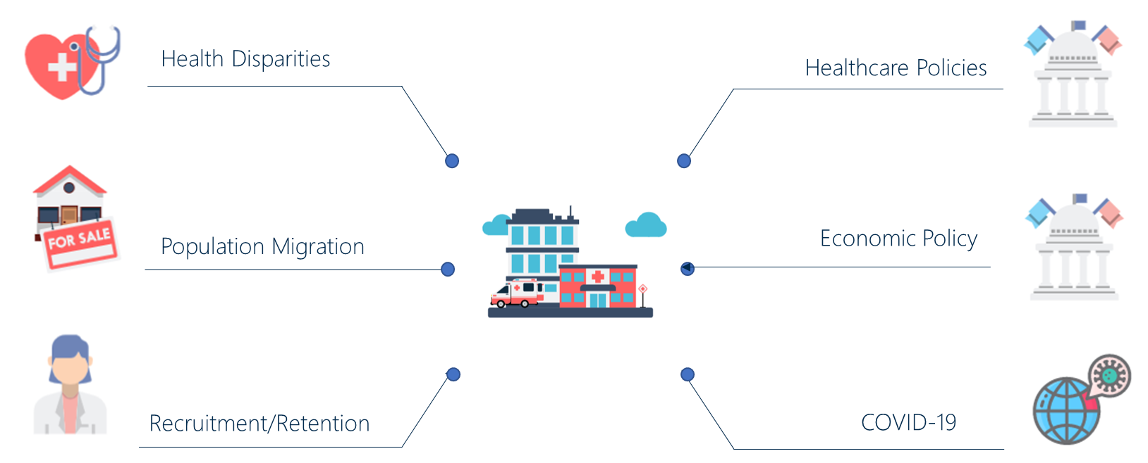
Rural Hospitals: Convergence of Multiple
Pressure Points

Slide 13
Addressing COVID-19

Slide 14
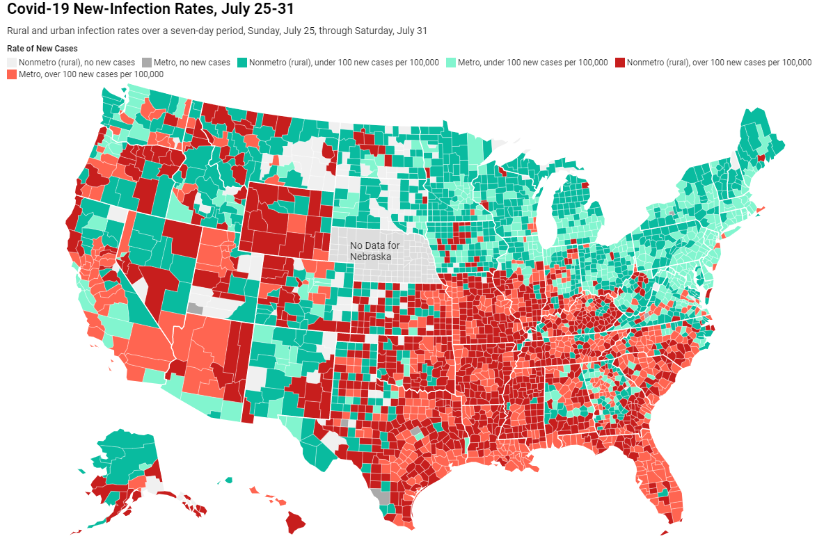
COVID-19 New Infection Rates
July 25-31, 2021
Source: Daily Yonder COVID-19 Dashboard, 2021.
Notes:
Analyzes new COVID-19 infection rates between April 25-May 1, 2021, finding a decline in the number of new infections but an increase in COVID-related deaths. Includes an interactive map of all U.S. counties' infection rates. Details the distribution of rural COVID-19 hotspots and rural vaccination efforts across the country.

Slide 15
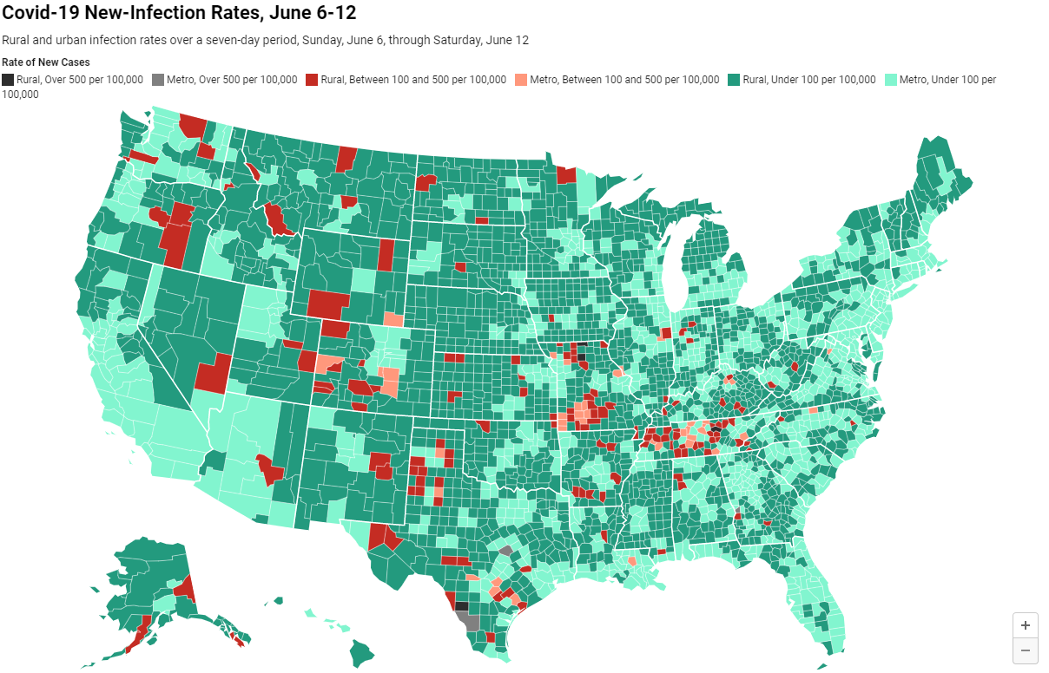
COVID-19 New Infection Rates
June6-12, 2021
Source: Daily Yonder COVID-19 Dashboard, 2021.
Notes:
Analyzes new COVID-19 infection rates between April 25-May 1, 2021, finding a decline in the number of new infections but an increase in COVID-related deaths. Includes an interactive map of all U.S. counties' infection rates. Details the distribution of rural COVID-19 hotspots and rural vaccination efforts across the country.

Slide 16
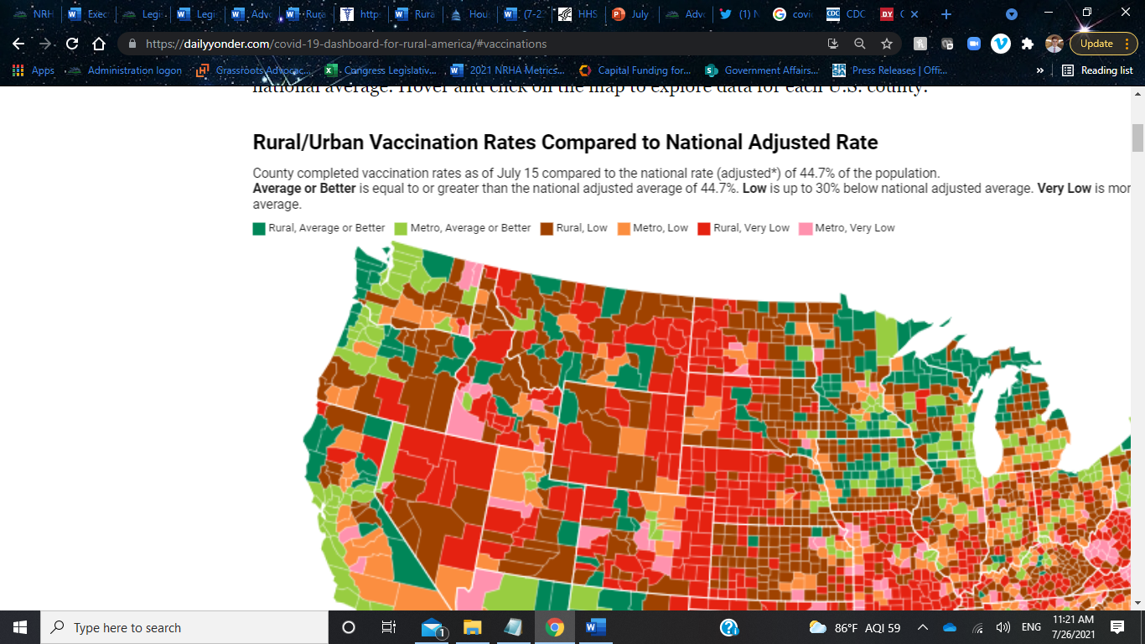
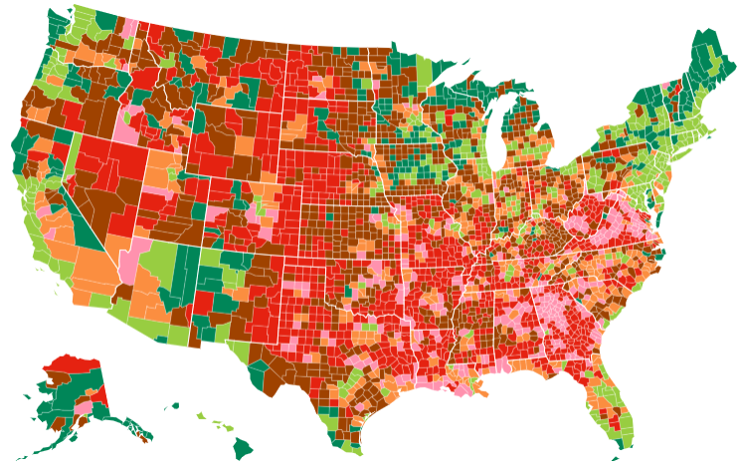
COVID-19 Rural Vaccination Rates
As of July 15, 2021
Source:. CDC and selceted state departments of health
https://dailyyonder.com/covid-19-dashboard-for-rural-america/
Notes:
Rural/Urban Vaccination Rates Compared to National Adjusted Rate
County completed vaccination rates as of July 15 compared to the national rate (adjusted*) of 44.7% of the population.
Average or Better is equal to or greater than the national adjusted average of 44.7%. Low is up to 30% below national adjusted average. Very Low is more than 30% below the national adjusted average.

Slide 17
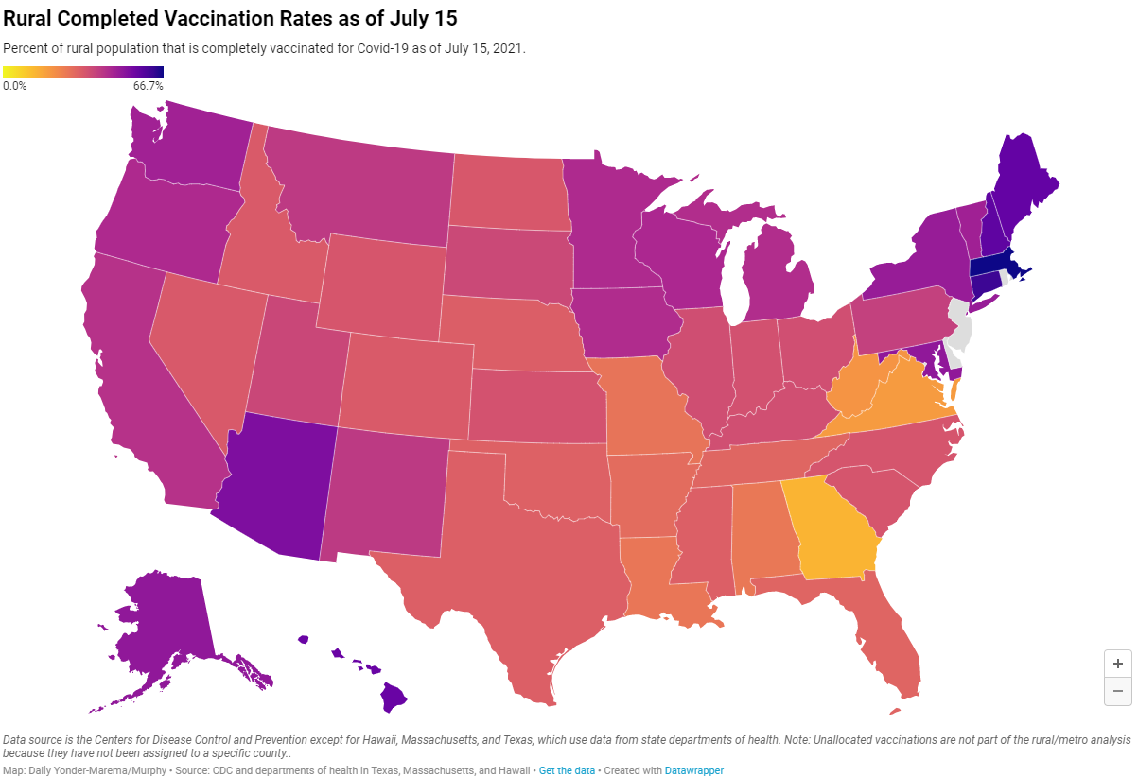
COVID-19 Rural Vaccination Rates
As of July 15, 2021
Source:. CDC and selceted state departments of health
https://dailyyonder.com/covid-19-dashboard-for-rural-america/
Notes:
Rural/Urban Vaccination Rates Compared to National Adjusted Rate
County completed vaccination rates as of July 15 compared to the national rate (adjusted*) of 44.7% of the population.
Average or Better is equal to or greater than the national adjusted average of 44.7%. Low is up to 30% below national adjusted average. Very Low is more than 30% below the national adjusted average.

Slide 18
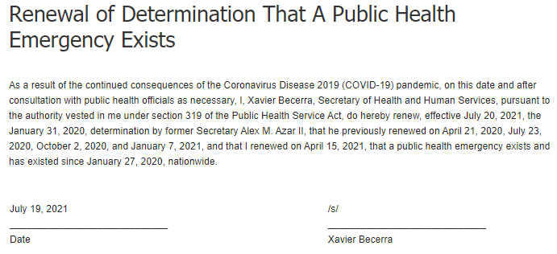
HHS Secretary Extends PHE &
Distributes COVID-19 Funds
$100 million for rural health clinics (RHC) for vaccine outreach
$398 million for small rural hospitals for COVID-19 testing and mitigation
$103 million to reduce burnout & promote mental health for the health workforce
$144 million for HRSA Health Center Program look-alikes to respond to and mitigate the spread of COVID-19
Notes:
U.S. Department of Health and Human Services (HHS) Secretary Becerra has renewed the determination that the COVID-19 public health emergency (PHE) exists. This decision extends the PHE another 90 days, or until October 18, 2021, and allows the Centers for Medicare and Medicaid Services’ (CMS) 1135 waivers, including those that allow rural providers to furnish telehealth services, to continue. HHS has reviewed state Medicaid telehealth policies before and during the COVID-19 pandemic and found that while as many as 47 state Medicaid programs were paying for some form of care via telehealth before the COVID-19 Public Health Emergency, data show that services increased more than 20-fold between February and April 2020. Rates declined after April but remained far above pre-pandemic level. NRHA is continuing to advocate that Congress make permanent provisions that allow rural providers to offer telehealth services to their patients.
Rural Health Clinics Receive $100 Million for COVID-19 Vaccine Outreach (from FORHP Announcements)
This week, HHS announced that funds will go to more than 1,980 Rural Health Clinics (RHCs) to help residents understand the benefits of vaccination against COVID-19 and other infectious diseases. The funds will be administered by the Health Resources and Services Administration (HRSA) through the Rural Health Clinic Vaccine Confidence Program.
HHS Provides $398 Million to Small Rural Hospitals for COVID-19 Testing and Mitigation and other COVID-19 related resources (from HRSA)
Thanks to the American Rescue Plan, the U.S. Department of Health and Human Services (HHS) through HRSA provided $398 million in funding through the Small Rural Hospital Improvement Program (SHIP) to 1,540 small rural hospitals for COVID-19 testing and mitigation.
The Department also announced, “The availability of an estimated $103 million in American Rescue Plan funding over a three-year period to reduce burnout and promote mental health among the health workforce. These investments, which take into particular consideration the needs of rural and medically underserved communities, will help health care organizations establish a culture of wellness among the health and public safety workforce and will support training efforts that build resiliency for those at the beginning of their health careers (HHS press release).”
Additionally, the Department announced it has, “Awarded nearly $144 million in American Rescue Plan funding to 102 HRSA Health Center Program look-alikes (LALs) to respond to and mitigate the spread of COVID-19, and enhance health care services and infrastructure in communities across the country. LALs are community-based health care providers that provide essential primary health care services to underserved communities and vulnerable populations but do not otherwise receive HRSA Health Center Program funding (HHS press release).”

Slide 19

Rural Vaccine Confidence:
Key Messages
Sharing THE FACTS: safe, effective, free of charge, development
Protecting LOCAL BUSINESSES while strengthening economy: local healthcare works, keeping workers safe, stay open
Protecting YOURSELF: hospitalizations/death, personal choice
NRHA: COVID-19 Vaccine Talking Points
Notes:
In a recent MMWR, the Centers for Disease Control and Prevention (CDC) collected data on vaccine doses administered across the rural-urban continuum and found that coverage was lower overall, among all age groups, and among men and women in rural compared with urban counties. They found that as of April 10, a lower percentage of rural adults had received a COVID-19 vaccine compared to urban adults – a difference of about ~7% within their study. To address lagging rural vaccination rates, NRHA is communicating to the administration and external partners the need for rural-appropriate messaging and stakeholder engagement. The factors that motivate rural Americans to get vaccinated are often different than those of their urban counterparts, and thus, the messages rural community leaders share should be different. NRHA believes that to increase rural COVID-19 vaccine confidence and uptake, it is important we develop a local approach that empowers and encourages trusted community leaders to share clear, concise, and often personal messages about vaccine safety, efficacy, and social impact.

Slide 20
NRHA COVID-19 Outreach Toolkit
Objectives
Promote the benefit of COVID-19 vaccination in rural America
Stakeholders
Rural Healthcare Leaders: hospitals, outpatient clinics, community health workers, public health officials
Features
Talking points for community leaders
Increase rural residents’ confidence in the COVID-19 vaccines
Empower rural leadership from three key sectors to support vaccination activities in their communities
Fillable templates including op-eds, posters, social media, PSAs
Community guides and assessments
FAQs, Fact Sheets
Data and survey findings
Rural Faith Leaders
Rural Agriculture Leaders
Notes:
This plan leverages existing, and identifies new, outreach strategies with NRHA members and other rural stakeholders to increase COVID-19 vaccine confidence in rural communities throughout America.
NRHA Strategy: NRHA will communicate clear, consistent information to members and other rural stakeholders about increasing COVID-19 vaccine confidence. NRHA’s main objectives are to:
Promote the benefit of COVID-19 vaccination in rural America
Increase rural residents’ confidence in the COVID-19 vaccines
Empower rural leadership from three key sectors (healthcare, faith community, and agriculture) to support vaccination activities in their communities
To achieve the above objectives, NRHA’s major activities will include:
Educating eligible rural individuals through healthcare providers, community-based organizations and directing vaccination resources and site resources for their respective State
Distributing educational materials to NRHA members, rural health providers, community-based organizations and other rural stakeholders
Providing access to training for leadership for three key sectors of rural leaders to work with their communities
Identifying and disseminating vaccine confidence best practices in rural communities
Developing targeted rural vaccine messaging in partnership with key rural stakeholders
Target Audiences: NRHA’s outreach efforts will target leaders in the rural health, faith, and agriculture arenas with the ability to reach the diversity of rural residents, including specific underserved populations. The needs of these three groups will vary and need to be packaged in a way that resonates with their activities and involvement in the vaccine effort. By targeting each of these groups, NRHA aims to have these leaders in turn reach members of their unique communities to ensure the needs of rural individuals are met. The three target audiences for NRHA’s outreach efforts are:
Rural Healthcare Leaders: This sector will focus on engaging trusted healthcare leaders as a critical partner in increasing COVID-19 vaccine confidence who will in turn reach their diverse patient populations. This includes:
Rural hospitals and outpatient clinics, of all designations, who provide health care in rural communities.
Community Health Workers who assist with language translation, connection to transportation and basic education on the pandemic to inform patients.
Public Health officials, working in conjunction with local businesses, community-based organizations, and transit groups, who are particularly effective in improving access to vaccines for rural communities of color.
Rural Faith Leaders: The decision to get vaccinated is personal one that can be driven by emotion and faith. Working with faith leaders to build trust within their congregations and diverse members of the faith community.
Rural Agriculture Leaders: Farmers and ranchers have been vocal in their support of the science of vaccines. As major leaders in the rural e

Slide 21

COVID-19 Resources
NRHA COVID-19 Vaccine Resources
NRHA COVID-19 Rural Health Provision Summary
NRHA COVID-19 Technical Assistance Center
NRHA COVID-19 Resources Page
We Can Do This COVID-19 Public Education Campaign
Notes:
NRHA has produced a summary of the rural health provisions in COVID-19 relief legislation and highlights NRHA’s priorities for COVID-19 relief for rural health care.
HHS announced additional measures to encourage vaccinations and increase vaccine confidence as part of the next phase of its COVID-19 public education campaign. The Administration is launching the COVID-19 Community Corps – a nationwide, grassroots network of local voices people know and trust to encourage Americans to get vaccinated. The Community Corps will be comprised of trusted voices in communities across the country, including NRHA, and the Administration will regularly share updated public health information and resources for them to use with their communities to help get friends, family, and followers vaccinated.
The U.S. Department of Health & Human Services also announced a national effort to help community partners promote COVID-19 vaccine confidence. The campaign includes educational materials targeted to specific audiences and seeks volunteers for the COVID-19 Community Corps. Learn more and sign up to engage in the effort at https://wecandothis.hhs.gov/.

Slide 22
Updates from the Administration

Slide 23
Biden HHS Team (Nominated & Appointed)
Xavier Becerra+ | HHS Secretary
Andrea Palm+ | HHS Deputy Secretary
Rachel Levine+ | Assistant Secretary for Health
Vivek Murthy+ | Surgeon General
Francis Collins* | Director, National Institutes of Health
Rochelle Walensky* | Director, Centers for Disease Control & Prevention
Miriam Delphin-Rittmon+ | Assistant Secretary for Mental Health & Substance Use
Chiquita Brooks-LaSure+ | Administrator, Centers for Medicare & Medicaid Services
Liz Fowler | Director, CMS Center for Innovation within CMS
Daniel Tasi | Director, CMS Medicaid & CHIP
* Represents appointed positions; +Represents Senate confirmed

Slide 24
Biden HHS Team (Acting)
Janet Woodcock | Acting Commissioner, Food & Drug Administration
Diana Espinosa | Acting Administrator, Health Resources & Services Administration
Elizabeth Fowler | Acting Director, Indian Health Service
JooYeun Chang | Acting Assistant Secretary for Children and Families
Alison Barkoff | Acting Administrator for Community Living
Xochitl Torres Small | USDA Under Secretary for Rural Development
Notes:
Senate Agriculture Committee to Hold Hearing on Under Secretary of Agriculture for Rural Development Nominee
This week, the Senate Committee on Agriculture, Nutrition, and Forestry announced it will hold a hearing (on Thurday at 10:00 a.m. ET) on President Biden’s nomination of former Representative Xochitl Torres Small to serve as Under Secretary of Agriculture for Rural Development. During the 116th Congress, NRHA had a good working relationship with former Representative Torres Small and, if confirmed, we look forward to continuing to do so in her new role.

Slide 25
Regulatory Updates
Comments on Congressional Request for Information on a public option were due July 31, 2021.
CMS is seeking comments on:
  CY 2022 Home Health Prospective Payment System (PPS) proposed rule by August 27, 2021.
  CY 2022 Physician Fee Schedule (PFS) proposed rule by September 13, 2021.
  CY 2022 Hospital Outpatient Prospective Payment System (OPPS) & Ambulatory Surgical Center (ASC) proposed rule by September 17, 2021.
Notes:
CMS Releases CY 2022 PFS Proposed Rule
This week, the Centers for Medicare and Medicaid Services (CMS) released the CY 2022 Physician Fee Schedule (PFS) proposed rule on the Federal Registry. According to the CMS fact sheet, the agency, “Is proposing to allow certain services added to the Medicare telehealth list to remain on the list to the end of December 31, 2023, so that there is a glide path to evaluate whether the services should be permanently added to the telehealth list following the COVID-19 PHE,” in addition to implementing key rural health clinic (RHC) and federally qualified health center (FQHC) provisions of the Consolidated Appropriations Act of 2021. NRHA will share draft comments with our members via NRHA Connect and submit final comments prior to the deadline (5:00 p.m. on September 13, 2021).

Slide 26
Regulatory Updates
OPM (and friends) released the Requirements Related to Surprise Billing.
OMB released their notice of decision to not increase the minimum urban area population threshold, as recommended by NRHA.
NRHA submitted comments on OSHA's Emergency Temporary Standard.
President Biden announced his "Executive Order on Promoting Competition in the American Economy," which includes provisions related to hospital price transparency and consolidations.
HHS announced immigrant populations can now access public benefits, such as Medicaid coverage.
HealthCare.gov Special Enrollment Period Enrollment Ends August 15, Summer Sprint to Coverage Toolkit.
Notes:
OMB’s Notice of Decision to Not Increase Minimum Urban Area Population Threshold
This week, the Office of Management and Budget (OMB) announced the adoption of 2020 Standards for Delineating Core Based Statistical Areas. Five of the 6 proposed changes from the Notice published on January 19, 2021 were finalized in the announcement. The 2020 standards, which reflect modest revisions to the 2010 Standards for Delineating Metropolitan and Micropolitan Statistical Areas supersede the 2010 standards. As recommended by NRHA, OMB is not increasing the minimum urban area population to qualify as an MSA from 50,000 to 100,000. Additionally, NRHA is supportive of OMB's decisions to further evaluate the impact of increasing the minimum urban area population threshold and welcomes the opportunity to help OMB understand that impact increasing the threshold may have on federal rural health programs and their beneficiaries.
OSHA Emergency Temporary Standard
NRHA submitted comments on the Occupational Safety and Health Administration (OSHA) emergency temporary standard (ETS). NRHA noted that the ETS does not reflect current science or Centers for Disease Control and Prevention (CDC) guidelines pertaining to COVID-19. As such, NRHA requested OSHA remove, or at a minimum delay implementation of, the rule from the regulatory docket. At a
President Biden Announces New Executive Order on Price Transparency and Hospital Consolidation
President Biden announced a new executive order (EO) titled, “Executive Order on Promoting Competition in the American Economy.” Within the EO, President Biden encourages the Justice Department and Federal Trade Commission (FTC) to review hospital mergers to ensure patients are not harmed by the mergers. Further, the EO directs HHS to support existing hospital price transparency rules and focus on implementing the recently passed surprise medical bill legislation. The EO also includes provisions related to prescription drug policy, with the hopes of improving competition and lowering drug prices. NRHA will continue to analyze and track implementation of the EO over the coming weeks.
minimum, NRHA requested that OSHA allow additional time for providers to comment on this detailed, overly complex, rule.
HHS Encourages States to Educate Eligible Immigrants about Medicaid Coverage (from CMS)
On Thursday, HHS, through the Centers for Medicare & Medicaid Services (CMS) issued an informational bulletin to states’ Medicaid and Children’s Health Insurance Program (CHIP) agencies reaffirming that the 2019 Public Charge Final Rule – “Inadmissibility on Public Charge Grounds” – is no longer in effect and states should encourage their eligible immigrant populations to access public benefits related to health and housing.

Slide 27
The Provider Relief Fund &
Health Care Heroes Sustainability Fund
Provider Relief Fund (PRF) Reporting Portal is now open for providers who need to report on the use of funds in Reporting Period 1.
HHS issued new PRF frequently asked questions (FAQ) on July 15.
NRHA areas of focus:
  Flexibility in reporting of capital investment timeframes
  Clarity on reporting of depreciation costs on cost reports for cost-based providers
  Allocation of the remaining PRF dollars, as well as the $8.5 billion for rural providers
Legislation introduced: Senators Bennet and Cramer and Representatives Axne and Miller-Meeks introduced the Provider Relief Fund Deadline Extension Act (S. 2493/H.R. 4735) to allow providers who received PRF awards before June 30, 2020, to have until December 31, 2021 or the PHE end, to use their funds.

Slide 28
Updates from Congress

Slide 29
COVID-19 Relief Legislation & Administrative Action: NRHA Advocacy
Public Health Emergency Declaration
Coronavirus Preparedness and Response Supplemental Appropriations Act
Families First Coronavirus Response Act
Coronavirus Aid, Relief, and Economic Security (CARES) Act
Paycheck Protection Program and Health Care Enhancement Act
Paycheck Protection Program Flexibility Act
Consolidated Appropriations Act (CAA), 2021
American Rescue Plan Act
Medicare sequestration relief
Notes:
Public Health Emergency Declaration: On January 27, 2020, former HHS Secretary Alex Azar signed a public health emergency (PHE). Through the declaration of the PHE, HHS and the Centers for Medicare and Medicaid Services (CMS) were able to utilize Section 1135 waiver authority to waive certain provisions for the duration of the PHE. These include Critical Access Hospital (CAH) length of stay requirements and certain Medicare telehealth flexibilities. Currently, the PHE is effective through April 21, 2021.
Coronavirus Preparedness and Response Supplemental Appropriations Act: On March 6, 2020, Congress passed and the President signed H.R. 6074, the Coronavirus Preparedness and Response Supplemental Appropriations Act, 2020. This bill provided $8.3 billion in emergency supplemental appropriations for fiscal year (FY) 2020 to combat the spread of COVID-19.
Families First Coronavirus Response Act: On March 18, 2020, Congress passed and the President signed H.R. 6201, the Families First Coronavirus Response Act. This act provided funding for COVID-19 testing, 14-day paid leave for American workers affected by the pandemic, and funding for SNAP benefits.
Coronavirus Aid, Relief, and Economic Security (CARES) Act: On March 27, 2020, Congress passed and the President signed H.R. 748, the Coronavirus Aid, Relief, and Economic Security (CARES) Act. This, and the American Rescue Plan Act of 2021, are the most comprehensive COVID-19 response packages. The CARES Act created programs such as the Provider Relief Fund (PRF) and the Paycheck Protection Program (PPP), as well as several flexibilities as they pertain to telehealth.
Paycheck Protection Program and Health Care Enhancement Act (PPPHCEA): On April 24, Congress passed and the President signed H.R. 266, the Paycheck Protection Program and Health Care Enhancement Act (PPPCHEA). This was a $484 billion package that provided additional funding to the PPP and PRF.
Paycheck Protection Program Flexibility Act: On June 5, 2020, Congress passed and the President signed H.R. 7010, the Paycheck Protection Program Flexibility Act of 2020. This legislation provided modifications to the PPP in relation to forgiveness of the loans and repayment timelines.
Extended PPP Authority: On July 4, 2020, Congress passed and the President signed S. 4116, a bill to extend the authority for commitments for the PPP. This bill simply extended the application timeline to August 8, 2020.
Consolidated Appropriations Act (CAA), 2021: On December 21, 2020, Congress passed, and on December 27, 2020, the President signed H.R. 133, the Consolidated Appropriations Act, 2021. This legislation provided discretionary funding for the remainder of FY 2021 and included $800 billion toward additional COVID-19 relief.
American Rescue Plan Act: On March 6, 2021, Congress passed, and on March 11, 2021, the President signed H.R.1319, the American Rescue Plan Act of 2021. This legislation provided an additional $1.9 trillion in COVID-19 relief funding.
Medicare sequestration relief and technical corrections to the provider-based rural health clinic (RHC) program: On April 13, 2021, Congress passed, and on April 14, 2021, the President signed H.R. 1868, a bill to continue relief from Medicare sequestration and to provide technical corrections to changes to the provider-based RHC program that were enacted in the CAA, 2021.

Slide 30
American Rescue Plan Act of 2021
The American Rescue Plan (ARP) Act of 2021, H.R. 1319, was signed by President Biden on March 11, 2021. Key provisions include:
  $8.5 billion for rural providers in what is called the Health Care Heroes Sustainability Fund (HCHSF)--similar to PRF;
  Over $55 billion for COVID-19 vaccine deployment, testing, tracing, and mitigation activities;
  $1 billion in funding for the National Health Service Corps and Nurse Corps Loan Repayment Program;
  Increased eligibility to the PPP for rural hospitals affiliated with a larger hospital system (application deadline moved to 5/31/21 in subsequent legislation);
  $500 million for the creation of the 'Emergency Grants for Rural Health Care' through USDA.

Slide 31
State of Infrastructure
Included in the Bipartisan Infrastructure text:
  $65 billion for broadband connectivity buildout. Significant mention of rural.
  No funding for hospital capital included.
  Medicare sequestration continued for an additional year, until 2031.
Senate will vote final passage as early as Tuesday, August 10, 2021
NRHA worked hard to amend this legislation, particularly the Medicare sequestration pay-for.
Notes:
Key Procedural Vote on Bipartisan Infrastructure Package Fails
On Wednesday, the Senate failed to proceed with the bipartisan infrastructure package. Republicans were hesitant to support the measure without the text of the bill being finalized, we expect to be released over the weekend. NRHA will provide members with a summary of what is in the bipartisan package as soon we can. Following the bipartisan infrastructure package, NRHA expects Congress to move forward with a reconciliation package to fulfill the remainder of the President’s priorities in the infrastructure space. We will keep members apprised of developments via NRHA Connect.

Slide 32
State of Infrastructure
Bill then goes to the House of Representatives for consideration, timeframe unsure. Speaker Pelosi has indicated she wants to wait to pass the bipartisan bill until they've received the budget resolution.
Following Senate passage of the bipartisan infrastructure package, expectation is that they will move to consideration of the budget resolution. This action will pave the way for the start of the up-to-$3.5 trillion reconciliation package.
NRHA is working to ensure that rural providers are included in the reconciliation package.
Notes:
Key Procedural Vote on Bipartisan Infrastructure Package Fails
On Wednesday, the Senate failed to proceed with the bipartisan infrastructure package. Republicans were hesitant to support the measure without the text of the bill being finalized, we expect to be released over the weekend. NRHA will provide members with a summary of what is in the bipartisan package as soon we can. Following the bipartisan infrastructure package, NRHA expects Congress to move forward with a reconciliation package to fulfill the remainder of the President’s priorities in the infrastructure space. We will keep members apprised of developments via NRHA Connect.

Slide 33
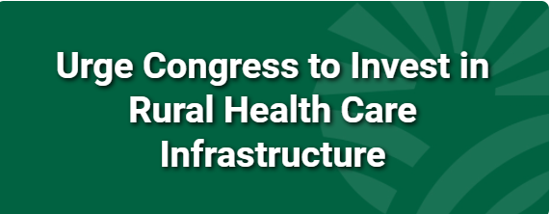
NRHA’s Bipartisan Infrastructure Framework Requests
  Improve broadband services in rural America.
  Provide capital funding for rural hospitals to build and enhance their infrastructure
NRHA infrastructure request document
Notes:
Pending a major reversal in current trajectory, it is unlikely there will be additional COVID-19 relief packages in 2021.
1. Provide capital funding for rural hospitals to build and enhance their infrastructure.
In rural areas, hospitals are often the first or second largest employer in each county. While these facilities are the lifeblood of a given community, they are typically dated and often operate on negative margins. To keep their doors open, rural hospitals must be able to meet the needs of their patients. Unfortunately, many rural providers have cited lack of resources and inadequate facilities as barriers to providing comprehensive services via in-person care and telehealth services. In some communities, rural hospitals date back more than a half-century and are not able to meet the demands of current health care needs.
2. Improve broadband and telehealth services in rural America
In the administration’s outline for the American Jobs Plan, President Biden intends to achieve 100 percent broadband connectivity nationwide, including in rural America. NRHA applauds this goal and believes it will be critical as health care continues to evolve. We request that Congress take the necessary steps to ensure that providers can continue providing telehealth services through the establishment of reliable, high-speed internet access.
3. Invest in rural workforce, including for health care.
It is critical that any infrastructure package be coupled with investment toward the rural health workforce. Throughout the pandemic, the largest obstacle our members faced was the lack of workforce. NRHA encourages Congress to build on the significant health care workforce investment made in the Consolidated Appropriations Act (CAA), 2021 and the American Rescue Plan to ensure the rural health workforce is strengthened and ready to serve their communities.
NRHA infrastructure requests document

Slide 34
NRHA’s Build Back Better Framework Requests
  Improve telehealth services in rural America by making CARES Act flexibilities permanent.
  Invest in rural workforce, including for health care.
  Maternal health support.
  Rural health clinic modernization.
NRHA infrastructure request document
Notes:
Pending a major reversal in current trajectory, it is unlikely there will be additional COVID-19 relief packages in 2021.
1. Provide capital funding for rural hospitals to build and enhance their infrastructure.
In rural areas, hospitals are often the first or second largest employer in each county. While these facilities are the lifeblood of a given community, they are typically dated and often operate on negative margins. To keep their doors open, rural hospitals must be able to meet the needs of their patients. Unfortunately, many rural providers have cited lack of resources and inadequate facilities as barriers to providing comprehensive services via in-person care and telehealth services. In some communities, rural hospitals date back more than a half-century and are not able to meet the demands of current health care needs.
2. Improve broadband and telehealth services in rural America
In the administration’s outline for the American Jobs Plan, President Biden intends to achieve 100 percent broadband connectivity nationwide, including in rural America. NRHA applauds this goal and believes it will be critical as health care continues to evolve. We request that Congress take the necessary steps to ensure that providers can continue providing telehealth services through the establishment of reliable, high-speed internet access.
3. Invest in rural workforce, including for health care.
It is critical that any infrastructure package be coupled with investment toward the rural health workforce. Throughout the pandemic, the largest obstacle our members faced was the lack of workforce. NRHA encourages Congress to build on the significant health care workforce investment made in the Consolidated Appropriations Act (CAA), 2021 and the American Rescue Plan to ensure the rural health workforce is strengthened and ready to serve their communities.
NRHA infrastructure requests document

Slide 35
FY 2022 Appropriations
Week of July 26th, the House passed seven appropriations bills out of the chamber, including the L-HHS-E and Ag bills.
Last week, ahead of August recess, the Senate Appropriations Committee is considering the Ag bill.
NRHA expects the L-HHS-E bill to be considered in the Senate Appropriations Committee following August recess.
Seems increasingly likely the federal government will be operating on a continuing resolution for at least some amount of time.
Notes:
CHF staff have heard that Senate leadership is planning to mark up three appropriations bills before adjourning for August recess: Transportation-HUD, Energy and Water, and MilCon-VA. There are some indications that the Agriculture bill may also get a markup. Because it is highly unlikely that the Senate will have passed a budget resolution before the recess, subcommittees will not have 302(b) allocations to work from…The Labor-HHS bill is not expected to be considered until after the Senate returns from the break.
I did not do a comprehensive update of the Ag bill that passed the House but it included nearly $3.7 billion for the Community Facilities program and $786 million for the ReConnect Broadband program (both are amounts greater than what we requested), while the USDA Rural Hospital TA program only received level funding ($2 million).

Slide 36
FY 2022 Appropriations
NRHA FY 2022 Requests (dollars in millions)
Which bill? | Program | NRHA Request | HAC | SAC
Agriculture | Rural Hospital Technical Assistance Program | 5 | 2
L-HHS-E | Rural Hospital Flexibility Grants | 92.2 | 80
L-HHS-E | Telehealth | 37.4 | 39
L-HHS-E | Rural Maternity & Obstetrics Management Strategies Program | 10 | 10.4
L-HHS-E | Rural Residency Planning and Development | 12.7 | 12.7
L-HHS-E | CDC Office of Rural Health | 1 | 0
Notes:
CHF staff have heard that Senate leadership is planning to mark up three appropriations bills before adjourning for August recess: Transportation-HUD, Energy and Water, and MilCon-VA. There are some indications that the Agriculture bill may also get a markup. Because it is highly unlikely that the Senate will have passed a budget resolution before the recess, subcommittees will not have 302(b) allocations to work from…The Labor-HHS bill is not expected to be considered until after the Senate returns from the break.
I did not do a comprehensive update of the Ag bill that passed the House but it included nearly $3.7 billion for the Community Facilities program and $786 million for the ReConnect Broadband program (both are amounts greater than what we requested), while the USDA Rural Hospital TA program only received level funding ($2 million).

Slide 37
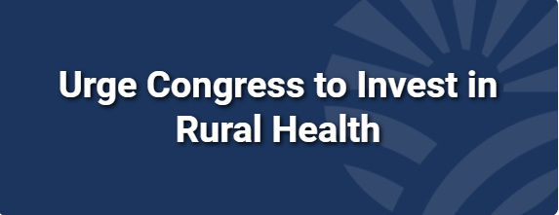
NRHA FY 2022 Appropriations Requests
Establish an Office of Rural Health within the CDC
Expand the USDA Rural Hospital Technical Assistance program
Fund the Rural Maternity and Obstetrics Management Strategies program
Expand the Rural Residency Planning and Development program
Enhance the HHS Office for the Advancement of Telehealth
Reauthorize and modernize the Medicare Rural Hospital Flexibility program
  NRHA FY 2022 appropriations request document
Notes:
Earlier this month, the House Appropriations Committee scheduled the subcommittee and full committee markup hearing for the Agriculture, Rural Development, Food and Drug Administration, and Related Agencies (June 25 & June 30) and Labor, Health and Human Services, Education, and Related Agencies (July 12 & July 15) sections of the appropraiationsbills. NRHA looks forward to working with House Members over the next few weeks to ensure the rural health care safety net receives robust funding via the FY 2022 appropriations process.
NRHA is advocating for robust funding for all necessary rural health lines
Establishment of an CDC Office of Rural Health
Support for Rural Maternity and Obstetrics Management Strategies (RMOMS) program
Expansion of the Rural Residency Planning and Development program
Enhancement of HHS Office for the Advancement of Telehealth
Modernization of the Medicare Rural Hospital Flexibility program
Expansion of the USDA Rural Hospital Technical Assistance program
NRHA FY 2022 appropriations requests document
Rural Health Care Coalition FY22 Appropriations Dear Colleague letter

Slide 38
Other Advocacy Items
Rural hospital sustainability
  REH designation; reinstatement of necessary-provider status for CAHs; elimination of the 96-hour rule for CAHs.
Graduate Medical Education
  Rural Physician Workforce Production Act
Continuation of telehealth flexibilities
Behavioral health and substance use disorder assistance
Rural health clinic modernization
  Creation of reporting requirements for provider-based RHCs in exchange for eliminating the cap they're subject to

Slide 39
Advocate With Us!

Slide 40
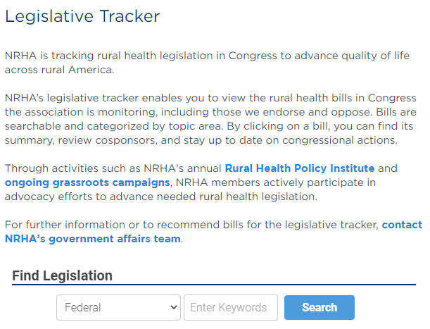
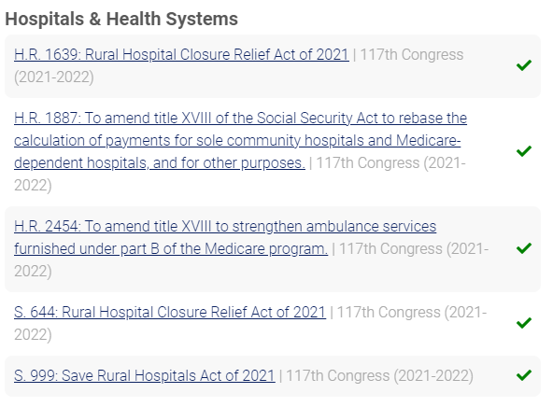
NRHA's Legislative Tracker

Slide 41

Help Us Advocate for Rural Health
NRHA is drafting advocacy campaigns for the future of the
rural health clinic program and more. Be on the lookout!
Notes:
Participate in NRHA's infrastructure rural health advocacy campaign to encourage Congress to:
Provide capital funding for rural hospitals to build and enhance their infrastructure.
Improve broadband and telehealth services in rural America.
Invest in rural workforce, including for health care.
Participate in NRHA's rural health advocacy campaigns to send an email/letter (pre-drafted by our team) to your Congress and/or the Administration.
These are made available via NRHA Connect and NRHA's website.
Get other advocates you know to do the same!

Slide 42
Help Us Advocate for Rural Health
Send advocacy alerts in your organization’s newsletter.
Attend a local town-hall to speak with your Members of Congress.
Sign up to receive NRHA's Rural Roundup & NRHA Today.
Engage with NRHA Advocacy online!
  Social media: Twitter, Facebook, LinkedIn
Notes:
NRHA Connect login: https://connect.nrharural.org/home
Find a local townhall: https://townhallproject.com/
NRHA Rural Roundup sign-up link: http://eepurl.com/gwaRq9
NRHA Today sign-up link: https://www.ruralhealthweb.org/news/nrha-today
NRHA GA Twitter: https://twitter.com/NRHA_Advocacy Facebook: https://www.facebook.com/NRHAAdvocacy LinkedIn: https://www.linkedin.com/company/national-rural-health-association/?viewAsMember=true
GA emails: melehwany@nrharural.org, jjorgensen@nrharural.org, mzeagler@nrharural.org

Slide 43
amorgan@nrharural.org
@amorganrural (TWITTER)
Notes:
NRHA is a national nonprofit membership organization with more than 21,000 members, made up of a diverse collection of individuals and organizations with the common goal of ensuring all rural communities have access to quality, affordable health care.
Our mission is to provide leadership on rural health issues.

