Slide 1
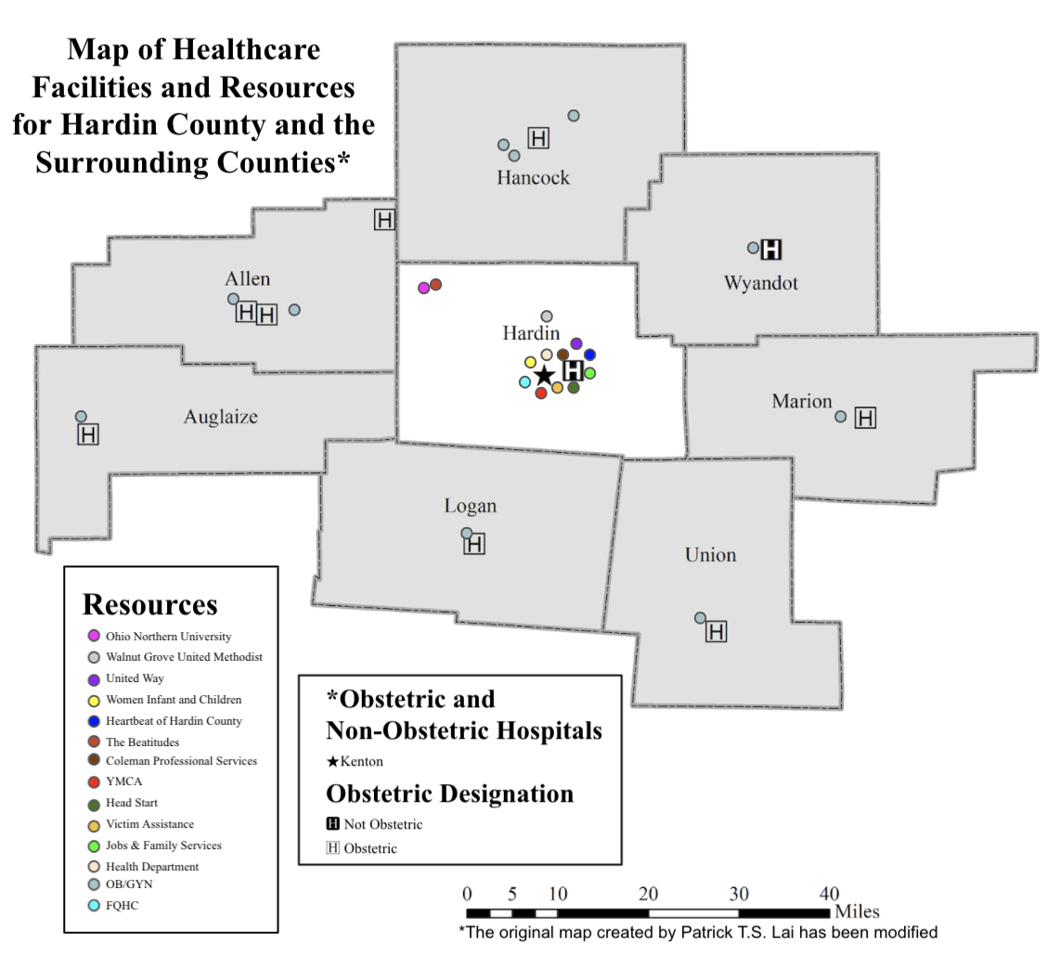
“Go to where the people are”:
Recommendations to improve preconception care for rural women
Akia Clark, MPH(c), Indiana University & Natalie DiPietro Mager, PharmD, PhD, Ohio Northern University, Ada, Ohio, USA
Background:
There are few qualitative studies examining rural women and preconception care in the United States. In a previous study, women living in a Healthcare Professional Shortage Area and Maternity Care Desert (Hardin County, Ohio) expressed their concerns and their need for more resources to improve their health. As a follow-up study, key informants of Hardin County were interviewed to provide further insight on what the most pressing health needs are for women living in the county, what current resources for preconception and women’s health care are available to them, what barriers and challenges they face, and what interventions could be implemented to improve health and pregnancy outcomes.
To remove barriers and increase utilization of resources, recommendations emphasized:
Delivering education and outreach at schools and community locations
Incorporating entertainment
Providing childcare
Addressing social determinants of health
For more information, contact Akia at aclark@ohiopha.org or Natalie at n-dipietro@onu.edu
Results:
14 key informants participated, representing a variety of community assets and stakeholders:
Chamber of Commerce - Law Enforcement
Church - Ohio Northern University
Community Center - Ohio State Extension Office
Critical Access Hospital - Pregnancy Resource Center
FQHC - United Way
Head Start - WIC
Health Department - YMCA
Methods:
A purposive sample of key informants living or working in Hardin County were recruited and individually interviewed with semi-structured questions from two domains: perceived needs and barriers to care. Interview recordings were transcribed, pre-coded, and thematically analyzed.
Limitations:
Results may not be generalizable to other rural counties.
Future Directions for Research:
Next steps are to determine the best types of preconception care messaging and develop targeted interventions to improve health for rural women.

