Slide 1
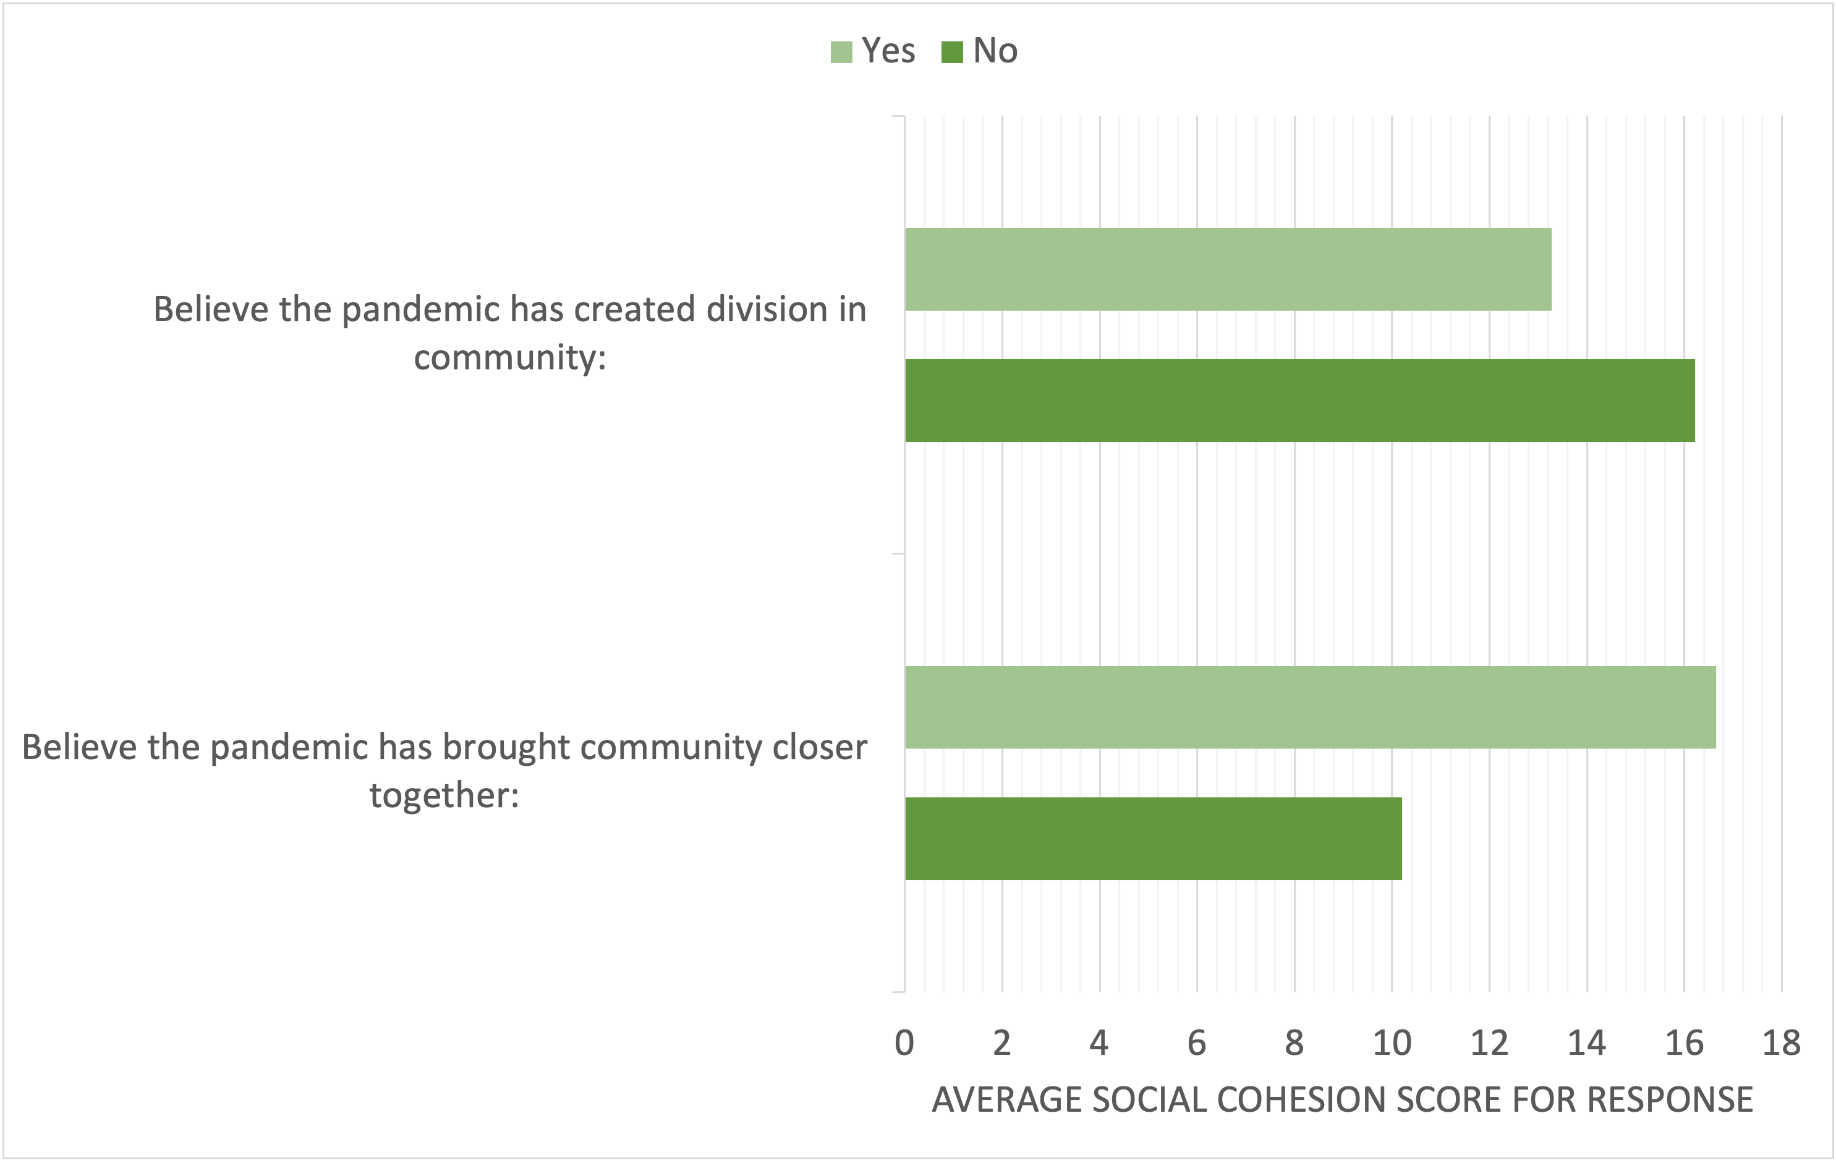
Perceptions of the community reaction during COVID-19 appear to be highly correlated with the extent to which a participant views the community as socially cohesive overall, as well as whether the county was prepared to take on a challenge of the nature of the pandemic.
Mary Quaboh, MPH: mq950414@ohio.edu Ohio University Department of Social and Public Health
Cory E. Cronin, PhD: croninc@ohio.edu Ohio University Department of Social and Public Health
Did COVID-19 disrupt community cohesion or create community cohesion?
FINDINGS
WHY THIS STUDY MATTERS: This study is important because it helps to understand whether pandemics such as COVID-19, has an effect on community cohesion. The study also helps public health practitioner to help communities prepare for pandemics.
BACKGROUND: Background: Social cohesion has been shown to play a role in how communities respond to emergency situations, such as disasters or the current COVID-19 pandemic (Borkowska & Laurence 2020; Townshend et al. 2014). As such, a better understanding of social cohesion and unity within communities may have valuable public health implications.
OBJECTIVE: The objective of this study is to examine community members’ perceptions as to whether a public health crisis (COVID-19) created more unity or more division within the community.
HOW WE DID THE STUDY: Data for this study are drawn from a community-based survey distributed electronically between November 2020 and January 2021 in a midwestern college town, selected for its established town-gown dynamic. The dependent variable is whether the COVID-19 pandemic created greater unity or greater division within the community (defined as the surrounding county). Due to the categorical nature of the dependent variable, an ordered logistics regression analysis was employed to examine how the outcomes relate to responses to the Perceived Neighborhood Social Cohesion scale (Dupuis et al. 2016), as well as individual behaviors and characteristics.
WHAT WE FOUND OUT: The survey response represented approximately 2% of the county population. The plurality of respondents (37%) indicated that they felt the community had experienced both some unity and some division. According to the regression analysis, perceptions of unity were significantly and positively related to perceptions of social cohesion and the belief that the community was well prepared for COVID-19, as well as the perception of COVID-19 as a significant health risk among other variables. Perceptions of division were significantly and negatively associated with both the social cohesion scale and the belief that the community was well prepared for COVID-19.
Perceptions of social cohesion and community impact of the pandemic
NEXT STEPS FOR RESEARCH & POLICY
Public health implications
The promotion of social cohesion, including perceptions of safety, communication, and positive leadership, during typical times may establish an important groundwork for community response to a public health emergency.
Next Steps for
Research & Policy:
Public health implications
The promotion of social cohesion, including perceptions of safety, communication, and positive leadership, during typical times may establish an important groundwork for community response to a public health emergency.
Ordered logistic regression:
Perception of community social
cohesion and belief that pandemic
brought community closer together:
Ordered logistic regression:
Perception of community social
cohesion and belief that pandemic
created division in community:
Regression results adujust for sex, student status, age, level of education, Athens County resident status, belief in community preparedness, belief in level of risk of illness, and individual protective behavior.
Notes:
Notes:
In Powerpoint, click View > Guides
Keep text within gutter guides.
Author list: Don’t split names onto two lines (e.g., “Jimmy [break] Smith”). If that happens, use a new line, unless you need the space. Bold the first names of anybody who’s presenting in person.
Intro/methods/result: Do not drop below font size 28, but if you have extra space, jack up the font size until the space is full.
Do not use color in the sidebars except in graphs/figures. It’ll pull attention from the center and slow interpretation for passersby.

