Slide 1
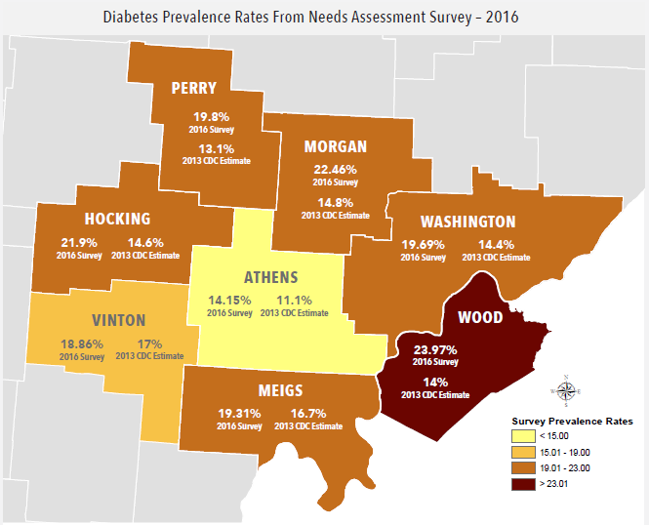
Educating Healthcare Providers on How Appalachian
Culture Impacts Diabetes Care via 360-degree Virtual Reality
Brooke E. Rigot, OMS II¹, Elizabeth A. Beverly, PhD^{1,2,3}
1. Department of Medicine, Ohio University Heritage College of Osteopathic Medicine, Athens, OH 45701, USA
2. Department of Primary Care, Ohio University Heritage College of Osteopathic Medicine, Athens, OH 45701, USA
3. The Diabetes Institute, Ohio University, Athens, OH 45701, USA
BACKGROUND
RESULTS
The prevalence of diabetes in southeastern Ohio is 19.9%, more than double the national average of 9.4%.
Here, people battle a poverty rate 1.5 times that of the US average, and suffer from higher unemployment, lower educational achievement, poorer health, and lower access to health care.
Despite the presence of health disparities, the impact of socioeconomic status and barriers to health care in Appalachia is understudied.
The unique culture of Appalachia influences healthcare beliefs, practices, and behaviors. Cultural acknowledgement and understanding can help providers and educators break barriers and improve quality of life.
The purpose of this study was to explore healthcare providers’ and educators’ experiences via a cinematic virtual reality (cine-VR) training program in diabetes, social determinants of health, and Appalachian culture.
Figure 1. Diabetes Prevalence Rates in southeastern Ohio
Theme 1: Contextualizing Barriers in Appalachian Culture
Many participants addressed socioeconomic status as a major barrier preventing people with diabetes in Appalachia from receiving quality healthcare to manage both type 1 and type 2 diabetes.
Transportation, low educational achievement, financial insecurity, limited or no insurance, and lack of access to healthcare services were commonly cited as examples of barriers that people with diabetes face in rural Appalachian Ohio.
“Access to healthcare, the right healthcare too, I don't know, how many people actually have an endocrinologist who are overseeing their diabetes care rather than a primary care physician supervising their care, and food insecurity, resources, resources to medication, and financial barriers, transportation.” (ID 106)
“So, there’s poverty, it’s distressed economies, very remote location –lack of health care providers, and also lack of health literacy. I don’t know if people really understand things like that.” (ID 107)
“I think some of the things that really are important to harp on are the isolation that a lot of people feel here, whether it be from actually getting the care that they need or whether it's getting the pharmaceutical agents that they need, or whether it's getting the nutrition help that they need, whether it's just access to a store, whether it's a person to help them get to point A to point B. It’s a sense of isolation, I mean, you've got that family, but other than that family, there's a sense of isolation the rest of the resources that are available to you. (ID 111)
Theme 2: Common Beliefs about Diabetes Among the Appalachian Community
Table 1. Participant Demographic Characteristics (n=20)
Variable | n (%)
Age (years) | 43.8±11.8
Gender (Female) | 18 (90.0)
Race (White) | 19 (95.0)
Occupation type Community health worker/Health educator Nurse Dietitian Pharmacist Exercise physiologist Medical Directors Physical therapist Psychologist | 5 (25.0) 4 (20.0) 3 (15.0) 2 (10.0) 2 (10.0) 2 (10.0) 1 (5.0) 1 (5.0)
Years of clinical and/or academic experience 1-5 years 6-10 years 11-15 years 16-20 years 21-25 years 25+ years | 6 (30.0) 4 (20.0) 0 (0) 4 (20.0) 4 (20.0) 2 (10.0)
Many participants noted that people with diabetes in Appalachia felt that their diabetes diagnosis was inevitable due to the high prevalence of the disease among their families and friends.
One commonly shared belief was because type 2 diabetes was so common in this area, people did not feel that it was a preventable disease, and in turn, lifestyle changes were not made to reduce the risk of developing diabetes.
“I think most just are – I’m trying to think of the word. Resigned to the fact that it’s going to happen, and I think that instead of making lifestyle changes, it’s just easier to take medicine for most folks.” (ID 101)
“I think that there is some, definitely some folks who think, "Well everyone in my family's had it so I'm gonna get it too," because that's what they've seen and that's what they know. And the doctors may or may not know what they're talking about, so they probably trust their personal experience more than they trust the – what the physician is saying in some cases.” (ID 104)
“And then just not fully understanding what diabetes is, just kinda like, "Well I went to the doctor's, I was given a pill to take, I was told I have diabetes, I think it's because it means my sugars are high but that's about it." Not really understanding what diabetes is, how it was caused, and then a lot of those secondary complications that go along with diabetes can be prevented or managed.” (ID 106)
“Yeah. It’s not that serious until they lose a leg or get to the point where they're going to lose a leg or their eyesight, and then it's too late. And I think that people always feel like that won’t happen to me. I think that's how it is.” (ID 114)
METHODS
We conducted in-depth telephone interviews with healthcare providers and educators who participated in the 3-hour VR training program.
Narrative qualitative methods were used in this study to explore participants experiences with the virtual reality technology and the training program.
The research team devised a semi structured interview guide. Two trained qualitative researchers asked participants broad, open-ended questions about the VR content and the educational experience.
Interviews lasted 20 to 45 minutes. All interviews were digitally audio recorded and transcribed verbatim.
Data was collected until saturation was reached; or no new information was generated from the interviews.
A multidisciplinary team performed content and thematic analyses by marking and categorizing key words, phrases, and texts using NVivo 12 software.
SUMMARY & CONCLUSIONS
All of the participating healthcare providers and educators were able to recall the social determinants of health that were addressed in the cine-VR training program. They understood the impact that these social determinants of health had on self-care, diabetes outcomes, and quality of life.
When asked to identify Appalachian views towards diabetes, participants described diabetes fatalism or the feeling of inevitability that people in Appalachia would develop diabetes because all of their family members and friends had diabetes.
In summary, the participating healthcare providers and educators found the cine-VR training useful. The cine-VR technology offers participants a glimpse into the lives of people with diabetes and culture of the region. This type of training is invaluable to geographically and culturally distinct regions like Appalachian Ohio.
Creation of the Cine-VR program was funded by the Ohio Department of Medicaid and administered by the Ohio Colleges of Medicine Government Resource Center; research supported by the Osteopathic Heritage Foundation Ralph S. Licklider, D.O. Endowed Faculty Fellow in Behavioral Diabetes

