Slide 1
Pandemic Increases Pressure on Rural Hospitals and Communities
2022 Ohio Rural Health Conference
August 2022

Slide 2
Contents
Understanding Who We Serve
Rural Health Inequity
Uncertainty Threatens Stability
Nurse Staffing Crisis and its Impact
Ohio’s Top Performing Rural Hospitals

Slide 3
Convergence of Multiple Pressure Points
Health Disparities
Healthcare Policies
Population Migration
Economic Policy
Recruitment/Retention
COVID-19

Slide 4
Population Health Disparity Rural v. Urban
Percentile Ranking
69
63
69
63
62
Rural
41
32
33
33
32
Urban
Over 65
Diabetes
Median HSHLD Income
Access to Primary Care
Access to Mental Health

Slide 5
Population Health Disparity Rural v. Urban
Percentile Ranking
69
60
60
61
Rural
53
44
48
40
40
32
Urban
Median HSHLD Income
Child Poverty
Uninsured Adult
Uninsured Children
Premature Death

Slide 6
Rural Hospitals Vulnerable to Closure
AK
VT
NH
ME
WA
MT
ND
SD
MN
WI
MI
NY
CT
MA
OR
ID
WY
NE
IA
IL
IN
OH
PA
NJ
RI
CA
NV
UT
CO
KS
MO
KY
WV
MD
DE
DC
AZ
NM
OK
AR
TN
VA
NC
453
HI
TX
LA
MS
AL
GA
SC
FL
0
1%—9%
10%—15%
16%—20%
21%—25%
26%—30%
31%—40%
41%+
Medicaid Expansion State
Percentage of State Rural Hospitals Determined to be Vulnerable

Slide 7
Where the Safety Net is Weakest Vulnerable Rural Communities v. Rural
Percentile Ranking
Vulnerable Hospital Community
73
77
69
60
61
53
33
23
23
17
Rural
Primary Care
Mental Health
Uninsured Adult
Uninsured Children
Premature Death

Slide 8
Rural Health Inequity
Stability of the rural health safety net

Slide 9
Rural Population Disparity Adults Uninsured
AK
VT
NH
ME
WA
MT
ND
SD
MN
WI
MI
NY
CT
MA
OR
ID
WY
NE
IA
IL
IN
OH
PA
NJ
RI
CA
NV
UT
CO
KS
MO
KY
WV
MD
DE
DC
AZ
NM
OK
AR
TN
VA
NC
HI
TX
LA
MS
AL
GA
SC
FL
Percentage of population served by rural hospitals that is adults under age 65 without health insurance.
0-5%
6%-10%
11%-15%
16%-20%
21%-25%
>25%
Medicaid Expansion State

Slide 10
Rural Population Disparity Child Poverty
AK
VT
NH
ME
WA
MT
ND
SD
MN
WI
MI
NY
CT
MA
OR
ID
WY
NE
IA
IL
IN
OH
PA
NJ
RI
CA
NV
UT
CO
KS
MO
KY
WV
MD
DE
DC
AZ
NM
OK
AR
TN
VA
NC
HI
TX
LA
MS
AL
GA
SC
FL
Percentage of population served by rural hospitals that is under age 18 in poverty.
0-5%
6%-10%
11%-15%
16%-20%
21%-25%
>25%
Medicaid Expansion State

Slide 11
Rural Population Disparity Non-Hispanic Black
AK
VT
NH
ME
WA
MT
ND
SD
MN
WI
MI
NY
CT
MA
OR
ID
WY
NE
IA
IL
IN
OH
PA
NJ
RI
CA
NV
UT
CO
KS
MO
KY
WV
MD
DE
DC
AZ
NM
OK
AR
TN
VA
NC
HI
TX
LA
MS
AL
GA
SC
FL
Percentage of population served by rural hospitals that is non-Hispanic Black or African American.
0-5%
6%-10%
11%-15%
16%-20%
21%-25%
>25%
Medicaid Expansion State

Slide 12
Urban/Rural Divide for Black Americans Rural Health Inequity – Premature Death
Percentile Ranking
86
86
87
79
70
76
76
Black Americans Living in Rural Communities
68
65
46
Black Americans Living in Urban Communities
Alabama
Georgia
Louisiana
Mississippi
South Carolina

Slide 13
Rural Population Disparity Hispanic
AK
VT
NH
ME
WA
MT
ND
SD
MN
WI
MI
NY
CT
MA
OR
ID
WY
NE
IA
IL
IN
OH
PA
NJ
RI
CA
NV
UT
CO
KS
MO
KY
WV
MD
DE
DC
AZ
NM
OK
AR
TN
VA
NC
HI
TX
LA
MS
AL
GA
SC
FL
Percentage of population served by rural hospitals that is Hispanic.
0-5%
6%-10%
11%-15%
16%-20%
21%-25%
>25%
Medicaid Expansion State

Slide 14
Urban/Rural Divide for Hispanics Rural Health Inequity – Premature Death
Percentile Ranking
99
97
89
87
85
79
71
80
Hispanics Living in Rural Communities
63
55
48
56
Hispanics Living in Urban Communities
Arizona
California
Colorado
New Mexico
Nevada
Texas

Slide 15
Uncertainty Threatens Temporary Stability
Stability of the Rural Health safety net

Slide 16
An Anomaly and Not a Turning of the Tide

Slide 17
Red Sky in Morning, Sailor’s Warning
Negative
Operating Margin
Medicare Sequester
PAYGO*
Bad Debt Reimbrusement
45%
$228.5M
$900M+
$222.8M
Excluding relief funds
2% cut July-Dec 2022
4% cut 2023
Negative
Operating Margin
Medicare Sequester
PAYGO*
Bad Debt Reimbursement
Ohio
30%
$11.2M
$22.5M
$10.6M
*PAYGO is a legislative rule that requires across-the-board cuts to spending programs if new legislation increases the federal deficit.

Slide 18
How Unstable is the Rural Health Safety Net? Operating Margin, Closures and Hospital Vulnerability
$12.9B
Pandemic Relief Payments*
40%
Operating in the Red (includes relief funds)
2
Rural Hospitals Closed in 2021
*CARES Act and CAAP

Slide 19
Pandemic Relief Funds Stabilize Safety Net
CARES Act
Medicare Advanced Payments
American Rescue Plan
$4.8B
$8.2B
$887M

Slide 20
Nurse Staffing Crisis and Dwindling Access to Services
Stability of the rural health safety net

Slide 21
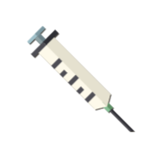
Rural Hospital Staffing Survey What percentage of your healthcare personnel is fully vaccinated?
52%
90%-100%
39%
70%-89%
The percentage of those indicating that 90%-100% of healthcare personnel are fully vaccinated has increased.
But…40% of respondents still put their staff vaccination rate between 70 and 89%.
8%
50%-69%
<50%
April ’22*
October ‘21
May ‘21
*Survey conducted March 2, 2022 – April 15, 2022.

Slide 22
Rural Hospital Staffing Survey Impact of vaccine mandates on healthcare personnel
If your facility mandated COVID vaccination prior to January 2022, what percentage of healthcare personnel chose to depart?
If your facility recently completed or is in the process of implementing the Federal mandate for COVID vaccination, what percentage of your healthcare personnel do you expect have or will refuse COVID vaccination?
<2%%
67%
<2%%
35%
3%-5%
22%
3%-5%
6%-10%
6%-10%
11%-15%
11%-15%
27%
*Survey conducted March 2, 2022 – April 15, 2022.

Slide 23
Rural Hospital Staffing Survey Which roles are you experiencing the greatest difficulty filling?
Nursing
96.2%
Ancillary Services
66.2%
Facilities
Nursing was identified by 96.2% of respondents as a role in which they are having difficulty filling. Staffing shortages can directly impact quality of care and access to care for rural communities.
Physicians
Other
Admin
*Survey respondents were able to select multiple positions for which they are having difficulty filling. As a result, the percentages do not equal 100. Survey conducted September 21, 2021 - October 15, 2021.

Slide 24
Rural Hospital Staffing Survey How would you rank the following reasons for nurse staff departures in 2021?
48%
More financially lucrative opportunities at staffing agency
1
1
2
More financially lucrative opportunities at another hospital
Among survey respondents, 48% ranked more financially lucrative opportunities at staffing agencies as the #1 reason for nurse staff departure this year.
3
Pandemic Burn Out
2
4
Retirement
3
5
Unwillingness to comply with vaccine mandate
4
6
Other
5
*Survey conducted March 2, 2022 – April 15, 2022.

Slide 25
Rural Hospital Staffing Survey Using sign-on bonuses to attract New Staff
Are you using sign-on bonuses to attract new staff?
Approximately how large are the sign-on bonuses?
Yes
68%
$1K-$5K
39%
Yes
$6K-$10K
34%
Considering
9%
No
$11K-$15K
No
23%
%
$16K-$20K
$21K+
*Survey conducted March 2, 2022 – April 15, 2022.

Slide 26
Rural Hospital Staffing Survey Lack of nurse staffing and the impact on patient care
Has a lack of nurse staffing prevented your hospital from admitting patients in the last 60 days?
Are issues related to nurse staffing resulting in the suspension of services at your hospital?
17%
Yes
Yes
36%
Yes
No
71%
No
64%
Considering
No
13%
Considering
April ’22*
October ‘21
Positive movement in the results since last fall. However, the staffing crisis is still impacting the delivery of care and causing the suspension of services within communities already at risk.
*Survey conducted March 2, 2022 – April 15, 2022.

Slide 27
Rural Hospital Staffing Survey Lack of nurse staffing and the impact on patient care
Has your reliance on travelling nurses changed during the pandemic?
Prior to the pandemic, how often would you estimate that you used travelling nurses?
27%
42%
No
Never
Yes
20%
50%
Slightly
Rarely
No
53%
9%
%
Significantly
Regularly
April ’22*
October ‘21
These two charts illustrate how a lack of nurse staffing is driving greater reliance on travelling nurses. A majority of respondents continue to say they rarely used travelling nurses prior to the pandemic and more than 50% say their use has increased significantly as hospitals struggle to fill nursing gaps.
*Survey conducted March 2, 2022 – April 15, 2022.

Slide 28
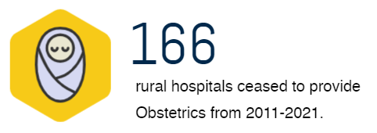
Diminishing Access to Services Vanishing or service pauses even though hospital doors stay open
311
“COVID has caused a resetting of market rates and a reshuffling of nurse staffing.”
Rural hospitals ceased to provided Chemotherapy from 2014-2020.
198
Rural hospitals ceased to provided Obstetrics from 2011-2019.
“We have had candidates turn down offers due to housing concerns.”

Slide 29
Top 100 Rural & Community Hospitals
Stability of the rural health safety net

Slide 30
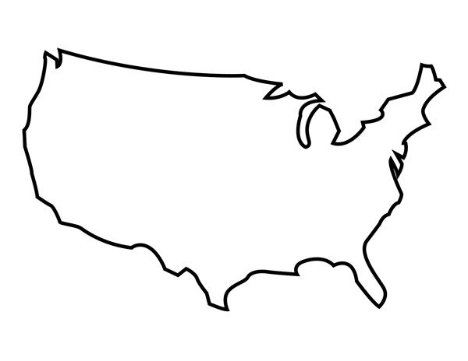
2022 Top 100 Critical Access Hospitals
WA
ND
OR
MT
WI
OR
MN
ID
SD
KS
IA
MA
WY
MI
IL
PA
UT
CO
IN
NE
NV
VA
NM
AR
19
10-12
LA
8
5-7
3-4
1-2

Slide 31
2022 Top 100 Rural & Community Hospitals
WA
OR
MT
MN
VT
MI
NY
WY
WI
MA
PA
UT
IA
IL
OH
IN
MD
CO
CA
KS
WV
VA
NE
KY
NC
OK
SC
AR
GA
7,8
TX
6
HI
FL
5
4
3
1,2

Slide 32
Ohio’s Top 100 Footprint
Tiffin Hospital

Slide 33
How the 2022 Top 100 CAHs Measure Up to Rural Peers
Top 100 Median
Critical Access Median

Slide 34
About
We deliver a rural-relevant framework through which leadership teams and frontline staff can better understand performance and initiate further clinical and financial improvement.
Helping Rural Providers Navigate a New Era through:
Network Collaboration
Our expertise and research has been featured in:
Strategic & Operational Advisory
Quality Improvement
Advanced Analytics
Rural Relevant Research

Slide 35
Connect with Our Team
Michael Topchik National Leader
mtopchik@chartis.com
Troy Brown Network Consultant
tbrown@chartis.com
Melanie Pinette MEM, Senior Analyst
mpinette@chartis.com
Billy Balfour Communications
wbalfour@chartis.com

