Slide 1
Ohio State Extension Public Health AmeriCorps
2022 Ohio Rural Health Conference
Pat Bebo MS, RDN Ohio State University Extension, CFAES
Erik Porfeli PhD Department of Human Sciences, EHE
Notes:
Pat

Slide 2
Agenda
Set the stage
Describe OSU Extension
Introduce the Cooperative Extension Framework for Health Equity
Describe Public Health AmeriCorps and E-PHAC
Introduce the opportunity for an Ohio Health Alliance
Describe next steps
Notes:
Pat

Slide 3
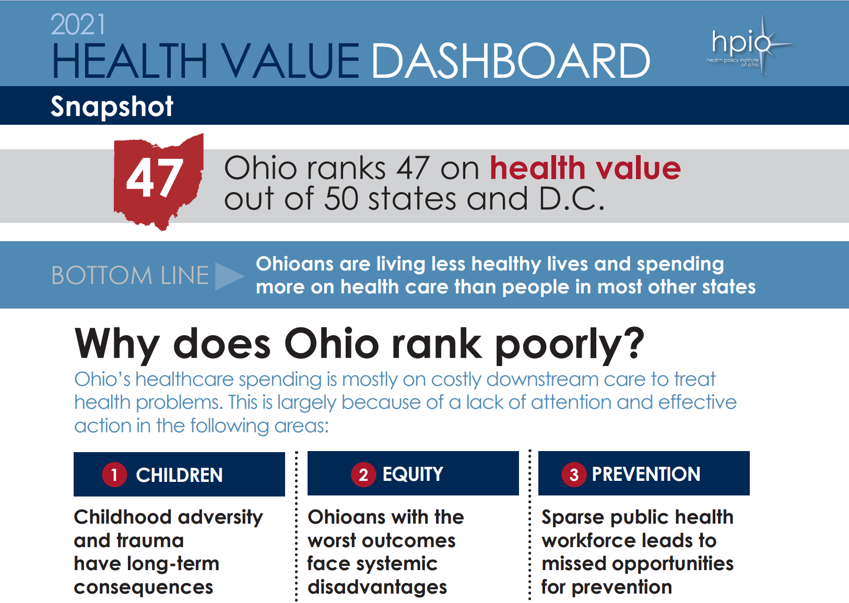
The Challenge
Notes:
2021_HealthValueDashboard_Snapshot.pdf (netdna-ssl.com)
Erik

Slide 4
4 in 5 Physicians Surveyed
Patients’ social needs = medical conditions
Not confident in capacity to address them
Unmet social needs lead to worse health
Health system doesn’t help
These determinants just don’t affect poor
Notes:
Health Care’s Blind Side: The Overlooked Connection between Social Needs and Good Health.” Online Report. Princeton NJ: Robt Wood Johnson Foundation. December, 2011
Erik

Slide 5
The Opportunity
Three of the top 10 employers in Ohio are Hospital Systems
  #1. Ohio State University & University Hospitals
  #4. Cleveland Clinic Foundation – Cleveland
  #6. University Hospital of Cleveland – Cleveland
Health care jobs among the fastest growing in Ohio
Each physician brings more than $2 million in annual revenue to a community.
Notes:
http://ohiolmi.com/proj/projections.htm
http://hubpages.com/business/Ohio_jobs
Erik

Slide 6
Improving the Health of Ohio through Evidenced-Based Strategies
Focus on advancing children’s health and educational success
Promote equity in access to health, education, and economic opportunities
Focus on health promotion and the prevention of chronic diseases through strengthening the public health workforce and addressing the social determinants of health
Notes:
2021_HealthValueDashboard_ES.pdf (netdna-ssl.com)
Erik

Slide 7
A sustainable compelling vision for advancing the health of Ohio may be found at the intersections of…
Health, economic prosperity, and educational attainment within community share the same social determinants.
They also affect each other in communities yielding vicious and virtuous intergenerational cycles.
These relationships limit the impact of programs focused on enhancing just one of the three.
We need a multi-prong and system approach, which necessitates a large and diverse array of partners
Educational Attainment
Economic Vitality
Community Health
Notes:
Erik

Slide 8
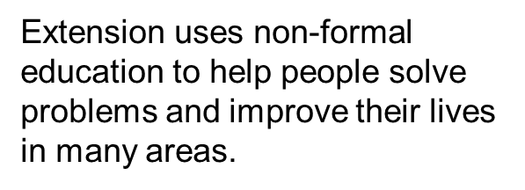

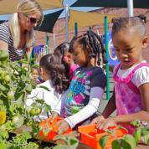
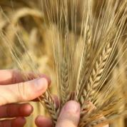

Cooperative Extension
State
LGU
Federal
USDA
Local
County office
4-H Youth Development
Community Development
Ag and Natural Resources
Family and Consumer Sciences
Notes:
Pat ( focus on FCS Content) and how all the program areas align with previous slide
Partnership among federal government, LGUs and local communities. The goal of this partnership is to translate research into action. Extension uses non-formal education to help people solve problems and improve their lives in many areas. You may have worked with Extension’s educators in any one of 88 counties throughout the state. Family and Consumer science educators provide education to help people develop the skills for living a stable productive life through health and nutrition, stress management, mindfulness, mental wellness , relationship with self and others, and financial wellbeing 4-H projects involving youth and leadership development, Community development projects that focus on economic development in lower income areas-agriculture and natural resources managing production of food in environmentally sound ways, all the work is focus on creating more stable environments through the dissemination of research or evidence based information and/or programming

Slide 9
OSU Extension
Mission
  We create opportunities for people to explore how science-based knowledge can improve social, economic and environmental conditions.
Notes:
Pat All this to say our goal is to live our mission on a daily basis in the communities we serve throughout the state

Slide 10
Core Themes
The Cooperative Extension Framework for Health Equity and Well-Being (2021)
Health Equity – Allocating resources to communities and groups that are experiencing the most significant barriers to achieving optimal health.
Social Determinants of Health –Consideration of those factors beyond the influence of an individual such as broadband availability, transportation, food insecurity, and access to healthcare.
Coalitions and Community Assets– The resources of multiple entities are focused on common objectives.
Notes:
Microsoft Word - Health Framework Popular Version Final.docx (aplu.org)
Pat and Erik
Health landscape is changing
Opioid and medication misuse crisis
Mental Health
COVID
Climates Change
Nutrition and food insecurity
Health Insurance
The “health” arena for Extension has quickly gained programming prominence the framework raises awareness of the influence of social systems on human health
Extension is evolving from an “expert” in a community to a community partner engaging with residents to empower them to identify the needs and together facilitate solutions to create lasting change in communities

Slide 11
Public Health AmeriCorps
Main goals
Address public health needs of local communities by providing support in state and local public health settings and advancing more equitable health outcomes for underserved communities.
Create pathways to good quality public health-related careers through onsite experience and training, with a focus on recruiting AmeriCorps members who reflect the communities in which they will serve.
Notes:
Pat when this opportunity became available it was a natural fit to leverage Extension and our partnership with Erik in the Department of Human Sciences, partners in the College of Public Health and Erik’s long time partner in the development of other AmeriCorps project Gina Weisblat with CWRU

Slide 12
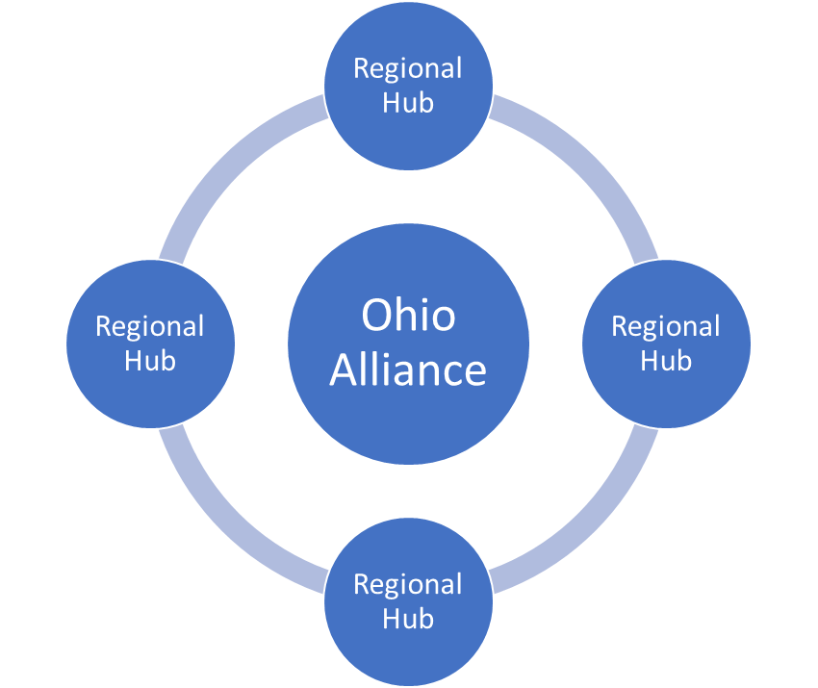
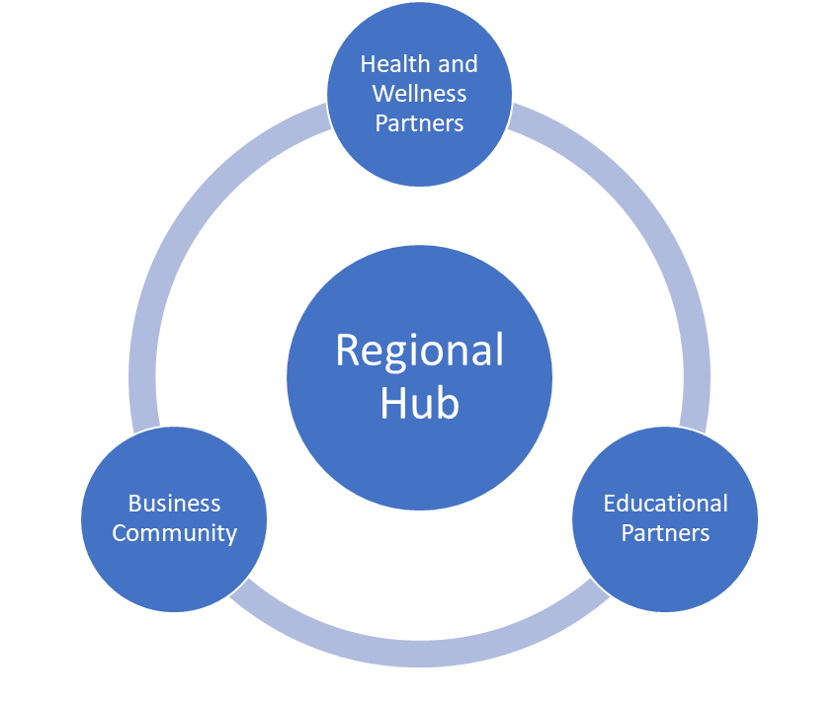
E-PHAC- The Ohio State University Extension Public Health AmeriCorps project
Notes:
Pat

Slide 13
E-PHAC
Mission
Establish and engage local alliances to concurrently advance the health, education, and economic prosperity of their community through systemic changes fueled by local resources.
Notes:
Pat

Slide 14
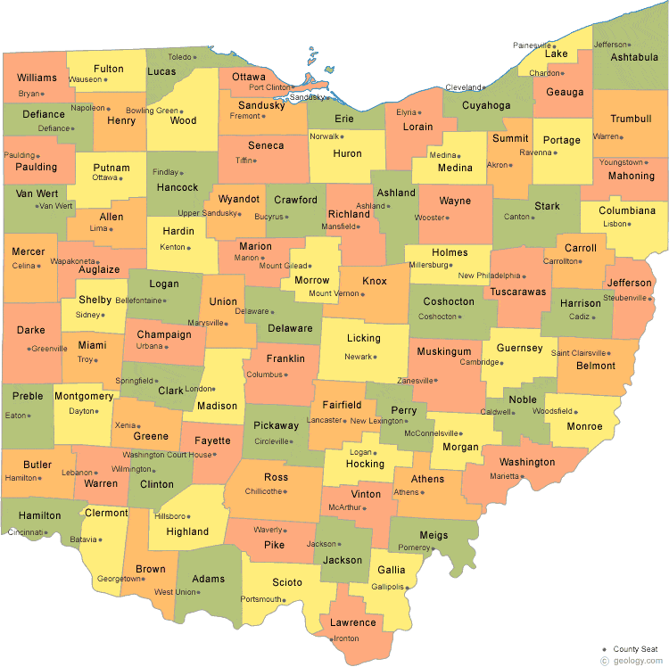
E-PHAC Goals at a Glance
Hub Structure
Extensions Educators and AmeriCorps members will establish a local alliance composed of health, education, and economic partners spanning their region
The alliance will support the efforts to project personnel to engage youth and adults in grassroots efforts to identify and tackle local health concerns with local resources
Project personnel will connect youth and adults to educational pathways leading to health careers
Project personnel will collaborate with educational partners to connect educational pathways to local shadowing, mentorship, internship, and job opportunities.
A local alliance, with direct support from project personnel, will ultimately effect systems change toward composing a health and wellness care workforce for and from underserved communities.
Establish a public health ecosystem with
state-wide scope and deep reach into local
communities.
9-10 Extension Educators supervising…
74 AmeriCorps Members…
The ecosystem will engage thousands of community members to develop and enact community health projects serving tens of thousands of Ohioans.
Notes:
Pat

Slide 15
Ohio Health Alliance
Health systems, community health centers, local practices in underserved communities
K-12 partners, an array of health professions pipeline programs, and higher education partners
Engagement of the business community with a vested interest in health and wellness
But alliances can be hard to establish and grow without people and resources devoted to them.
What organizations are devoted to building community alliances and may have a priority devoted to health?
Notes:
Erik

Slide 16


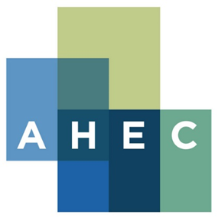
Entities devoted to community partnerships can include…
US Cooperative Extension engages people to strengthen their lives and communities through research-based educational programming. With access to about $1 billion annually, state-based extension systems deliver a massive array of community-based programs devoted to agriculture, health, workforce development, community vitality, positive youth development.
AmeriCorps improves lives, strengthen communities, and foster civic engagement through service and volunteering through a network of 270,000 members and $800 million in annual funding
Area Health Education Centers improve the supply, distribution, retention and quality of primary care and other health practitioners in medically underserved areas with about $43 million in annual federal funding coupled with added State and local funding.
$1.8 Billion in Annual Funding to Enhance Community Health and Vitality
Notes:
Erik

Slide 17
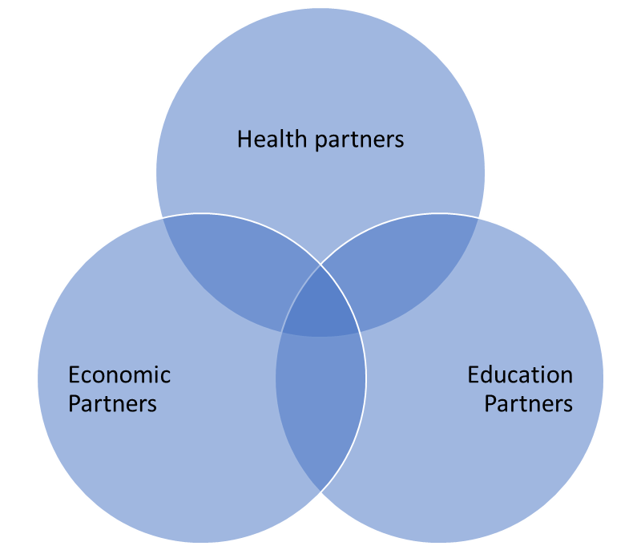
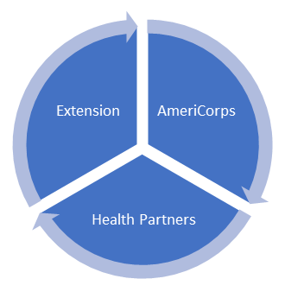
Our Opportunity
Mobilize stakeholders devoted to the intersections of health, economic propserity, and education within community and employ a systematic approach we call the IDEAS model
Identify and define
Identify and define the essential health and health workforce challenges and opportunities in underserved communities to serve as the common ground for an alliance.
Develop
Develop local alliances devoted to advancing community health initiatives, educational pathways, and a future healthcare workforce to meet the health needs of the community.
Enact
Enact the effort with partners to engage youth and adults in the health of their communities and health career opportunities
Assess
Assess the impact
Share
Share the successes with existing and prospective stakeholders to affirm and strengthen the local alliances
Notes:
Erik

Slide 18
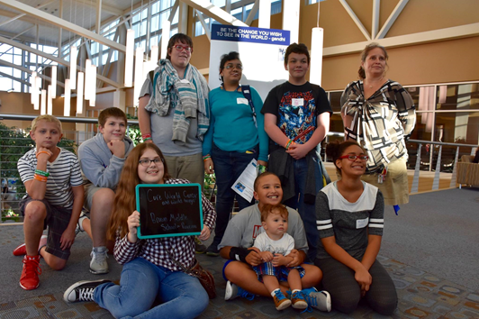
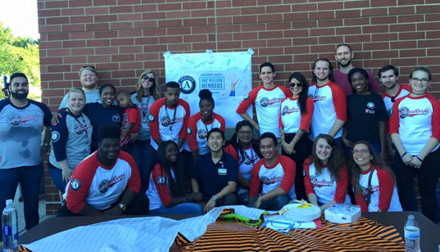
The Public Health Ecosystem Model to Engage Community Members
IDEAS Model
Identify and learn
Enact the Program
about a pressing health concern
Develop a Program
with partners and resources
with partners and resources
Assess
the benefits and limitations of the program
Share
the program with the broader community
Notes:
The Health Professions Affinity Community (HPAC) is a program designed to empower youth to identify and address health concerns in their community utilizing ...
Pat ( using same IDEAS model different environments having alignment with systems and organizations powerful)

Slide 19

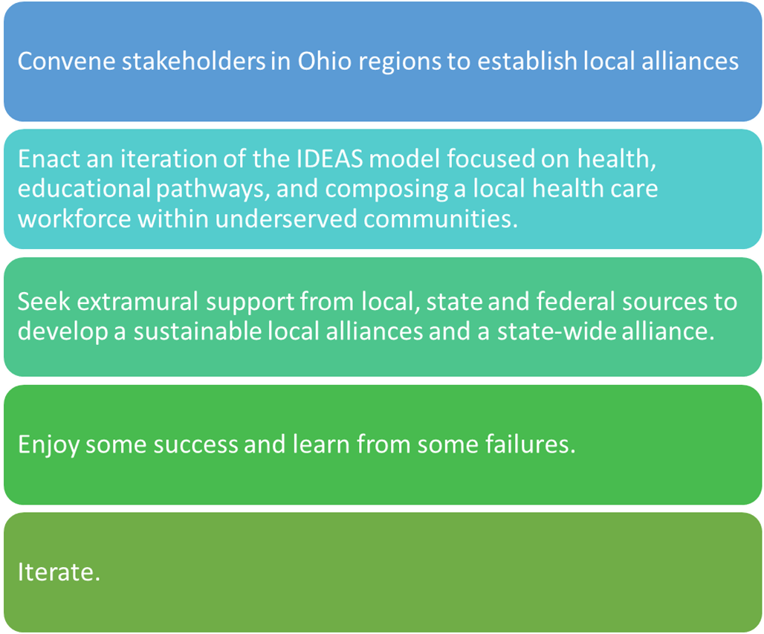
Notes:
Erik

Slide 20
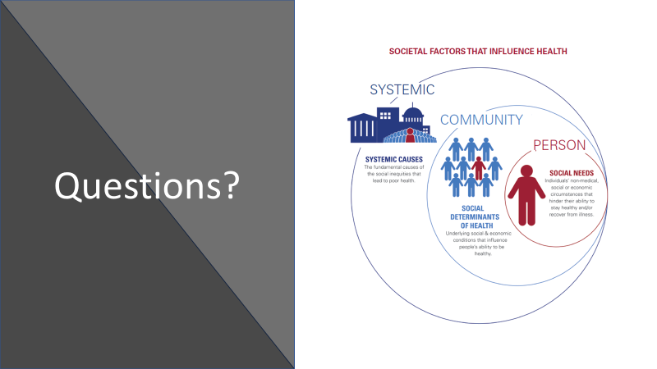
Notes:
Pat

