Slide 1
New Public Health Reporting Requirements
Ohio Rural Health Conference
August 1, 2022
Cathy Costello
Scott Mash
Cathy Rich

Slide 2
General Policy Changes: Statutes and Regulations Ohio Board of Pharmacy
ePrescribing of Controlled Substances
(EPCS)

Slide 3
EPCS for Part D Prescriptions: Federal Law
E-Prescribing of controlled substances for Part D prescriptions
Requires that 70% of a prescriber’s Part D controlled substances prescriptions to be prescribed electronically.
Compliance date proposed to be moved back to January 1, 2024.
If prescribing < 100 Part D controlled substance prescriptions per calendar year, prescriber is exempt.

Slide 4
EPCS Ohio Law: Broader in Scope
New law on ePrescribing of Controlled Substances (EPCS) in Ohio is effective September 23, 2022 (H.B. 193)
Law requires that EPCS be used for all prescriptions for Schedule II Controlled Substances unless there is a specific exception.
Exceptions include the following:
A temporary technical, electrical, or broadband failure.
Prescriptions for nursing home residents or hospice patients.
Prescriber is employed or under contract with organization that operates the pharmacy.
Prescriber determines that an electronic prescription cannot be issued in a timely manner and the patient’s medical condition is at risk.
Prescription is issued from a health care facility (including the ED), and the prescriber reasonably determines that an electronic prescription would be impractical for the patient or would cause delay that may adversely impact the patient’s medical condition.
Prescriber writes < 50 prescriptions for Schedule II/year.
Prescriber is a veterinarian.

Slide 5
Takeaway between Federal and Ohio Changes
Prescriber must use EPCS if he/she writes > 50 Schedule II prescriptions/year (Ohio).
For inpatient and ED patients, prescription can still be hand-written if prescriber determines it is impractical or would cause delay that would adversely impact the patient.
For hospice and nursing home residents, no requirement for EPCS.
If EPCS can’t be used in a timely manner and the patient medical condition would be at risk, then written prescription can be used.
If prescriber and pharmacy are under the same organization, then no requirement.

Slide 6
Drugs Covered by EPCS Schedule II
Examples of Schedule II narcotics: hydromorphone (Dilaudid®), methadone (Dolophine®), meperidine (Demerol®), oxycodone (OxyContin®, Percocet®), and fentanyl (Sublimaze®, Duragesic®).
Other Schedule II narcotics: morphine, opium, codeine, and hydrocodone.
Examples of Schedule II stimulants: amphetamine (Dexedrine®, Adderall®), methamphetamine (Desoxyn®), and methylphenidate (Ritalin®).
Other Schedule II substances: amobarbital, glutethimide, and pentobarbital.
For a complete list of Schedule II controlled substances, visit: https://codes.ohio.gov/ohio-administrative-code/rule-4729:9-1-02

Slide 7
Ohio Public Health and CDC Reporting
For 2022

Slide 8
Public Health Reporting – Current Definition of “Active Engagement”
Active Engagement was defined in the EHR Incentive Stage 3 rule (2016) as “when an eligible professional (now a MIPS eligible clinician) is in the process of moving towards sending “production data” to a public health agency or clinical data registry or is sending production data to a public health agency or clinical data registry.”
Currently, for CMS and federal reporting, 3 options to demonstrate Active Engagement:
Completed registration to submit data
Testing and validation
Production

Slide 9
Public Health Reporting – Active Engagement (Cont’d)
Issues with current 3 levels of engagement:
No incentive within the program to move through the levels of Active Engagement towards the goal of Production data submission.
A clinician’s “failure to submit EHI to public health authorities could be considered an interference under the information blocking regulations.”

Slide 10
Public Health Reporting : Proposed Change to “Active Engagement” for 2023
Beginning with 2023, CMS is proposing to consolidate the Active Engagement options and require progression towards active submission of data.
Proposed Active Engagement reporting options:
Pre-production and Validation: a combination of current option 1, completed registration to submit data, and current option 2, testing and validation
Validated Data Production: current option 3, production
May spend only one reporting period at the Pre-production and Validation level of active engagement per measure. Must progress to the Validated Data Production level for the next reporting period for the particular PH measure.
Also proposing that ECs/Groups report their level of active engagement during attestation.

Slide 11
Proposed Promoting Interoperability Scoring Methodology for Public Health
CMS has placed a higher importance on Public Health Reporting since COVID:
Would like to allocate more points to this measure as a means of incentivizing adoption.
The chart on the following page provides a summary of the scoring methodology changes.

Slide 12
2023 P.I. proposed scoring for mips providers
 | Objectives | Measures | Weight | Alternative Attestation
---- | Protect Electronic Health Information | Conduct a security risk analysis and implement mitigation plan during calendar year. Conduct self-assessment using the High Priorities SAFER Guide during the calendar year. | Required but Not scored | Required but Not scored
1 | eRx | e-Prescribing | 10 Points | 10 Points
 |  | Query of PDMP – query includes all permissible prescriptions and dispensing of Schedule II, III, or IV drugs | 10 Points | 10 Points
2 | Health Information Exchange | Support electronic referral loops by sending electronic information | 15 Points | Automatic 30 Points (Bilateral or TEFCA)
 |  | Support electronic referral loops by receiving and reconciling health information | 15 Points | Automatic 20 Points
3 | Provider to Patient Exchange | Provide patients electronic access to their health information Includes API access for apps in addition to patient portal | 25 Points | 25 Points
4 | Public Health & Clinical Data Registry Reporting | Must be actively engaged with or exclude from: Immunization, Electronic Case Reporting Registries | 25 Points | 25 Points
 |  | (OPTIONAL) Be actively engaged with a Public Health Registry, Clinical Data Registry, Syndromic Surveillance | 5 Points (Bonus) | 5 Points (Bonus)

Slide 13
Query of PDMP (OARRS Query)
Proposed Query of PDMP measure language:
For at least one Schedule II opioid or Schedule III or IV drug electronically prescribed using CEHRT during the performance period, the MIPS eligible
clinician uses data from CEHRT to conduct a query of a PDMP for prescription drug history
Exclusions:
Any MIPS eligible clinician who is unable to electronically prescribe Schedule II opioids and Schedule III and IV drugs in accordance with applicable law during the performance period.
Any MIPS eligible clinician who writes fewer than 100 permissible prescriptions during the performance period.

Slide 14
Electronic Case Reporting

Slide 15
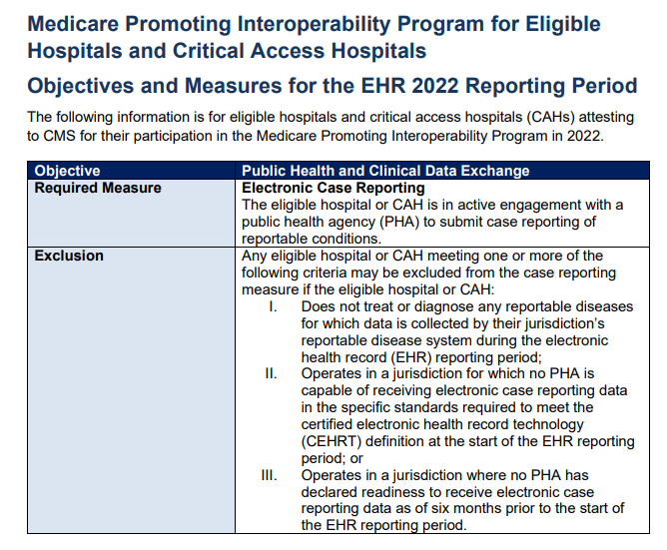
Important Information about Promoting Interoperability and Case Reporting in 2022 for Hospitals and MIPS
Note: Ohio Department of Health has shared that it is not ready to accept registration data from providers for 2022 electronic case reporting for eCR Now. It is appropriate to take an exclusion.

Slide 16
What Is Electronic Case Reporting? Extracted from the Final Hospital 2022 IPPS Rule CMS 1752-F
“Electronic case reporting is the automated, real-time, bi-directional exchange of case report information between EHRs and Public Health Agencies (PHAs).”
Electronic case reporting uses standard codes to trigger the transfer of relevant clinical data to PHAs for case investigation and follow-up.
As of March 2021, most states receive their case reporting through manual means (for example, fax, email, or phone), which results in delays, underreporting, and incomplete or inaccurate case data.
Electronic case reporting provides more timely and complete data than manual reporting, including data on demographics, comorbidities, immunizations, medications, occupation, and other treatments.
Final IPPS 2022 Rule CMS 1752-F, p. 1896

Slide 17
eCR Now: CDC’s Electronic Case Reporting System What is the eCR Now Reporting?
CDC and the Association of Public Health Laboratories created the FHIR API for COVID reporting:
Electronic case reports sent to a shared service platform managed by the Association of Public Health Laboratories (APHL (https://www.aphl.org/programs/informatics/pages/aims_platform.aspx). The platform is called the APHL Informatics Messaging Services (AIMS) platform.
Does not go directly to a Public Health Agency.
Information can be accessed by any public health agency that is connected to the eCR Now reporting system.
Also means that any health care provider that has implemented the specifications for eCR Now and connected to the APHL system also has a connection with every State PHA, many large local health departments, and some territories that are also connected.

Slide 18
eCR Now: CDC’s Electronic Case Reporting System What is the eCR Now Reporting?
Bi-directional process between CDC and the reporting provider:
Reporting by provider to CDC called “Electronic Initial Case Report” or “eICR”
CDC sends back a response to provider called a “Reportability Response” or “RR”

Slide 19
eCR Now: CDC’s Electronic Case Reporting System What are the eCR Now Reporting Triggers?
TRIGGER EVENTS FOR TRANSMISSION OF AN ELECTRONIC INITIAL CASE REPORT
Diagnosis (SNOMED, ICD-10 CM) | An eICR will be triggered when a diagnosis is recorded in the EHR that matches a value within the eRSD “Diagnosis Problem” value set. These codes could be held in problem list or diagnosis fields.
Lab Results (SNOMED) | An eICR will be triggered when a laboratory result is received by the EHR where the laboratory result matches a value within the eRSD “Organism Substance” value set.
Lab Result Test Name (LOINC) | An eICR will be triggered when a laboratory result is received by the EHR where the laboratory test name matches a value within the eRSD “Lab Observation Test Name” value set.
Lab Orders (LOINC) | An eICR will be triggered when a laboratory order is placed where the lab order matches a value within the eRSD “Lab Order Test Name” value set. Note: Because this trigger handles reporting on suspicion of a condition to meet related laws, this triggering should occur before lab results are available.
Medication (CVX, RXNORM, SNOMED) | An eICR can be triggered when a medication is administered or prescribed and matches a value within the eRSD “Medication” value set.

Slide 20
What must a provider be doing to meet the measure for 2022 Promoting Interoperability?
Providers have two options in 2022 to meet Public Health Reporting measure for Electronic Case Reporting
To be “actively engaged” provider must either be sending production data to eCR Now or be in the process of working towards connecting to send data (i.e., be registered through the Ohio Department of Health when its website opens and be technically ready to work with the vendor).
If attesting ‘Yes’ to meeting Electronic Case Reporting, provider must have registered by the 60th day of the reporting period (November 30, 2022) and be awaiting an invitation to begin testing and validation.

Slide 21
Registering with Ohio Department of Health for Electronic Case Reporting
Note: As of July 1, 2022, the Ohio Department of Health (ODH) is able to take registrations for Electronic Case Reporting. The link to registration is: https://odh.ohio.gov/know-our-programs/electronic-case-reporting/electronic-case-reporting

Slide 22
Newly Proposed Public Health Reporting Requirement for 2023 Antimicrobial Use and Resistance (AUR) Surveillance

Slide 23
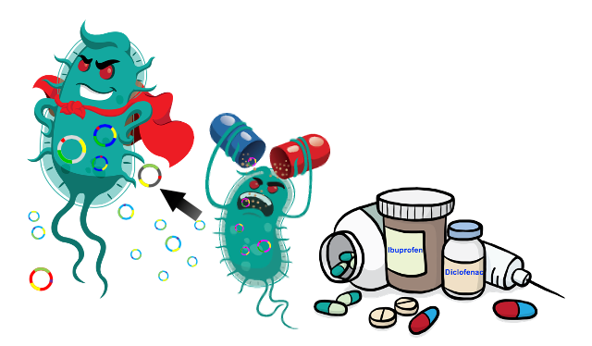
AUR Surveillance Overview
PROPOSED FOR 2023 REPORTING BY HOSPITALS AND PHYSICIANS FOR THE PROMOTING INTEROPERABILITY PROGRAM
CMS concerned with the misuse/overuse of antimicrobials that both facilitates the emergence of drug-resistant pathogens and exposes patients to needless risk for adverse effects.
Currently, hospitals & CAHs voluntarily report to CDC’s NHSN AUR Module with approximately 2,000 hospitals and 1,000 CAHs submitting data.
Why isn’t the voluntary reporting sufficient?
“Incomplete participation in NHSN’s AUR surveillance limits the generalizability of the AUR data: The data is subject to selection bias and do not provide a comprehensive national picture.”
“The benefits of monitoring AUR data for patient care and public health are most likely to be achieved when data collection and analysis are systematic, standardized, and achieve complete coverage across eligible facilities.”

Slide 24
Proposed Measure & Exclusions
New PH Measure - The eligible hospital or CAH is in active engagement with CDC’s National Healthcare Safety Network (NHSN) to submit antimicrobial use and resistance (AUR) data for the EHR reporting period and receives a report from NHSN indicating their successful submission of AUR data for the EHR reporting period.
3 Proposed Exclusions:
Does not have any patients in any patient care location for which data are collected by NHSN during the EHR reporting period.
Does not have electronic medication administration records (eMAR)/barcoded medication administration (BCMA) records or an electronic admission discharge transfer (ADT) system during the EHR reporting period
Does not have an electronic laboratory information system (LIS) or electronic ADT system during the EHR reporting period.

Slide 25
What Triggers the AUR Module?
3 criteria must be met to trigger the EHR to submit AR data
One of the four specimen types is collected:
Blood
Cerebral spinal fluid
Urine
Lower respiratory
One of the organisms on the following slide identified
Antimicrobial susceptibility testing has been completed

Slide 26
Organisms that Trigger AR Data Submission
All Acinetobacter species
Candida albicans; auris; glabrata; parapsilosis; tropicalis
Citrobacter amalonaticus; freundii; koseri
All Enterobacter species
All Enterococcus species
Escherichia coli
Klebsiella aerogenes; oxytoca; pneumoniae
Morganella morganii
Proteus mirabilis; penneri; vulgaris
Pseudomonas aeruginosa
Serratia marcescens
Staphylococcus aureus
Stenotrophomonas maltophilia
Streptococcus agalactiae (Group B Streptococcus)
Streptococcus pneumoniae

Slide 27
What Data Gets Submitted to the AUR Module?
2 files types submitted to the AR module
Event Files - Contains all information associated with an individual AR event. Reported from all inpatient locations & three specific outpatient locations (ED, pediatric ED & 24-hour observation areas)
Summary Files – Contains only summary level data

Slide 28
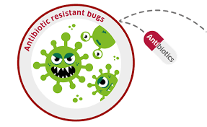
AUR Surveillance Technology Requirements
This proposed Public Health Reporting Registry will use technology certified to the criterion at 45 CFR 170.315(f)(6), “Transmission to public health agencies – antimicrobial use and resistance reporting.”
45 CFR 170.315(f)(6) requires the creation antimicrobial use and resistance reporting information for electronic transmission in accordance with the standard specified in § 170.205(r)(1).
170.205(r)(1) Public health - antimicrobial use and resistance information
(1) Standard. The following sections of HL7 Implementation Guide for CDA® Release 2 - Level 3: Healthcare Associated Infection Reports, Release 1, U.S. Realm (incorporated by reference in § 170.299).

Slide 29
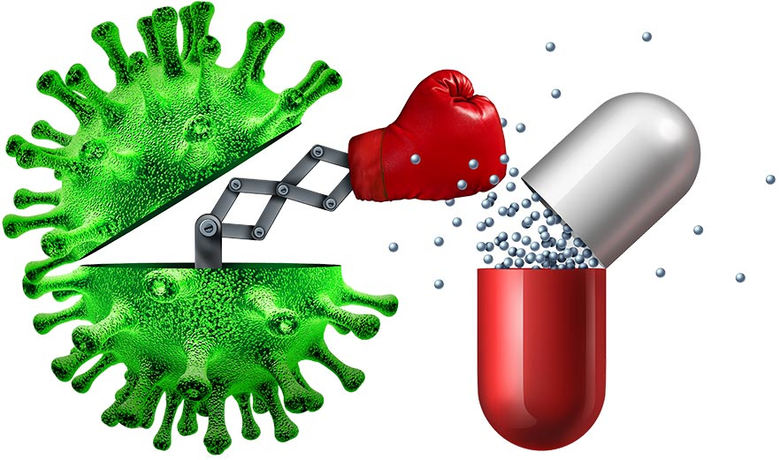
Current AUR Surveillance Availability in EHRs
The antimicrobial use and resistance reporting CEHRT functionality is already available in the following vendors’ products:
Allscripts (Sunrise)
Cerner (PowerChart & Soarian)
Epic
MD Charts (Physician’s Solutions)
Meditech (Magic & Expanse)
Rhapsody Interface Engine
A few other small EHRs

Slide 30
How to get started with NHSN AUR Surveillance
The CDC NHSN has a great website and documentation!
Website - https://www.cdc.gov/nhsn/psc/aur/index.html
Implementation guide documentation
Promoting Interoperability Program Guidance

Slide 31
How to get started with NHSN AUR Surveillance
Prerequisites for Antimicrobial Use and Resistance Surveillance
Must have required systems:
eMAR or BCMA for capturing antimicrobial medication administration
LIS for capturing antimicrobial related results
ADT system for capturing patient movements within the hospital
Must have CEHRT technology certified for AUR Surveillance
Must complete registration with CDC to submit with NHSN:
Enroll in NHSN
Map all NHSN location
Request and enter an NHSN Facility OID
Complete AUR Module training and enter monthly reporting plans within NHSN

Slide 32
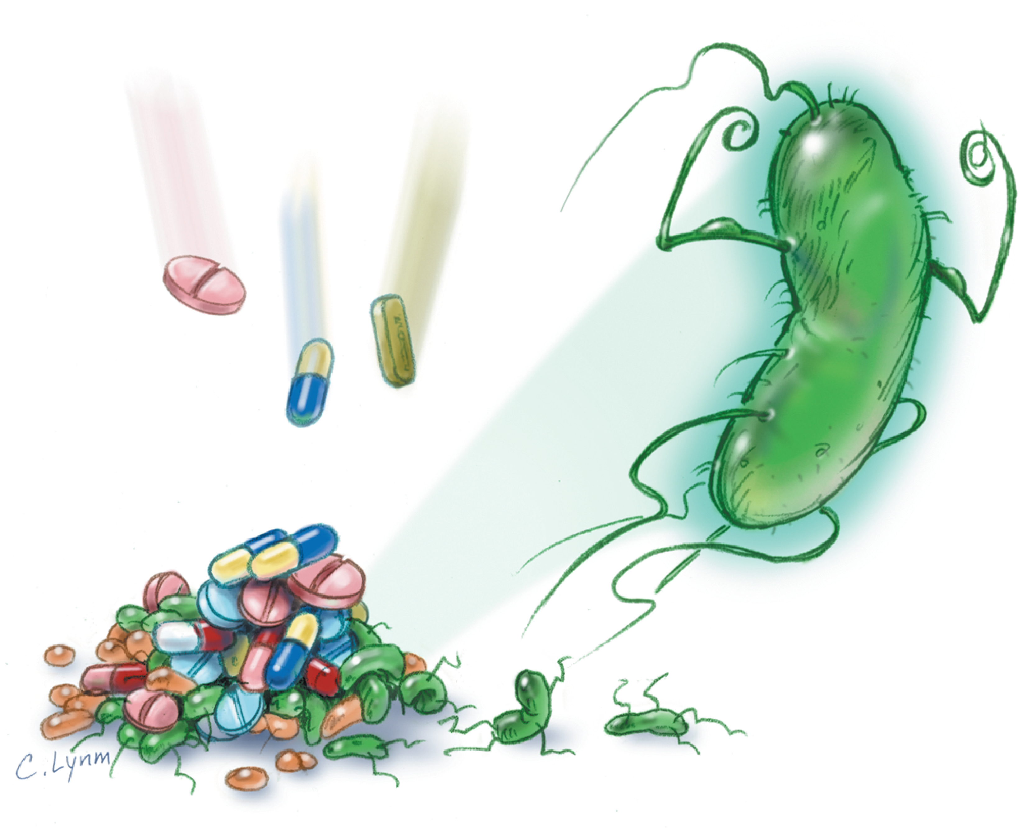
AUR Module Testing and Validation Steps
Do not proceed with Testing and Validation before completing the steps below:
Completed registration with NHSN
Received an email invitation from the CDC to proceed
Three test files, generated from your EHR’s AUR reporting module, will be emailed to the NHSN CDA Help Desk. Files must conform to the specifications outlined in the invitation letter.
Antimicrobial Use Summary CDA
Antimicrobial Resistance – Numerator CDA
Antimicrobial Resistance – Denominator CDA
When all CDAs pass validation, the hospital will receive an email indicating successful validation. AU & AR data can now be uploaded to the NHSN AUR module.
Save this email in your Book of Evidence!

Slide 33
Submission of Production AUR Data
Upon completion of testing & validation, the hospital will receive an invitation to proceed with uploading data to the production AUR module.
Hospital must then enter appropriate information regarding reporting plans within this section of the AUR module.
On the 1st day of every month, designated NHSN Facility Administrator and Optional Facility Contact will receive an email containing a monthly submission summary
On Feb 1 of each year, the hospital will receive an annual report summarizing the submission of AUR & AR data which should be saved in your Book of Evidence.

Slide 34
CliniSync: Where the Data Originates

Slide 35
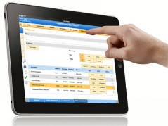
CliniSync: Connecting Across Ohio
18M Unique patient records in CliniSync HIE
156 Participating hospitals (Ohio, West Virginia & Kentucky) and
15,000 Independent and hospital-employed physicians
>500 LTC and Post-Acute Care 67 Home Health 31 Hospice
13 Health plans including 5 Medicaid Managed Care Plans
80+ Connected EHR vendors
18

Slide 36
What Data Is Contributed by CliniSync’s Providers?
Information that appears in the Community Health Record will depend on what is contributed by a given organization or type of practice.
Normally, hospitals contribute the following:
Admission and discharge notifications
CCD summary of care documents (includes at a minimum diagnoses, allergies, meds, demographic data) and:
Lab results
Imaging studies reports
Progress notes
Nursing notes
Care treatment plans
Discharge information
Provider practices contribute CCD summary of care documents created at the time of an encounter.
LTPAC sites contribute a summary of care document at the time a patient is transferred to a hospital or another facility or are discharged from the LTPAC site.

Slide 37
Connecting to National Networks
Connecting via CliniSync: Applicable to any CliniSync participant
Client queries CliniSync Community Health Record (CHR) for patient information.
CliniSync Participant
Provider
CliniSync sends query to eHealth Exchange Hub and CareQuality.
Data presents back to the client in two forms within the CHR:
Patient data from Ohio CliniSync network is pulled into the Consolidated CCD.
All data found on patient from eHealthExchange Hub participants and CareQuality members (in or outside of Ohio) will come back as separate documents within the CHR.

Slide 38
Using the e-Health Exchange Hub to retrieve data through Clinisync
eHx
Hub
CliniSync
Care Quality
Other HIEs or Connected Networks
Federal Partners
eHealth Exchange (eHx) was originally established to allow for exchange of clinical information between federal and private sector organizations.
Widest use now by federal agencies is to exchange clinical information on VA or Department of Defense patients.
CliniSync can access data from numerous 3rd parties as long as their EHR system is connected to one of the national networks and they are contributing data.
CareQuality Implementers
(e.g., CommonWell)

Slide 39
Contact us
Scott Mash, MSLIT, CPHIMS, FHIMSS
smash@ohiponline.org
(614) 541-2296
Cathy Costello, JD, CPHIMS
ccostello@ohiponline.org
(614) 664-2607
Cathy Rich
crich@ohiponline.org
(614) 664-2606
Visit or website for more information www.clinisync.org

