Slide 1
Empathy: Your Service Superpower
John D. Hanson
Pres., Accelerated Revenue, Inc. & Dir. of Bus. Dev., AR Billing Services

Slide 2
Which is NOT true about John?
Half-Canadian
Never broken a bone
Baptist preacher
Visited Crossed Swords-Baghdad, Iraq
39 years old
2 exciting giveaways!
Signed copy of John’s book
Accelerated Revenue workshop for your entire team

Slide 3
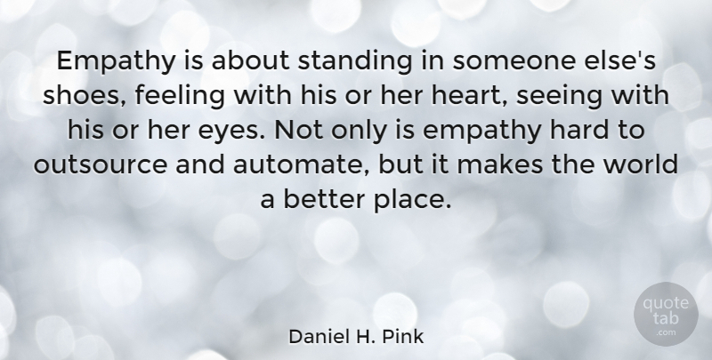
Empathy—What It Is
Empathy
Fairly-new word, about 100 years old
German, “Einfuhlung”
Literally, “In-Feeling”
Emotional Intelligence…towards others

Slide 4
The 4 Types of Empathetic Leaders
Which One Are You?
Quick Empathy Test
Born This Way
Learned Skill
Unaware
Against the Grain

Slide 5
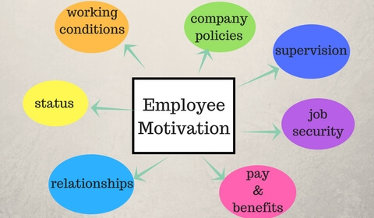

Slide 6
Your Mission:
Discover these in your team members’ lives

Slide 7
Acknowledge & Ask
Deflect strong emotions
Identify with how they feel
Acknowledge frustration
Provide Assurance
Ask well-worded, open-ended questions
Uncover root cause
Solve when possible
Elevate when needed
Warm transfer ALWAYS!

Slide 8
Know, Like, Trust
Trust Fall
Under Promise, Over Deliver
Sales Success

Slide 9
Mayo Clinic Study:
Stimulation
Stress Relief
Soothe Tension
Strengthen Immunity
Pain Relief
Satisfaction
Mood
Humor—It’s Good for You!

Slide 10
What CAN we do?
Educate
Empower
Entrust

Slide 11
5-Star Self-Pay Early Out Solutions
Strong Partnerships…….Brilliant Solutions
arbilling.com
Elevating Business to Heroic Success
Cost Savings + Culture + Cash Flow = Success
accrev.com

Slide 12
Which is NOT true about John?
Half-Canadian
Never broken a bone
Baptist preacher
Visited Crossed Swords-Baghdad, Iraq
39 years old
And the Workshop Drawing Winner is:

Slide 13
References
https://www.mayoclinic.org/healthy-lifestyle/stress-management/in-depth/stress-relief/art-20044456

